Slide 1
Timon Jongkind
Practor Smart Industries
3rd of September 2024

Slide 2
Content
Da Vinci College
Role of a Practor
Practoraat Smart Industries
Artificial Intelligence examples

Slide 3

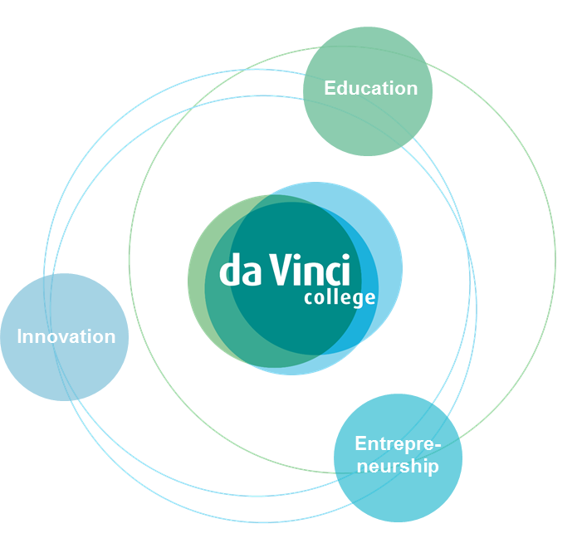
Da Vinci: Hybrid Learning Model
Professional practice forms the basis
Better alignment between education and the labor market
Innovations directly embedded in education
Flow from vocational education (MBO) to higher education (HBO) and the business sector

Slide 4



Vocational education in The Netherlands
SECONDARY VOCATIONAL EDUCATION
AGE 16+ (6 MONTHS – 4 YEARS)
School-based and work-based learning routes
Level 1: Assistant training
Level 2: Basic vocational training
Level 3: Full professional training
Level 4: Middle management and specialist training
Adult Education
Courses on a contract basis
HIGHER VOCATIONAL EDUCATION
(applied sciences)
Bachelor, post bachelor and Associate degree programs
From level 4
PRE-
VOCATIONAL
EDUCATION
AGE 12-16
Continous learning tracks – life long learning

Slide 5
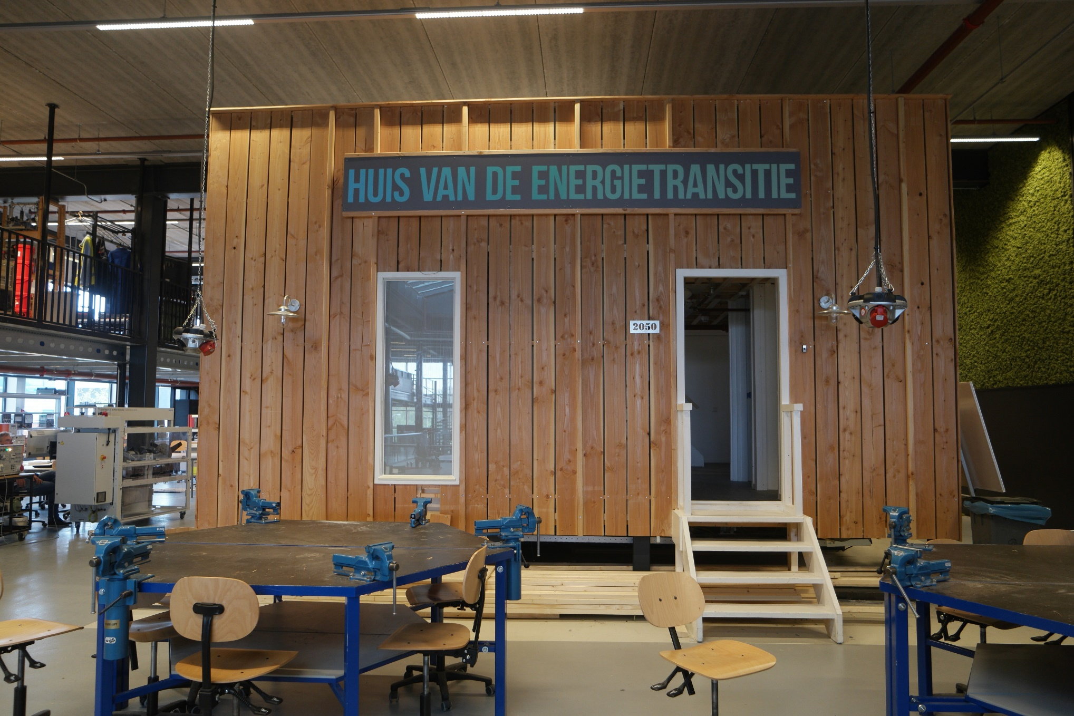
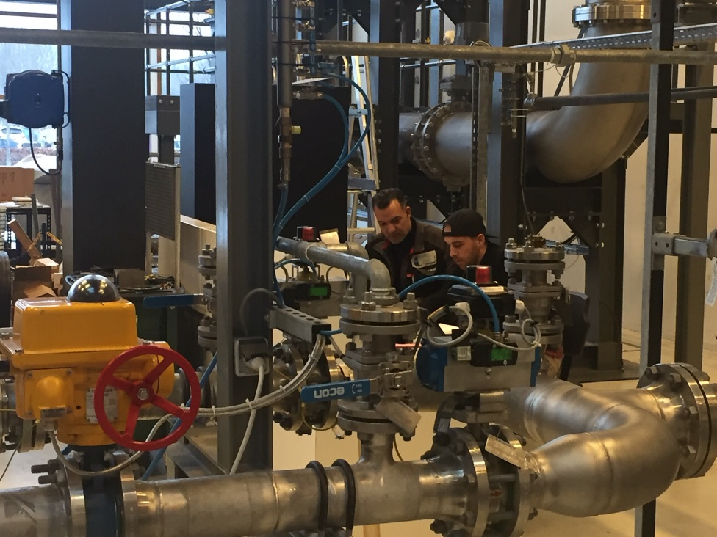
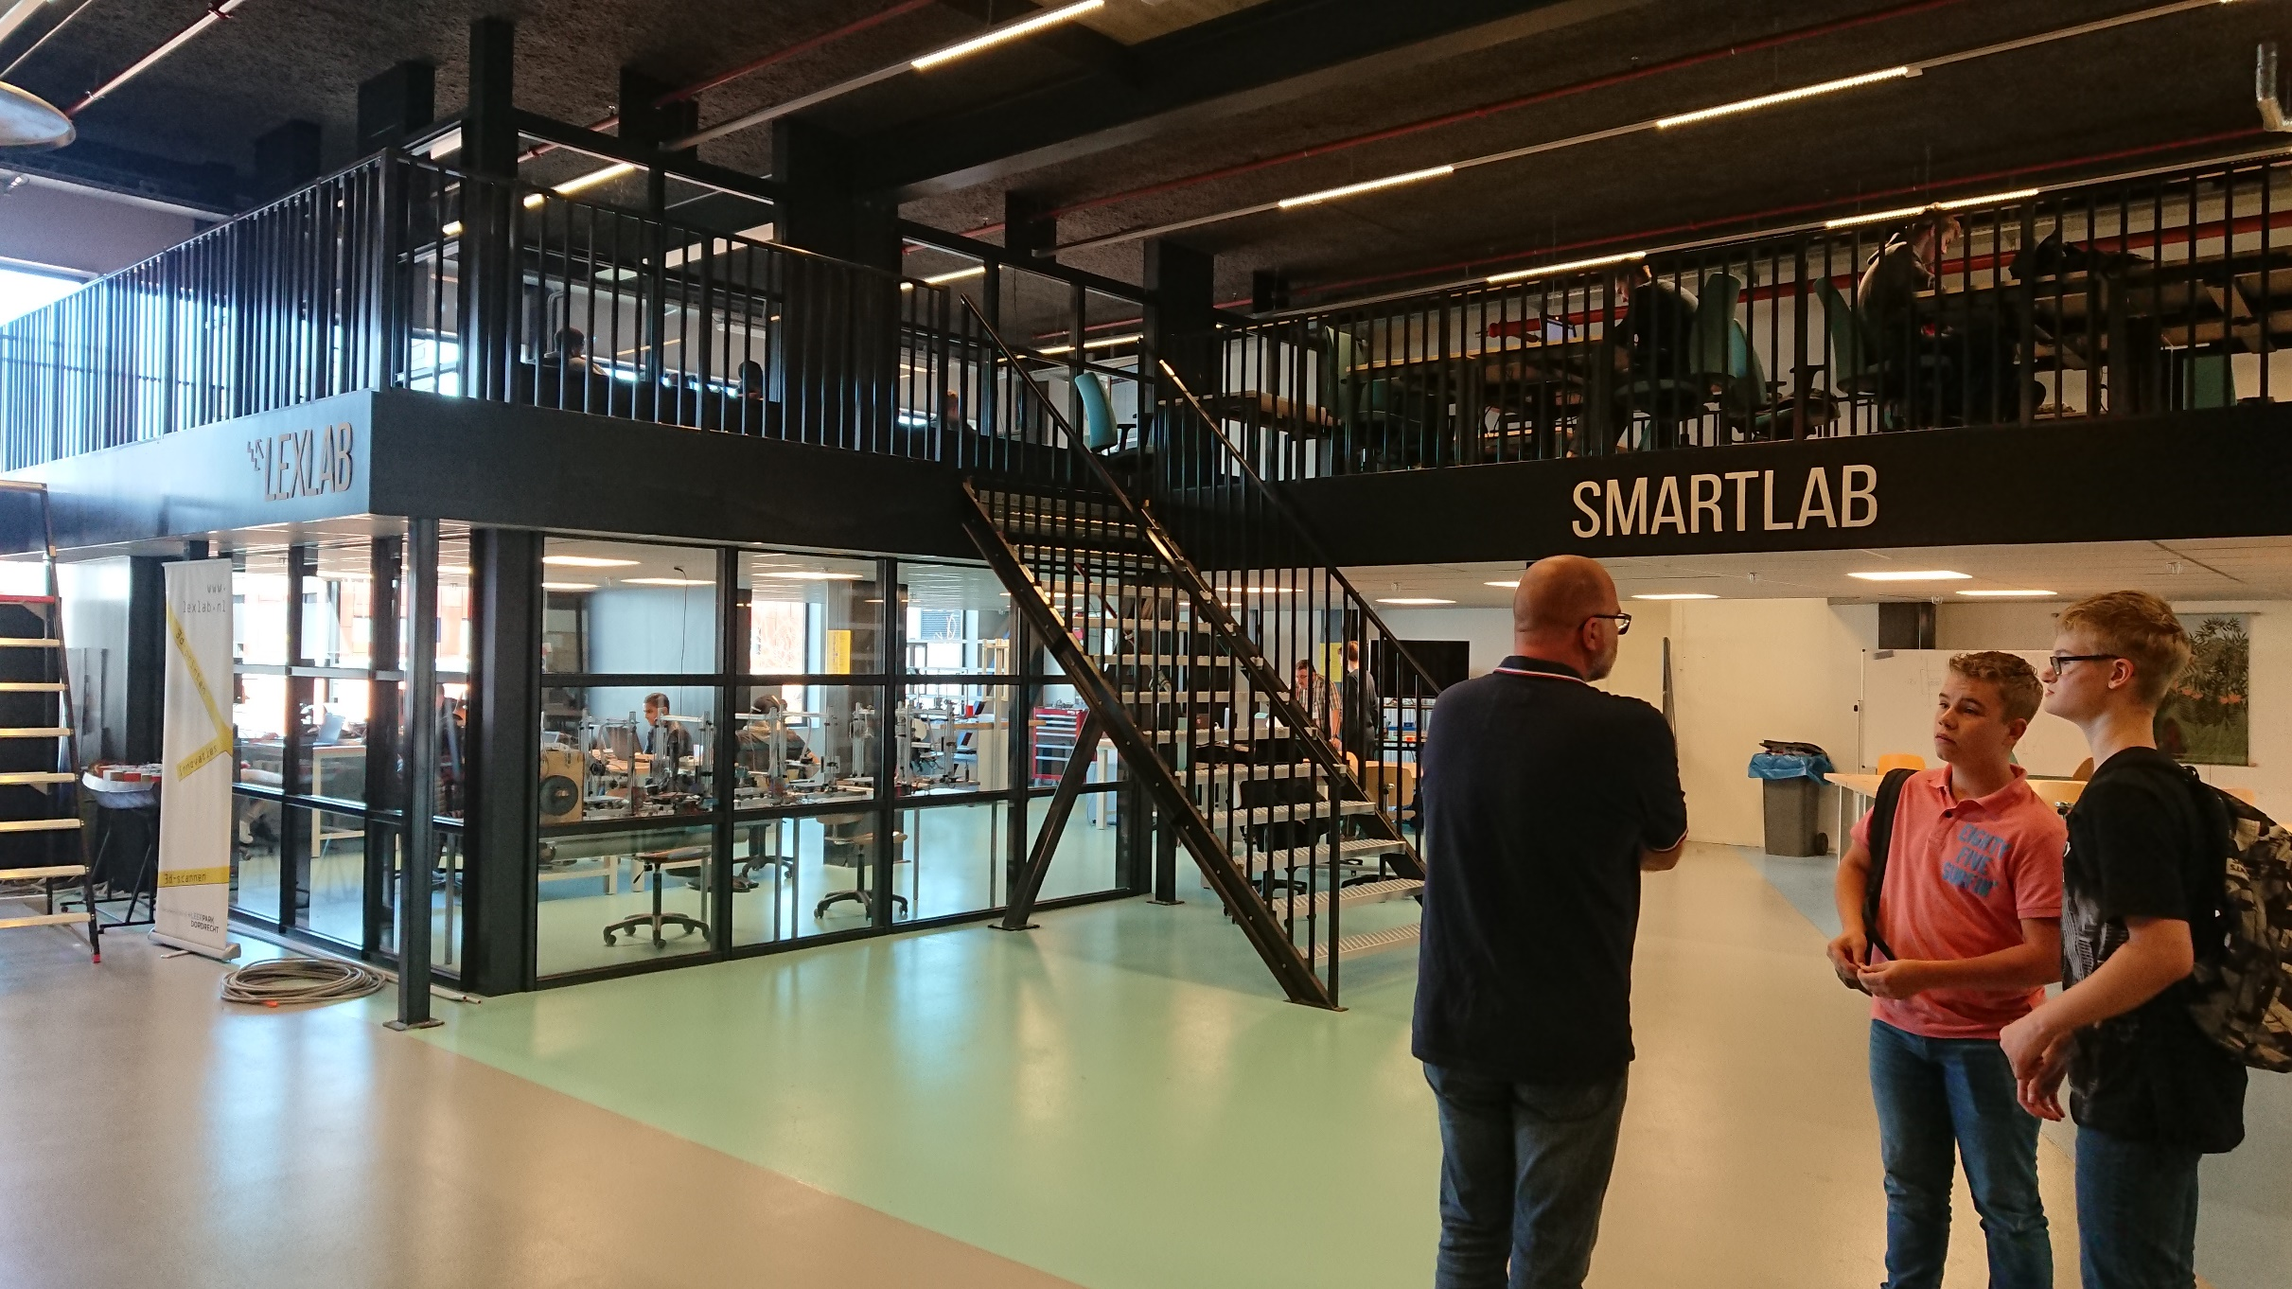
TECHNOLOGY ORIENTED WORKSPACES
EXCHANGING KNOWLEDGE
SHARING FACILITIES
MECHATRONICS
ENERGY TRANSITION
SMART TECHNOLOGY
INSTRUMENTATION AND CONTROL ENGINEERING
WELDING AND MILLING
AUTOMOTIVE
…
STIMULATING CROSS-OVERS
AND PRO-ACTIVE LEARNING

Slide 6
What is a Practoraat (Theory)
What
An expertise platform for practice-based research and professionalization of teachers.
Why
With the goal of spreading knowledge and innovation, and training for innovative craftsmanship.
How
By conducting practice-oriented research together with teachers, students, and the business community.

Slide 7

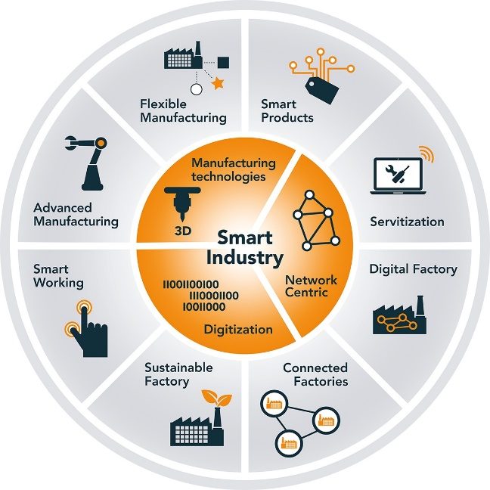
Practoraat Smart Industries
Innovation platform with focus on:
Smart Monitoring
Smart Manufacturing
OT Cyber Security
Artificial intelligence
Researching and developing:
Understandig the changes in professions
Different knowledge and skills
Development of education

Slide 8
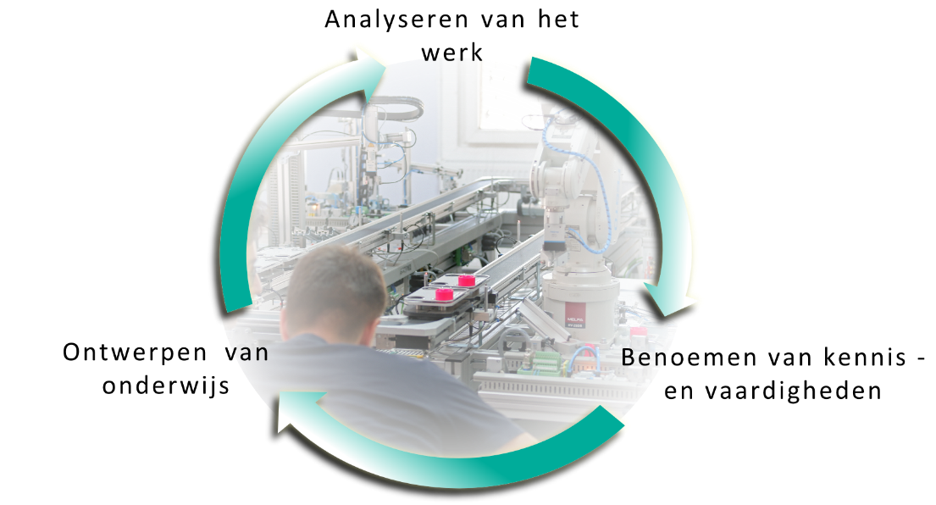
Activities
Changes in professions:
Field analysis
Experimenting with new techniques
Translating into knowledge and skills through:
Workplace and skills gap analyses
Describing professional profiles
Embedding in education through:
Curriculum for students/employees
Guest lectures / Practical assignments / Learning materials
Training for teachers

Slide 9
AI in Technical professions
Predictive Maintenance
Quality Control
Robotic Process Automation (RPA)
Smart Design and Prototyping
Enhanced Cybersecurity

Slide 10
AI Chatbot for teachers
Personalized Student Support
Interactive Learning
Professional Development

