Slide 1


INTERNATIONAL EDUCATIONAL FORUM
September 2-3, 2024
EDUCATION THROUGH
THE PARADIGM OF HUMANISM
AND ARTIFICIAL INTELLIGENCE
Organized by Municipality Varna, Bulgaria
edfor.varna.bg
www.varna.bg
SYNERGY AND ORCHESTRATION
SCIENCE, BUSINESS AND EDUCATION
Assoc. Prof. Galina Momcheva, PhD
Institute of Mathematics and Informatics
Bulgarian Academy of Sciences
2024

Slide 2


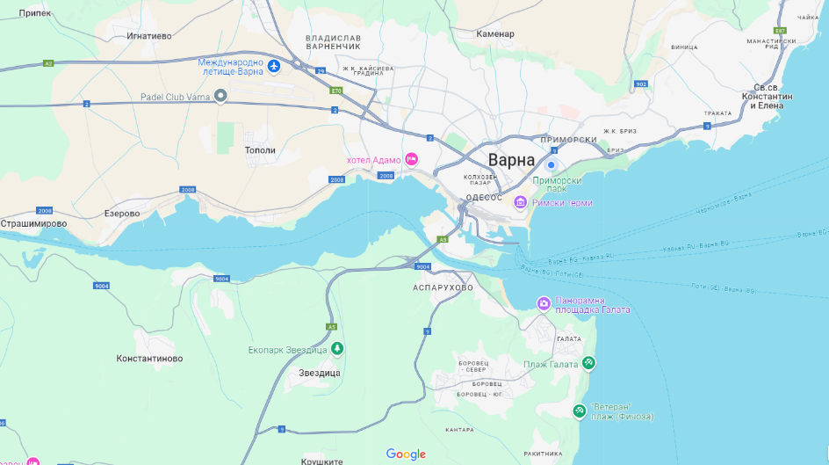
INTERNATIONAL EDUCATIONAL FORUM
EDUCATION THROUGH THE PARADIGM OF HUMANISM AND ARTIFICIAL INTELLIGENCE
SYNERGY AND ORCHESTRATION
SCIENCE, BUSINESS AND EDUCATION

Slide 3

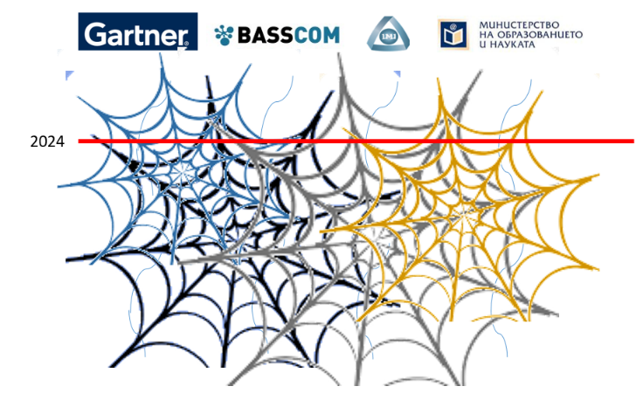
INTERNATIONAL EDUCATIONAL FORUM
EDUCATION THROUGH THE PARADIGM OF HUMANISM AND ARTIFICIAL INTELLIGENCE
SYNERGY AND ORCHESTRATION
SCIENCE, BUSINESS AND EDUCATION

Slide 4

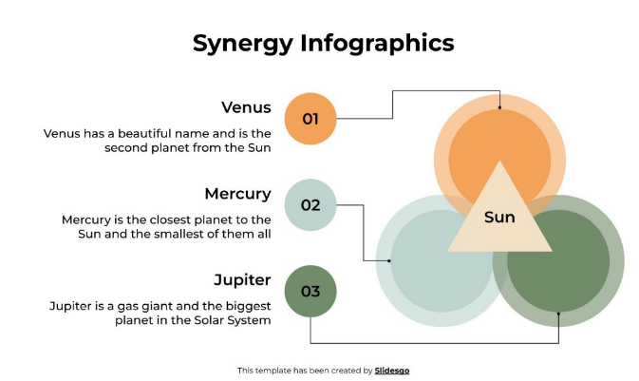
INTERNATIONAL EDUCATIONAL FORUM
EDUCATION THROUGH THE PARADIGM OF HUMANISM AND ARTIFICIAL INTELLIGENCE
SYNERGY AND ORCHESTRATION - SCIENCE, BUSINESS AND EDUCATION
SYNERGY INFOGRAPHICS
https://slidesgo.com/theme/synergy-infographics

Slide 5

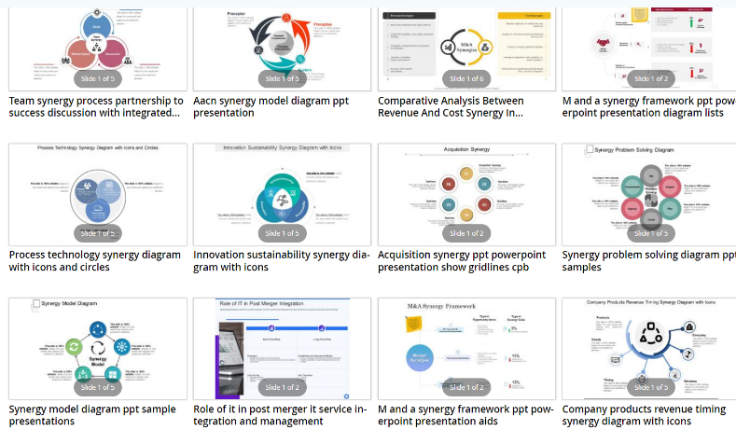
INTERNATIONAL EDUCATIONAL FORUM
EDUCATION THROUGH THE PARADIGM OF HUMANISM AND ARTIFICIAL INTELLIGENCE
SYNERGY AND ORCHESTRATION - SCIENCE, BUSINESS AND EDUCATION
SYNERGY DIAGRAMS
https://www.slideteam.net/powerpoint/Synergy-Diagram

Slide 6
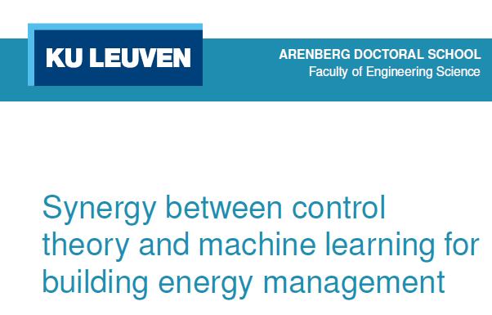
INTERNATIONAL EDUCATIONAL FORUM
EDUCATION THROUGH THE PARADIGM OF HUMANISM AND ARTIFICIAL INTELLIGENCE
SYNERGY AND ORCHESTRATION - SCIENCE, BUSINESS AND EDUCATION
SYNERGY IN PRACTICE
https://iglc.net/Papers/Details/1957

Slide 7
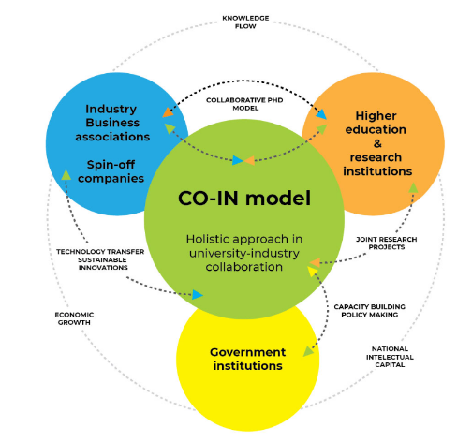
INTERNATIONAL EDUCATIONAL FORUM
EDUCATION THROUGH THE PARADIGM OF HUMANISM AND ARTIFICIAL INTELLIGENCE
SYNERGY AND ORCHESTRATION - SCIENCE, BUSINESS AND EDUCATION
SYNERGY IN PRACTICE
https://iege.edu.mk/iece/co-in/

Slide 8

INTERNATIONAL EDUCATIONAL FORUM
EDUCATION THROUGH THE PARADIGM OF HUMANISM AND ARTIFICIAL INTELLIGENCE
SYNERGY AND ORCHESTRATION - SCIENCE, BUSINESS AND EDUCATION
SYNERGY IN RESEARCH
Cortina-Borja, M., Smith, A.D., Combarros, O. et al. The synergy factor: a statistic to measure interactions in complex diseases. BMC Res Notes 2, 105 (2009). https://doi.org/10.1186/1756-0500-2-105

Slide 9
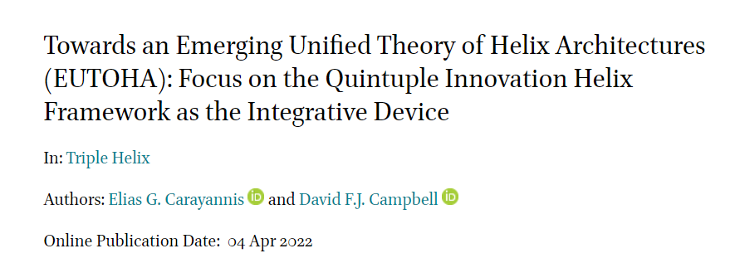

INTERNATIONAL EDUCATIONAL FORUM
EDUCATION THROUGH THE PARADIGM OF HUMANISM AND ARTIFICIAL INTELLIGENCE
SYNERGY AND ORCHESTRATION - SCIENCE, BUSINESS AND EDUCATION
SYNERGY IN RESEARCH
https://wsb.edu.pl/en/research/q-helix-initiative/about-q-helix-initiative
https://brill.com/view/journals/thj/9/1/article-p65_6.xml?language=en

Slide 10

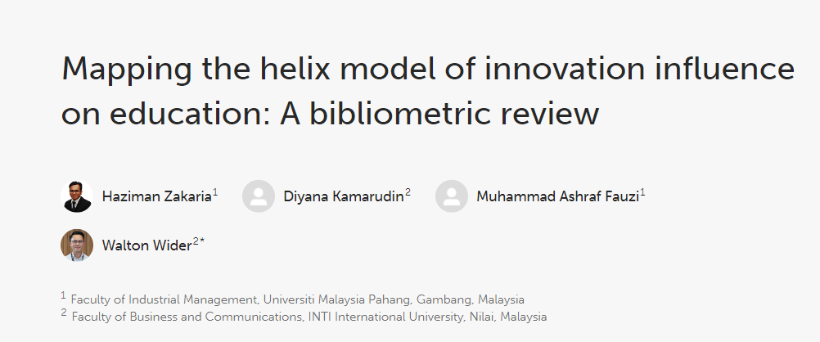
INTERNATIONAL EDUCATIONAL FORUM
EDUCATION THROUGH THE PARADIGM OF HUMANISM AND ARTIFICIAL INTELLIGENCE
SYNERGY AND ORCHESTRATION - SCIENCE, BUSINESS AND EDUCATION
SYNERGY IN RESEARCH
Zakaria H, Kamarudin D, Fauzi MA and Wider W (2023) Mapping the helix model of innovation influence on education: A bibliometric review. Front. Educ. 8:1142502. doi: 10.3389/feduc.2023.1142502

Slide 11
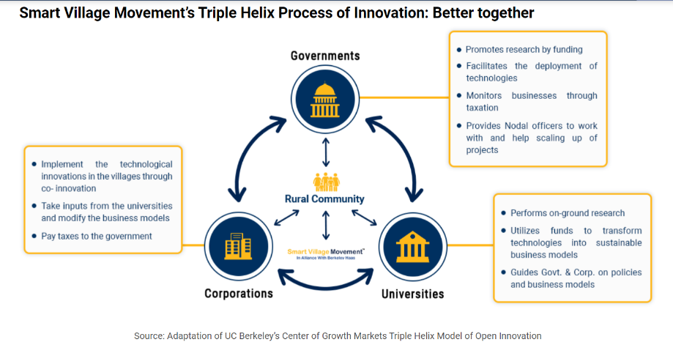
INTERNATIONAL EDUCATIONAL FORUM
EDUCATION THROUGH THE PARADIGM OF HUMANISM AND ARTIFICIAL INTELLIGENCE
SYNERGY AND ORCHESTRATION - SCIENCE, BUSINESS AND EDUCATION
TRIPLE HELIX MODEL
https://www.smartvillagemovement.org/svm-model/

Slide 12
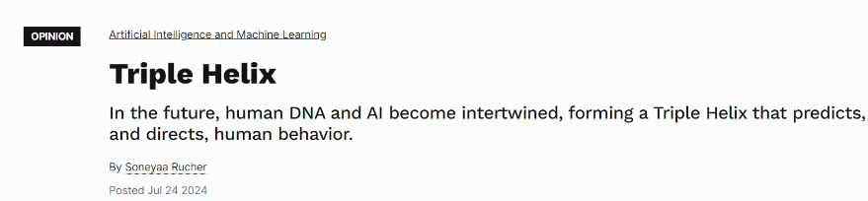


INTERNATIONAL EDUCATIONAL FORUM
EDUCATION THROUGH THE PARADIGM OF HUMANISM AND ARTIFICIAL INTELLIGENCE
SYNERGY AND ORCHESTRATION - SCIENCE, BUSINESS AND EDUCATION
TRIPLE HELIX (DNA + AI)
https://cacm.acm.org/opinion/triple-helix/
July 24, 2024

Slide 13
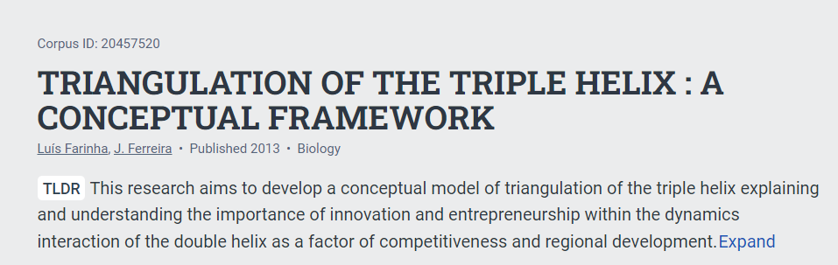
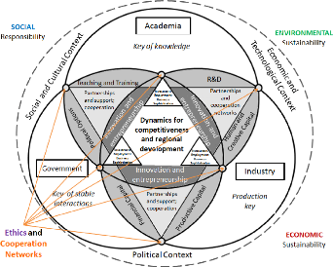
INTERNATIONAL EDUCATIONAL FORUM
EDUCATION THROUGH THE PARADIGM OF HUMANISM AND ARTIFICIAL INTELLIGENCE
SYNERGY AND ORCHESTRATION - SCIENCE, BUSINESS AND EDUCATION
TRIPLE HELIX MODEL
Farinha, L., & Ferreira, J.J. (2013). TRIANGULATION OF THE TRIPLE HELIX : A CONCEPTUAL FRAMEWORK.

Slide 14
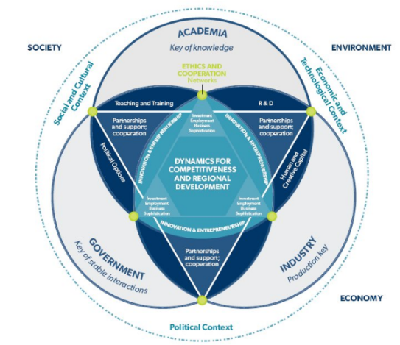
INTERNATIONAL EDUCATIONAL FORUM
EDUCATION THROUGH THE PARADIGM OF HUMANISM AND ARTIFICIAL INTELLIGENCE
SYNERGY AND ORCHESTRATION - SCIENCE, BUSINESS AND EDUCATION
TRIPLE HELIX MODEL
https://triple-helix.uff.br/about-triple-helix/

Slide 15
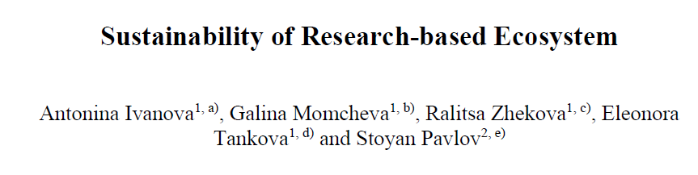
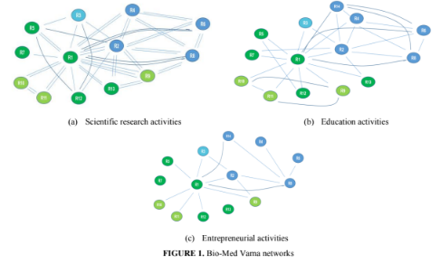
INTERNATIONAL EDUCATIONAL FORUM
EDUCATION THROUGH THE PARADIGM OF HUMANISM AND ARTIFICIAL INTELLIGENCE
SYNERGY AND ORCHESTRATION - SCIENCE, BUSINESS AND EDUCATION
ECOSYSTEM RESEARCH
SNA-BASED METHODOLOGY OF RESEARCH - > NETWORK ANALYSIS

Slide 16

INTERNATIONAL EDUCATIONAL FORUM
EDUCATION THROUGH THE PARADIGM OF HUMANISM AND ARTIFICIAL INTELLIGENCE
SYNERGY AND ORCHESTRATION - SCIENCE, BUSINESS AND EDUCATION
KPI for SUSTAINABLE STEAM ENVIRONMENT

Slide 17

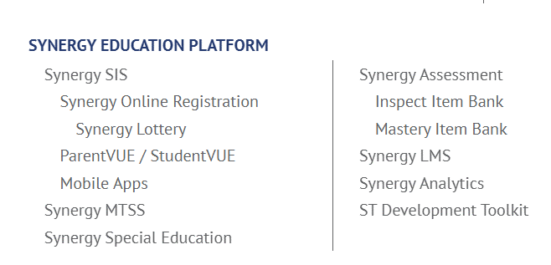
INTERNATIONAL EDUCATIONAL FORUM
EDUCATION THROUGH THE PARADIGM OF HUMANISM AND ARTIFICIAL INTELLIGENCE
SYNERGY AND ORCHESTRATION - SCIENCE, BUSINESS AND EDUCATION
PLATFORMS for EDUCATION
Synergy® Analytics is a comprehensive K-12 analytics solution for improving student performance and district administration, providing real-time actionable insights that promote data-based decision-making.
Turn your data into visual dashboards that are easy to understand and interpret for every user.
https://edupoint.com

Slide 18
INTERNATIONAL EDUCATIONAL FORUM
EDUCATION THROUGH THE PARADIGM OF HUMANISM AND ARTIFICIAL INTELLIGENCE
SYNERGY AND ORCHESTRATION - SCIENCE, BUSINESS AND EDUCATION
ORCHESTRATION
Orchestration is the coordinated execution of multiple IT automation tasks or processes. Orchestration is usually applied across multiple computer systems, applications, and services to ensure that deployment, configuration management, and other processes are performed in the proper sequence.
Automation and orchestration are distinct, but related concepts. Automation is the use of software to perform tasks without human intervention, to minimize errors and reduce the time spent manually performing the operations needed to deploy, manage, and scale IT applications and infrastructure.
Orchestration coordinates automated tasks across multiple systems into higher-order workflows, so that individual tasks can work together to serve a specific function or process.
https://www.redhat.com/en/topics/automation/what-is-orchestration

Slide 19
INTERNATIONAL EDUCATIONAL FORUM
EDUCATION THROUGH THE PARADIGM OF HUMANISM AND ARTIFICIAL INTELLIGENCE
SYNERGY AND ORCHESTRATION - SCIENCE, BUSINESS AND EDUCATION
DATA ORCHESTRATION
Data orchestration is an automated process that combines and organizes siloed data from various data storage locations, making it available for analysis.
The process of data orchestration involves three key steps:
1. Organizing Data: Aggregating data from diverse sources like social media, CRM systems, and behavioral data.
2. Transforming Data: Converting data into a standardized format suitable for analysis.
3. Data Activation: Making data readily available for analysis tools to extract actionable insights
https://rivery.io/data-learning-center/data-orchestration-complete-guide/

Slide 20



INTERNATIONAL EDUCATIONAL FORUM
EDUCATION THROUGH THE PARADIGM OF HUMANISM AND ARTIFICIAL INTELLIGENCE
SYNERGY AND ORCHESTRATION - SCIENCE, BUSINESS AND EDUCATION
EVENTS AS PLATFORMS for SYNERGY
SOFTIS SUMMER CAMP PRESENTATIONS from 28 SPEAKERS (upcoming video)
https://drive.google.com/drive/folders/1TNFXExVgbyAMreeyXv5O0r-yMnHdd7z9?usp=sharing

Slide 21


INTERNATIONAL EDUCATIONAL FORUM
EDUCATION THROUGH THE PARADIGM OF HUMANISM AND ARTIFICIAL INTELLIGENCE
SYNERGY AND ORCHESTRATION - SCIENCE, BUSINESS AND EDUCATION
EVENTS AS OPORTUNITIES for SYNERGY
REGISTRATION
https://docs.google.com/forms/d/e/1FAIpQLSeMdOSkcRnVUWvVgunI7eb57Li2fq2Tq4oqn--ScSqpRlkQBA/viewform

Slide 22
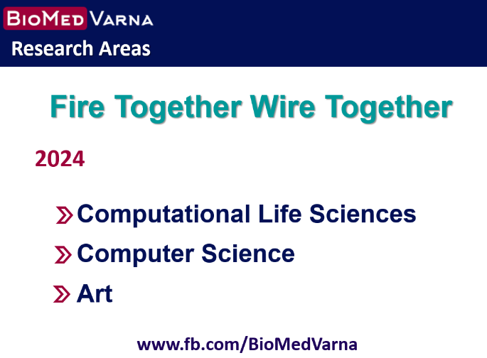
INTERNATIONAL EDUCATIONAL FORUM
EDUCATION THROUGH THE PARADIGM OF HUMANISM AND ARTIFICIAL INTELLIGENCE
SYNERGY AND ORCHESTRATION - SCIENCE, BUSINESS AND EDUCATION
TALENTS IN RESEARCH & SYNERGY IN RESEARCH

Slide 23

INTERNATIONAL EDUCATIONAL FORUM
EDUCATION THROUGH THE PARADIGM OF HUMANISM AND ARTIFICIAL INTELLIGENCE
SYNERGY AND ORCHESTRATION - SCIENCE, BUSINESS AND EDUCATION
PD COURSES FOR TEACHERS
IMI-BAS
Assoc. Prof. Galina Momcheva, PhD
1. STE(A)M – STRATEGIES. POLICIES. METHODOLOGIES. PRACTICES. EVENTS
2. STE(A)M – METHODOLOGICAL GUIDELINES AND RESEARCH APPROACHES
3. COMPUTER MODELING WITH MUSIC
4. PROGRAMMING AND DATA MINING FROM AUDIO
5. MATHEMATICS FOR COMPUTER SCIENCE
6. ALGORITHMS AND HEURISTICS
7. ALGORITHMS FOR AI
8. MANAGEMENT OF SCIENTIFIC RESEARCH TEAMS AND COMMUNITIES
9. CAREERS IN A DIGITAL ENVIRONMENT
10. BIOMETRIC SECURITY
11. LEARNING SKILLS DEVELOPMENT
12. COMPUTER MODELING LEARNING METHODOLOGY
13. METHODOLOGY OF LEARNING IN INFORMATICS AND IT
14. CURRENT GUIDELINES FOR PROGRAMMING TRAINING AND LEARNING
15. CURRENT SOFTWARE DEVELOPMENT PRACTICES
16. COMPUTER ANIMATIONS DEVELOPMENT
17. COMPUTER GAMES DEVELOPMENT
18. USER INTERFACES DESIGN
19. DESIGN THINKING AND COMPUTER SCIENCE
20. COMPUTATIONAL THINKING FOR PSYCHOLOGISTS
21. LINGUISTICS AND COMPUTER SCIENCES
22. COLLAGES AND COLLAGE TECHNIQUES

Slide 24

INTERNATIONAL EDUCATIONAL FORUM
EDUCATION THROUGH THE PARADIGM OF HUMANISM AND ARTIFICIAL INTELLIGENCE
SYNERGY AND ORCHESTRATION - SCIENCE, BUSINESS AND EDUCATION
Assoc. Prof. Galina Momcheva, PhD for TEACHERS
PD COURSES
ARTIFICIAL INTELLIGENCE ALGORITHMS (IMAGES, TEXT, SOUNDS) OCT 19, 2024
RESEARCH APPROACHES AND PRACTICES IN STEAM - SKILLS FOR NEW CAREERS
WEBINARS
COMPUTER SCIENCE LEARNING IN THE 8TH CLASS - NEWS, HIGHLIGHTS, USE OF ELECTRONIC PLATFORMS OCT 8, 2024

Slide 25
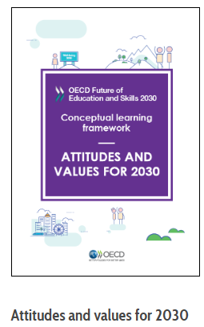
INTERNATIONAL EDUCATIONAL FORUM
EDUCATION THROUGH THE PARADIGM OF HUMANISM AND ARTIFICIAL INTELLIGENCE
SYNERGY AND ORCHESTRATION - SCIENCE, BUSINESS AND EDUCATION

Slide 26

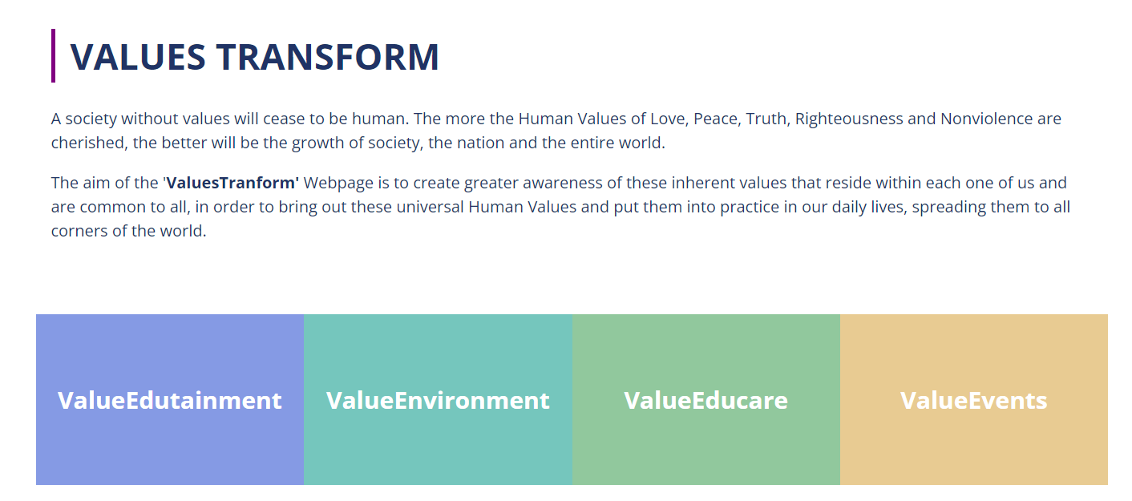
INTERNATIONAL EDUCATIONAL FORUM
EDUCATION THROUGH THE PARADIGM OF HUMANISM AND ARTIFICIAL INTELLIGENCE
SYNERGY AND ORCHESTRATION - SCIENCE, BUSINESS AND EDUCATION
#values
https://www.valuestransform.org

Slide 27
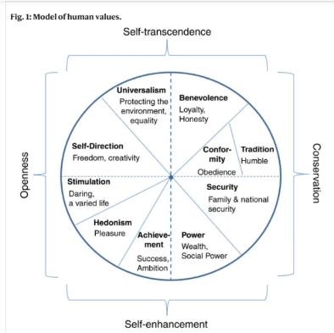

INTERNATIONAL EDUCATIONAL FORUM
EDUCATION THROUGH THE PARADIGM OF HUMANISM AND ARTIFICIAL INTELLIGENCE
SYNERGY AND ORCHESTRATION - SCIENCE, BUSINESS AND EDUCATION
Well-being as a function of person-country fit in human values
#values
https://www.nature.com/articles/s41467-020-18831-9

Slide 28

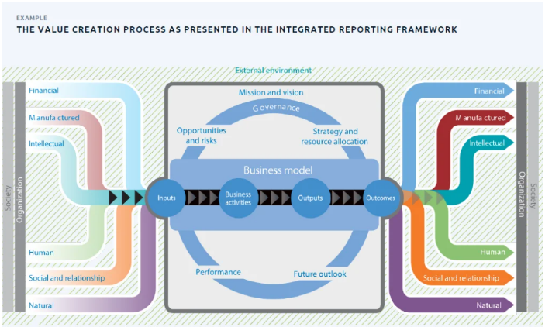


INTERNATIONAL EDUCATIONAL FORUM
EDUCATION THROUGH THE PARADIGM OF HUMANISM AND ARTIFICIAL INTELLIGENCE
SYNERGY AND ORCHESTRATION - SCIENCE, BUSINESS AND EDUCATION
Value Creation Definition, Model, and Examples in Business
#values

Slide 29
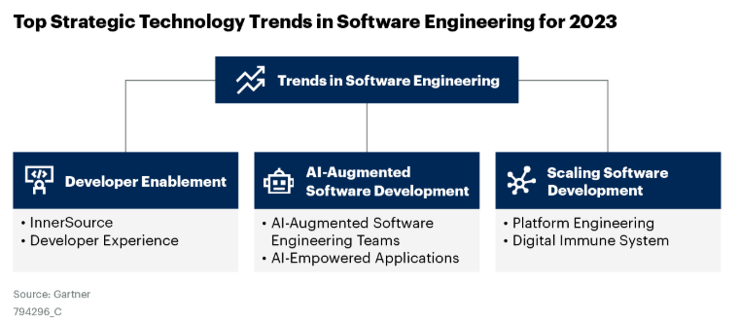
INTERNATIONAL EDUCATIONAL FORUM
EDUCATION THROUGH THE PARADIGM OF HUMANISM AND ARTIFICIAL INTELLIGENCE
SYNERGY AND ORCHESTRATION - SCIENCE, BUSINESS AND EDUCATION
https://innersourcecommons.org/
https://www.gartner.com/en/software-engineering/insights/top-technology-trends-in-software-engineering

Slide 30
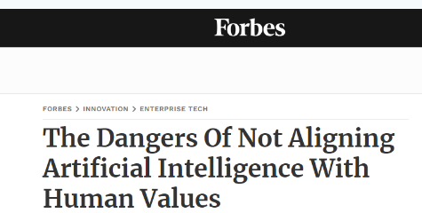
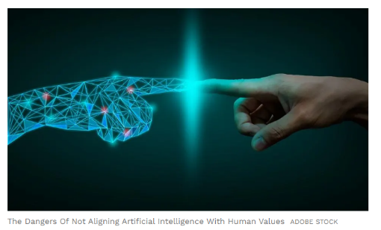
INTERNATIONAL EDUCATIONAL FORUM
EDUCATION THROUGH THE PARADIGM OF HUMANISM AND ARTIFICIAL INTELLIGENCE
SYNERGY AND ORCHESTRATION - SCIENCE, BUSINESS AND EDUCATION
#values
https://www.forbes.com/sites/bernardmarr/2022/04/01/the-dangers-of-not-aligning-artificial-intelligence-with-human-values/
https://viitorcloud.com/blog/collaboration-between-ai-and-human-values/

Slide 31









WITH OPEN MIND & HEART TO SUSTAINABLE INNOVATION SPACES THROUGH NETWORKING
SYNERGY AND ORCHESTRATION
SCIENCE, BUSINESS AND EDUCATION
Assoc. Prof., Institute of Mathematics and Informatics, Bulgarian Academy of Sciences, Sofia
Est. Res (R3), Research Institute, Medical University - Varna
Chair, BioMed-Varna Foundation, Varna
Expert, Ministry of Education, Sofia
Assoc. Prof. Galina Momcheva, PhD
Expert group for the development of
guidelines on high-quality informatics
gmomcheva@math.bas.bg
+359 888 793785 (viber, whatsapp, telegram)
https://orcid.org/0000-0003-0726-2022
https://www.researchgate.net/profile/Galina-Momcheva
https://scholar.google.com/citations?hl=en&user=vRPT-IcAAAAJ
https://www.linkedin.com/in/galina-momcheva-1a612817
https://www.facebook.com/gmomcheva

