Slide 1
Reimagining Higher Education: Universities in the Age of Digital Transformation
Irma Grdzelidze

Slide 2
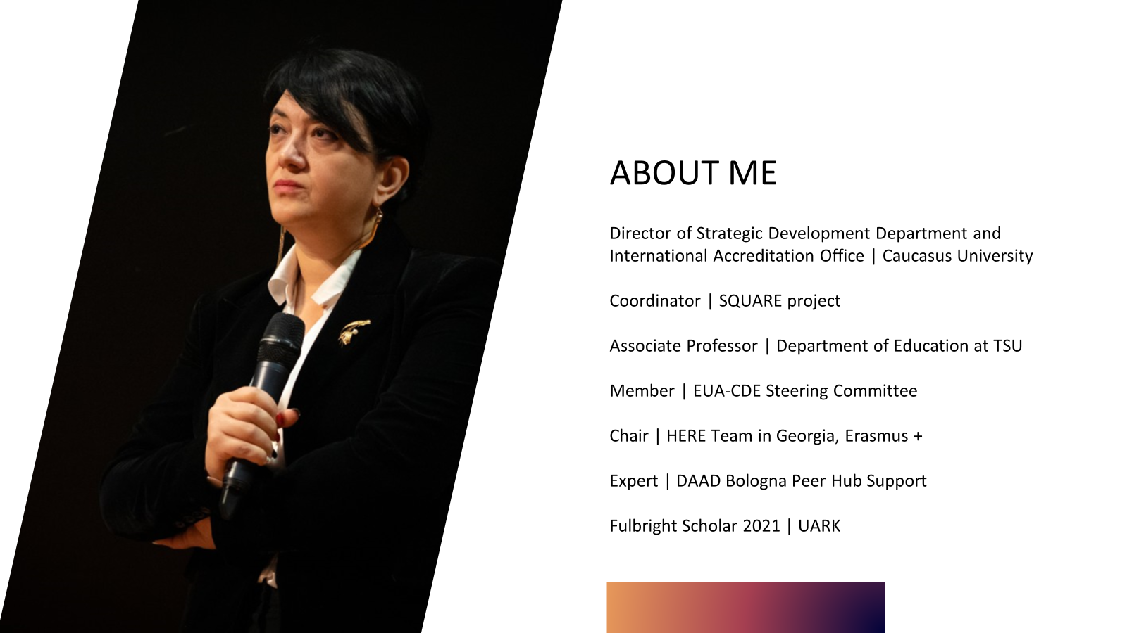

Slide 3
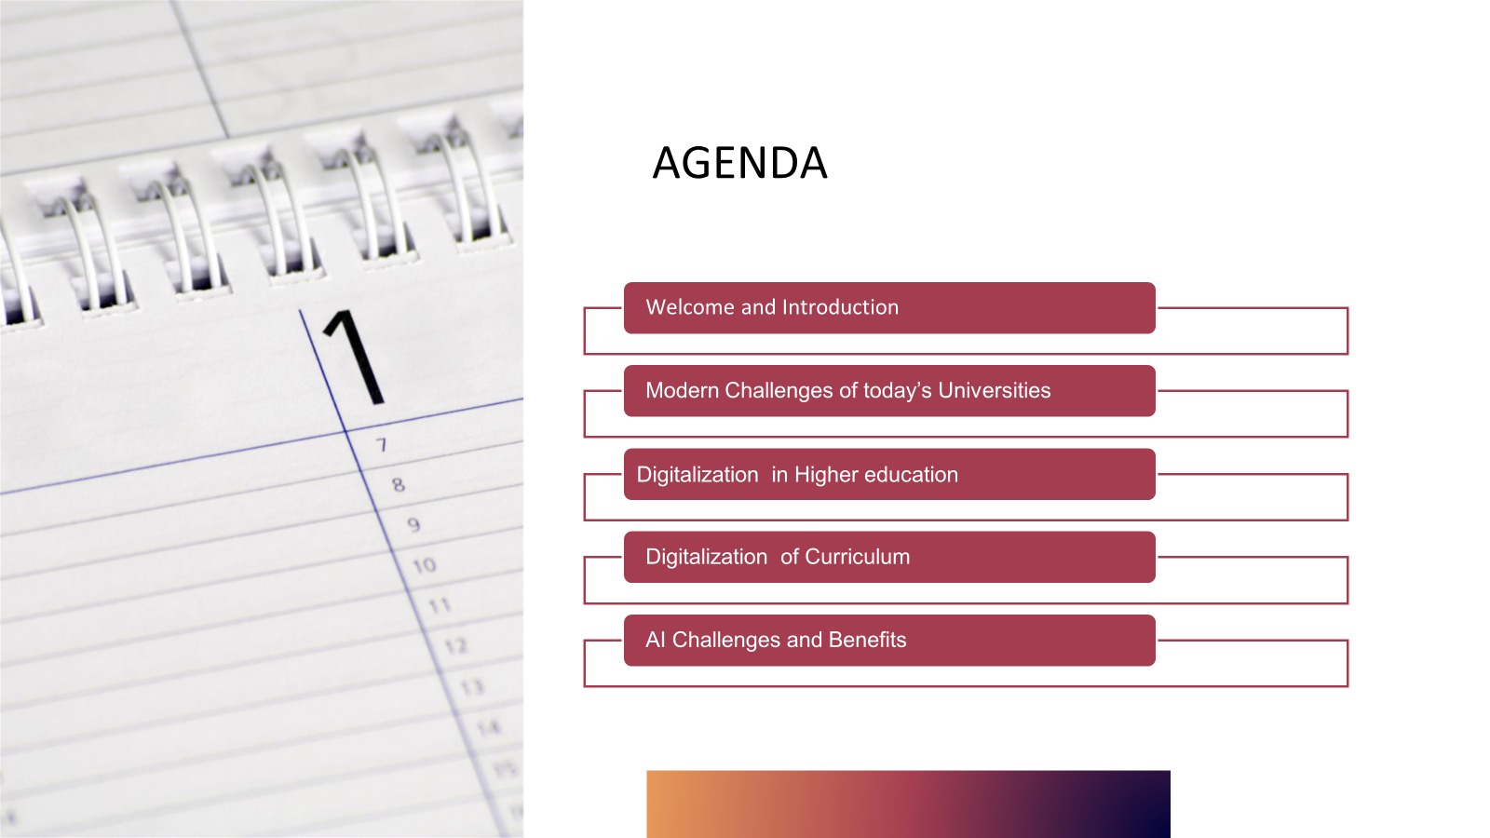


Slide 4
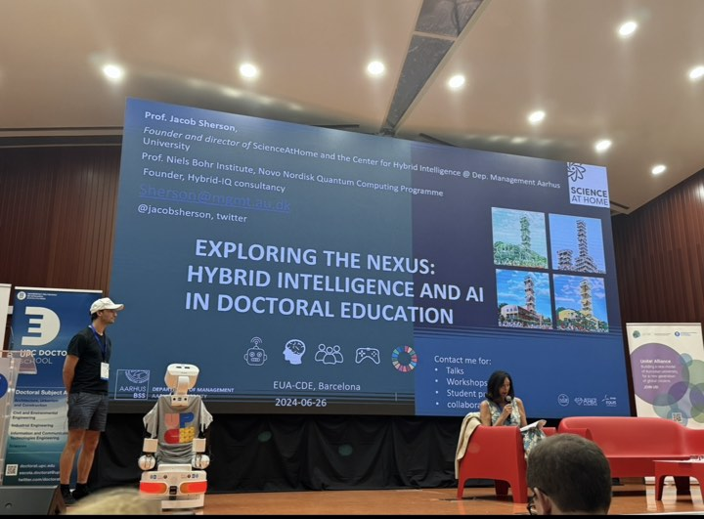

Slide 5

"Digital transformation is not just about technology, it’s about reimagining the future of education.“ Satya Nadella
"Universities must embrace the opportunities presented by digital technologies to remain relevant and provide value in a rapidly changing world.“ Diana Laurillard
"The real power of interactive technologies is that they let us learn in ways that aren’t otherwise possible or practical.“ David Lassner

Slide 6
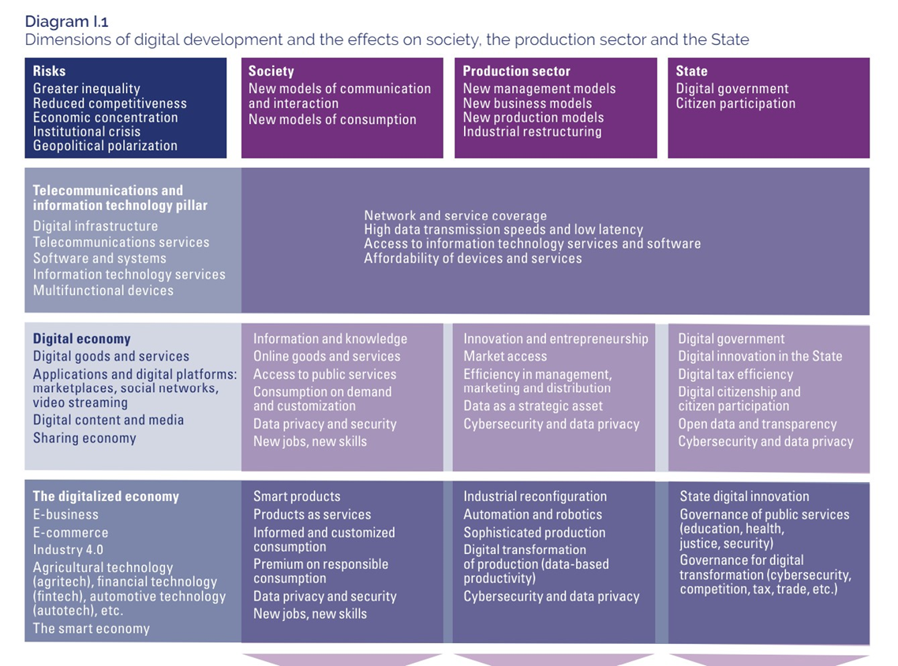

Slide 7
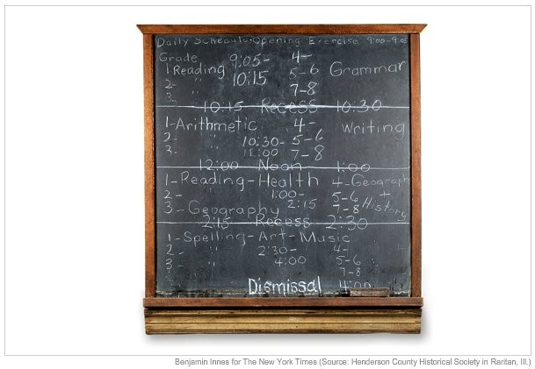
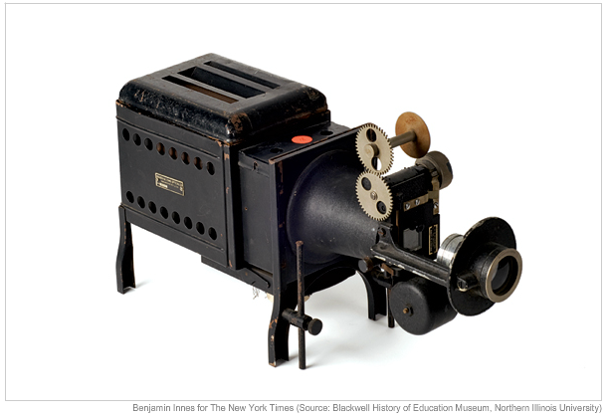


1890
1925
1970
2015
1925

Slide 8
Current Trends in Digitalization and AI in Education
Gamifying lessons – Static lessons are less likely to engage students. Using games, especially for younger students, helps to keep them engaged.
Self-directed learning – Students are now learning at their own speed. If they need to study one subject longer, they can. If they’re ready to move on, they’re able to.
Collaboration – Both teachers and students can work with others around the world.
Differentiated instruction – Not every student can learn from lectures or reading. Some concepts are difficult to grasp without interaction. Technology allows students to learn in a variety of ways and find what best suits their needs.
Distance learning – Technology can now be used to supplement virtual instruction.
Increasing use of digital tools in classrooms
Rise of online learning platforms
Adoption of AI for personalized learning experiences

Slide 9
AI tools and more
Personalized Learning- AI can be used to develop personalized learning plans for individual students based on their learning needs and abilities. This can help to improve learning outcomes by providing targeted instruction and support.
Adaptive Learning- AI can be used to develop adaptive learning systems that can adjust the pace and difficulty of instruction based on the individual needs of each student.
Intelligent Tutoring Systems -AI can be used to develop intelligent tutoring systems that can provide feedback, support, and guidance to students as they learn.
Automated Grading and Feedback -AI can be used to automate the grading and feedback process, allowing teachers to provide timely and accurate feedback to students.
Natural Language Processing - AI can be used to develop natural language processing systems that can interact with students in a conversational manner, providing them with feedback and support.

Slide 10
The Need for Updated Curriculum
“Groups like the National Science Foundation have been raising the alarm for some time that the United States is falling behind in science education and much more needs to be done around STEM education in K12 and beyond. The generative AI revolution adds the need to train students on prompt engineering and the abilities to build and train these powerful tools in ways that will solve the challenges of tomorrow.”
Ryan Lufkin, VP of Global Academic Strategy at Instructure
Rapid technological advancements
Preparing students for future job markets
Enhancing learning experiences through technology
Education systems should avoid a ‘one-size-fits-all’ approach in formulating curricula in order to foster diversity in students’ natural talents, and preserve the skill heritages of individual communities. This has proven effective in Estonia, a country which, despite its impoverished past, is considered to be a world leader in terms of its exemplary education system.
https://aijourn.com/the-crucial-role-of-curricula-in-shaping-the-future-of-ai/#:~:text=%E2%80%9CCurricula%20must%20focus%20on%20higher,in%20an%20AI%2Denabled%20future.

Slide 11
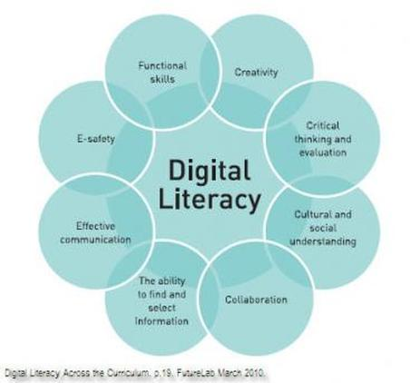
Key Components of a Digitally-Enhanced Curriculum
Integration of digital literacy skills
Incorporation of AI concepts and applications
Emphasis on computational thinking and problem-solving

Slide 12
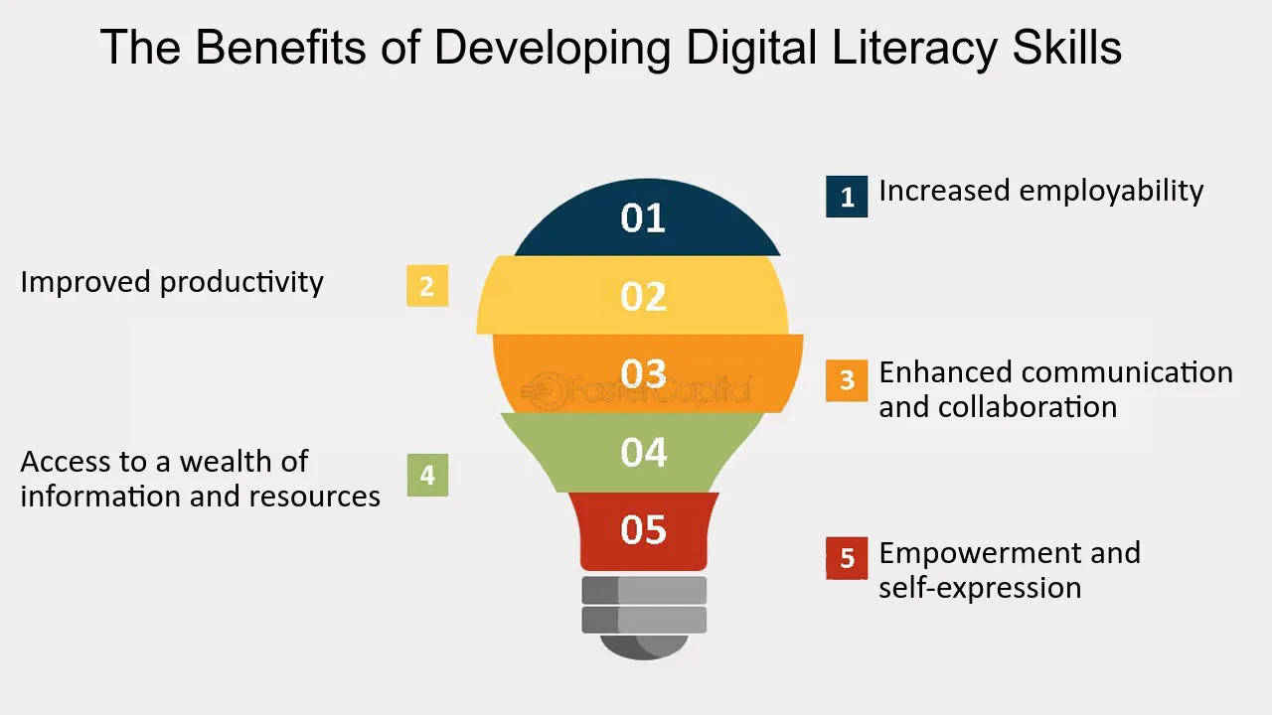

Digital Literacy Skills
Basic computer skills
Internet safety and digital citizenship
Use of productivity and collaboration tools

Slide 13
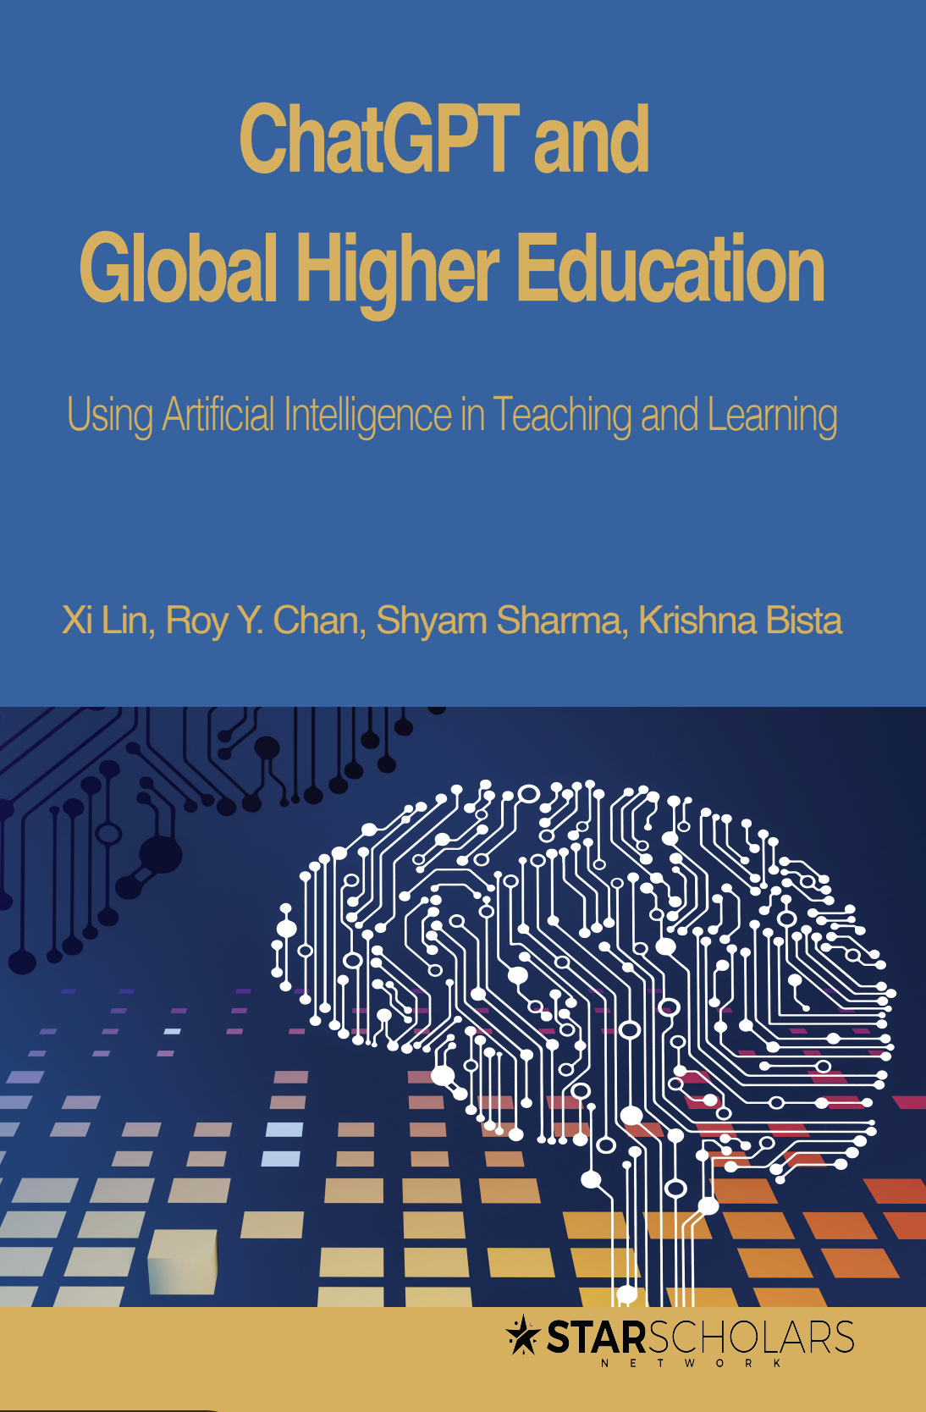
AI Concepts and Applications
Introduction to AI and machine learning
Real-world applications of AI
Ethical considerations in AI
https://onderwijstips.ugent.be/en/tips/chatgpt-een-generatief-ai-systeem-met-impact-op-he/
https://unesdoc.unesco.org/ark:/48223/pf0000385146
https://education.ec.europa.eu/focus-topics/digital-education/action-plan

Slide 14
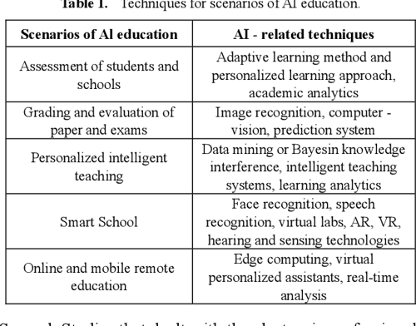
Teacher Training and Professional Development
Importance of ongoing training for educators
Workshops and online courses on digital tools and AI
Collaboration and sharing best practices

Slide 15
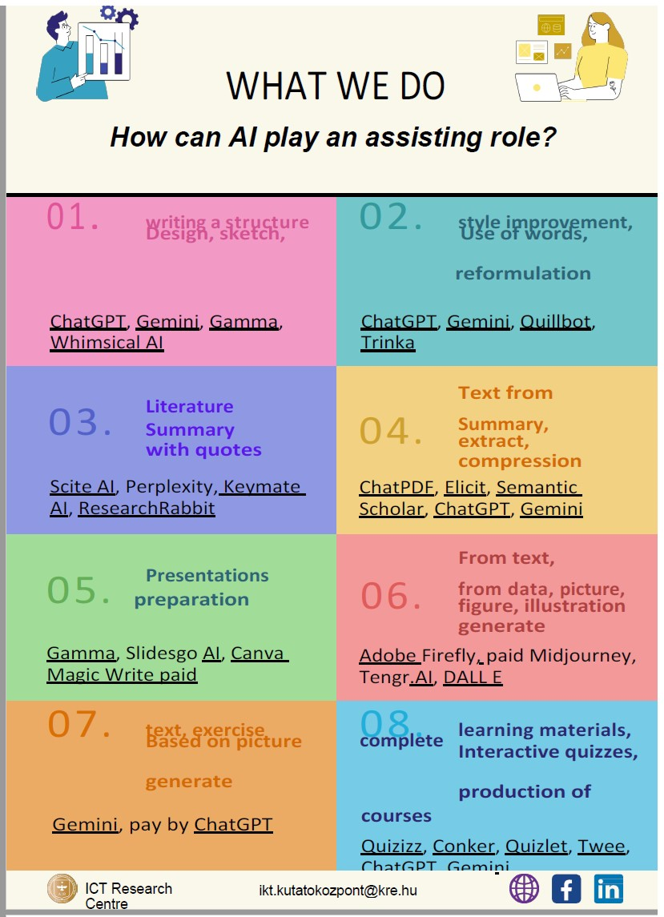
Try to make friends with AI

Slide 16
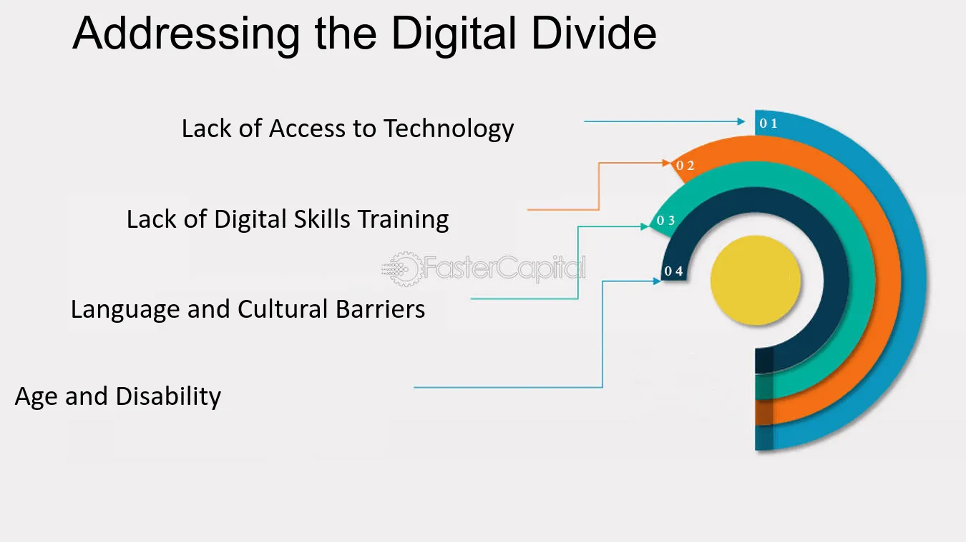
Challenges and Considerations
Access to technology and digital divide
Ensuring data privacy and security
Balancing screen time and traditional learning methods

Slide 17
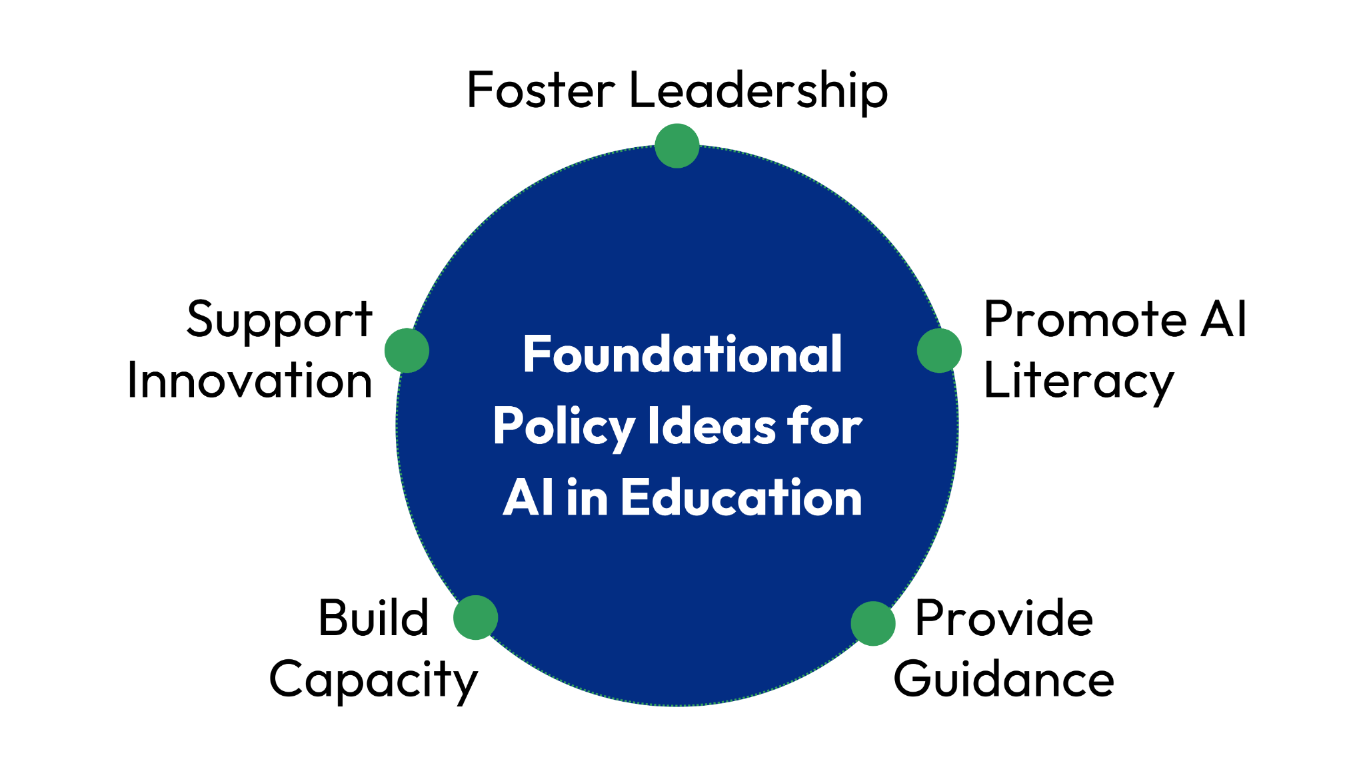
Conclusion
Recap of key points
The transformative potential of digitalization and AI in education
Call to action for educators and policymakers
World economic forum

Slide 18



PRODIGE

Slide 19
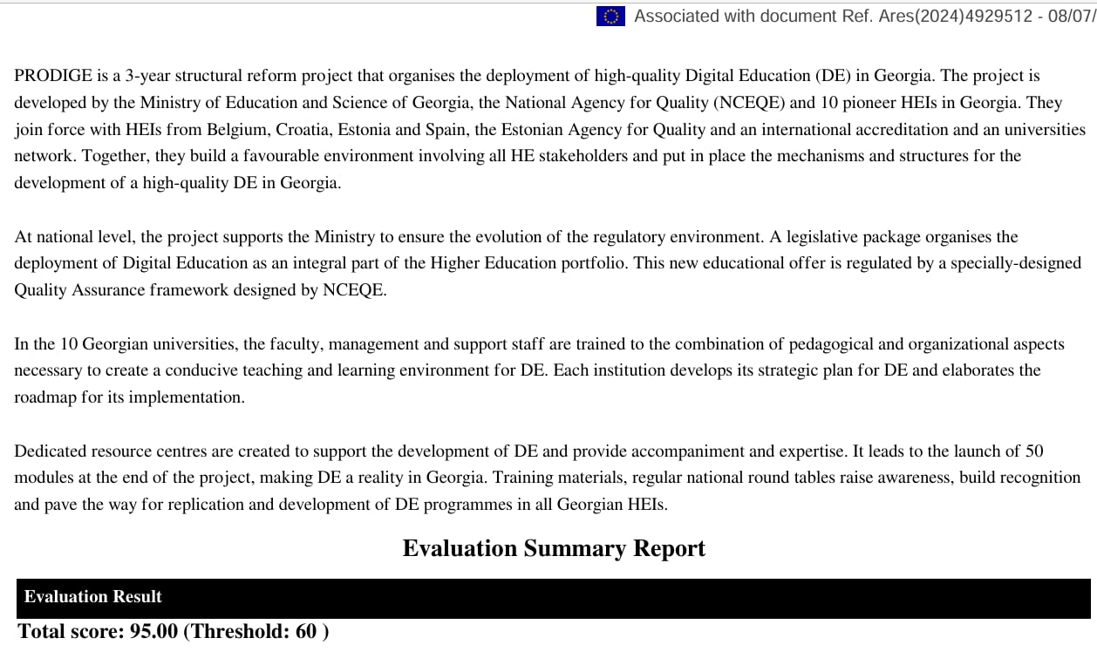

Slide 20
Thank you for your attention
In case of interest or further questions, contact at:
igrdzelidze@cu.edu.ge

