Slide 1

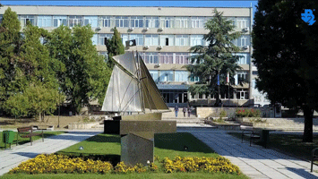

ADAPTIVE EDUCATIONAL TOOLS THAT ARE AWARE OF THE CURRENT EMOTIONAL-COGNITIVE STATE OF STUDENTS
Prof. Todor Ganchev, Head of the Artificial Intelligence Lab
Technical University of Varna

Slide 2
Our Mission
AI Advances + RTD
AI Applications & Services
AI Curricula @ TU-Varna
AI Empowerment of Citizens

Slide 3
Problem Formulation
Why do we need
adaptive educational tools?
Personality Features
Cognitive Capacity
Emotional Intelligence
Momentous State of Mind
Stress Management Skills
Inspiration, Focus, Fatigue, etc.

Slide 4
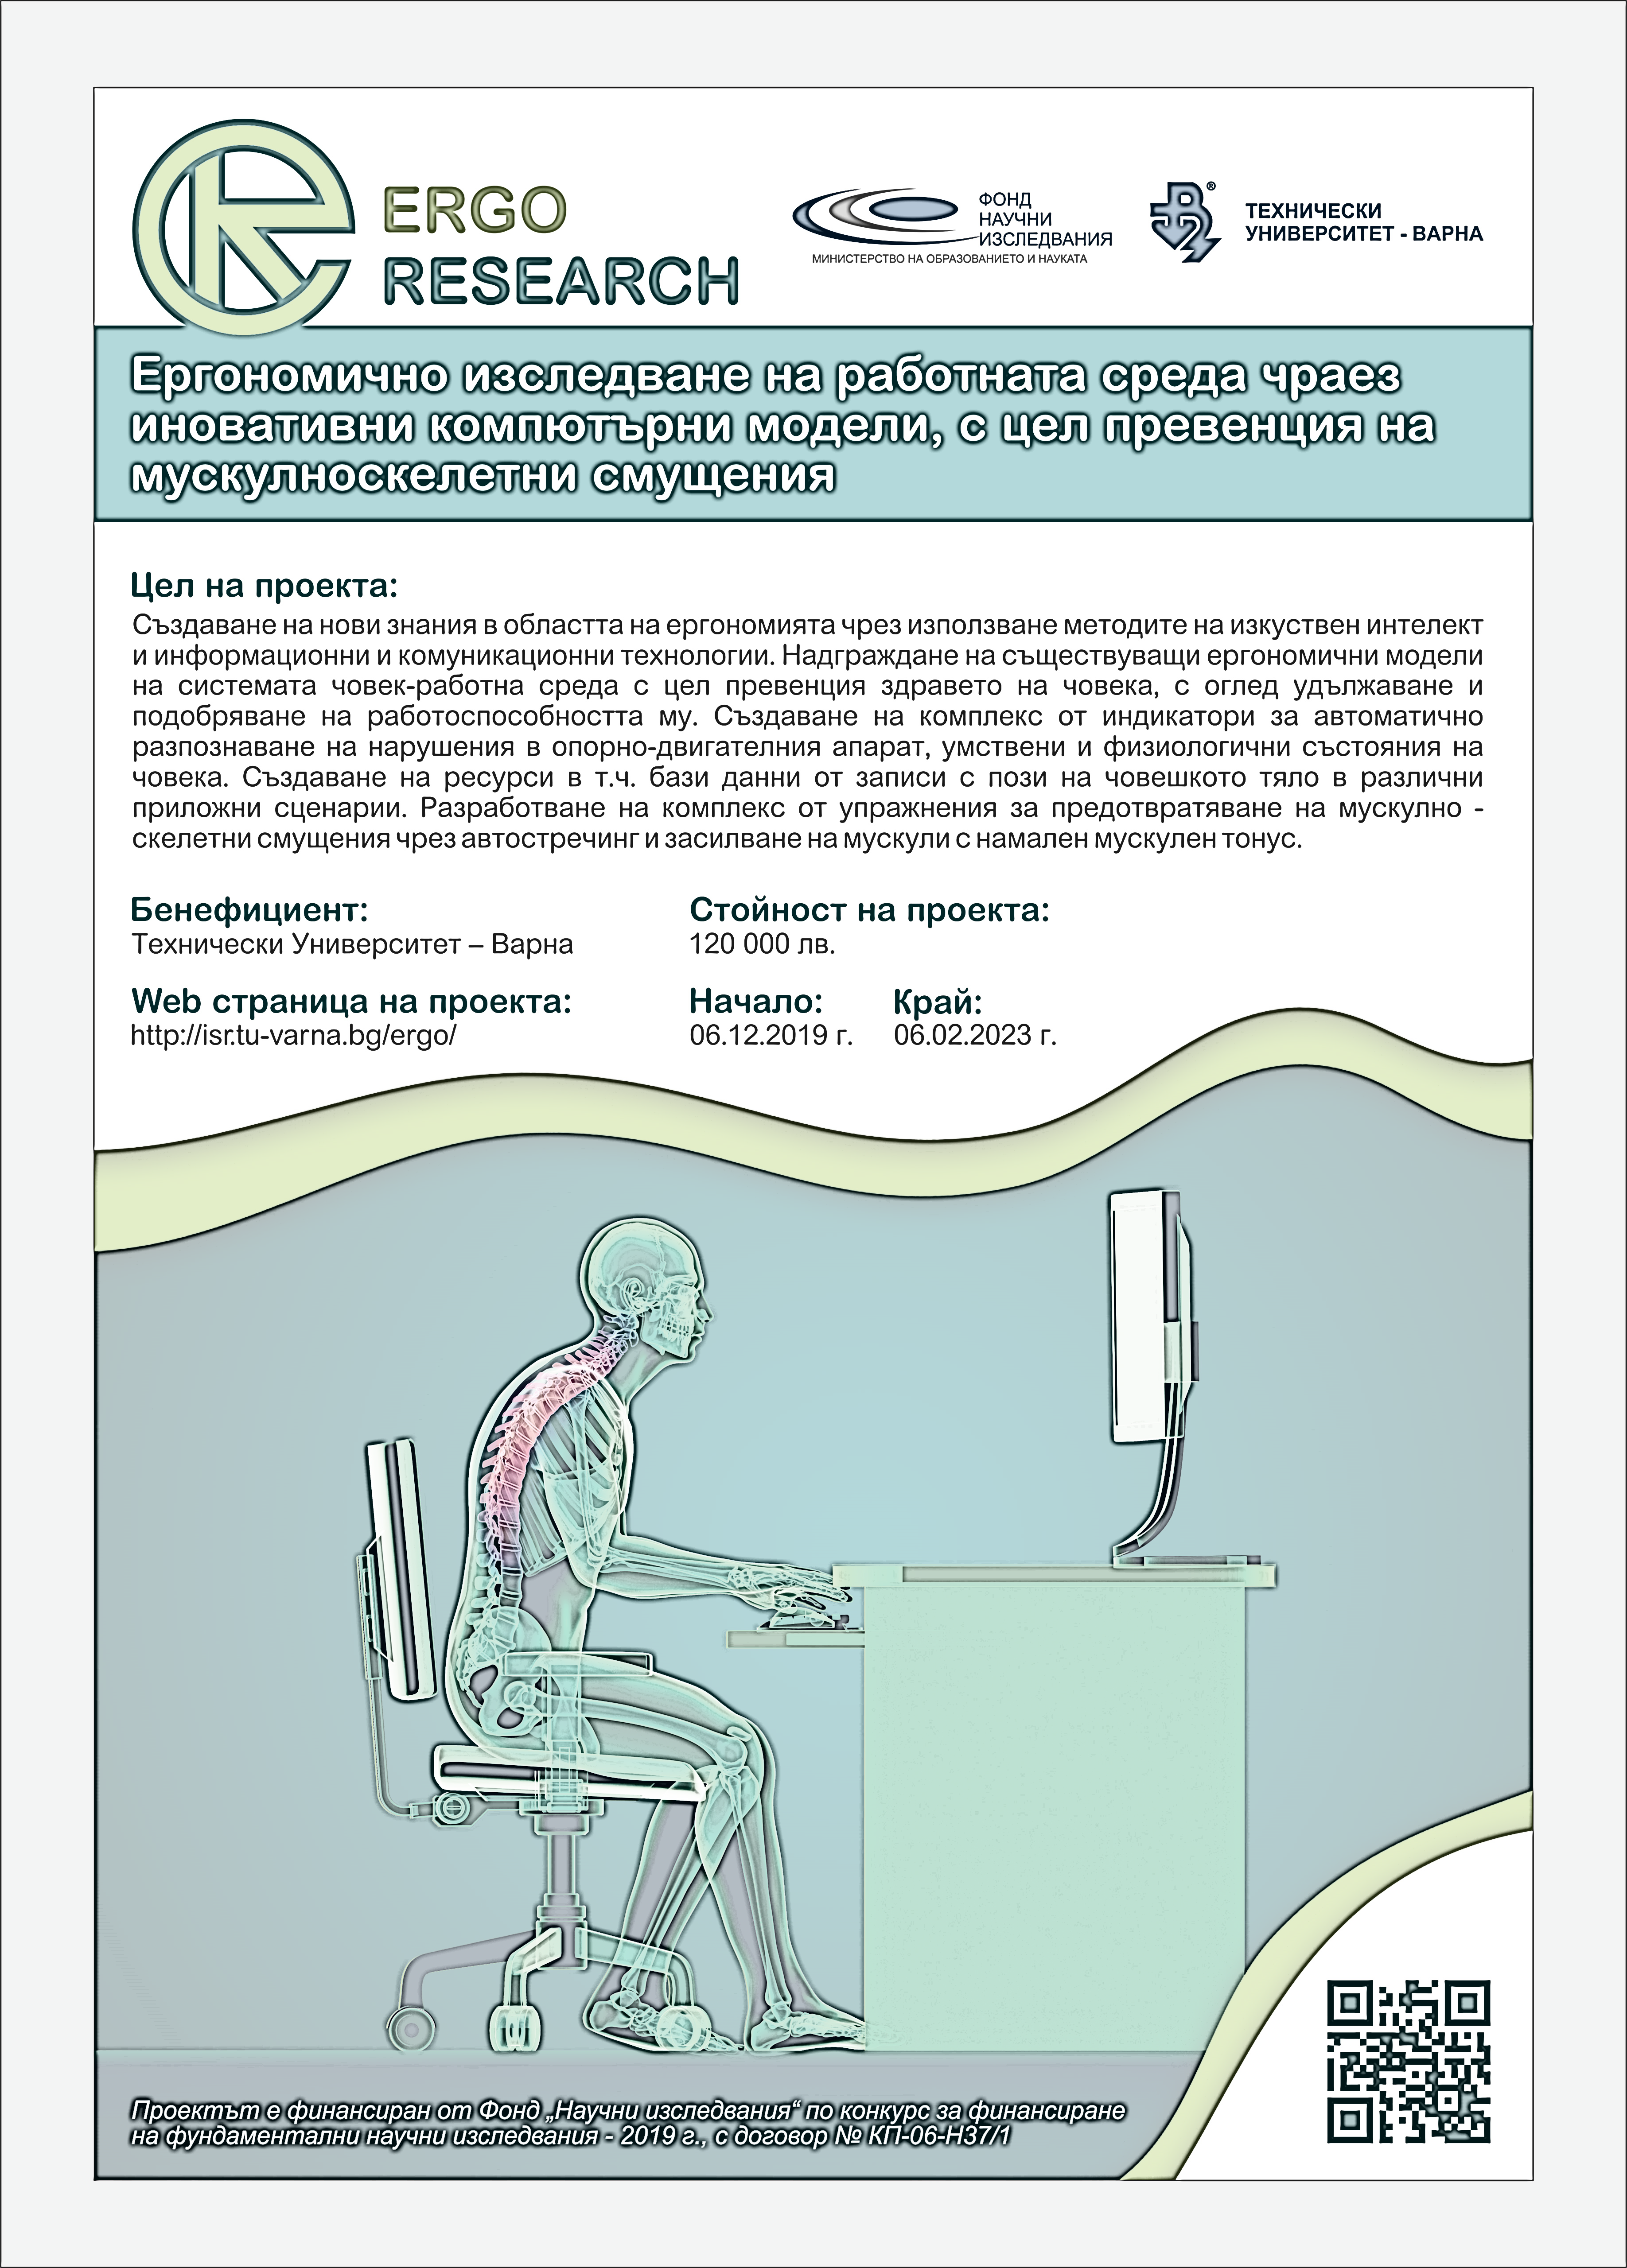
Why do we need
adaptive educational tools?
Human + Computer
Personality Features
Cognitive Capacity
Emotional Intelligence
Momentous State of Mind
Stress Management Skills
Inspiration, Focus, Fatigue, etc.

Slide 5
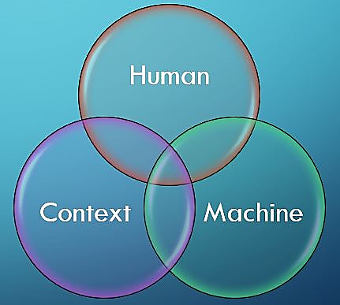
Adaptive?
Human + Computer

Slide 6

Adaptive => Intelligent !!!
Project iHMI, KP-06-H37/18, "Investigating the possibilities for the development of intelligent human-machine interfaces in the direction of recognising risky cognitive and emotional states."
(2019 – 2024)
Framework, Datasets, Models & Software

Slide 7
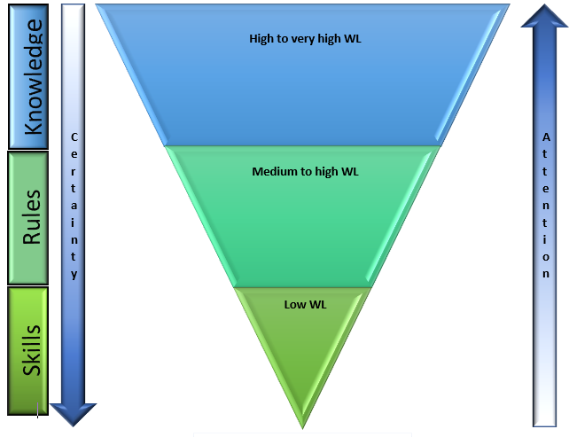
Towards implementation of emotional intelligence in human-machine collaborative systems
High-to-Very-High Workload
Medium-to-High Workload
Low WL
The Skill-Rule-Knowledge Pyramid (Lars Rasmussen)

Slide 8
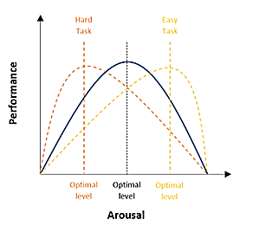
Towards implementation of emotional intelligence in human-machine collaborative systems
We build on the Yerkes-Dodson law!

Slide 9
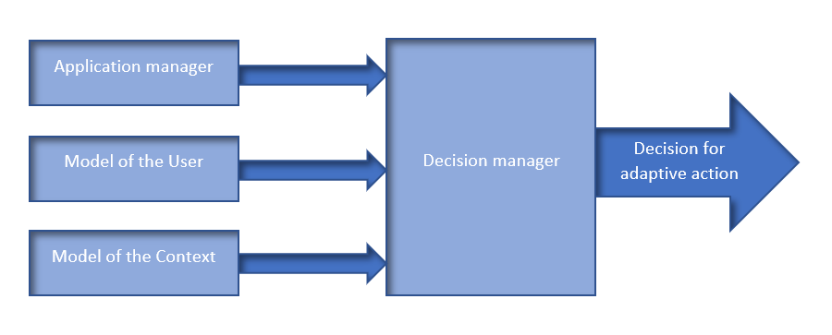
Towards implementation of emotional intelligence in human-machine collaborative systems
Concept of the Intelligent Human-Machine Interface Framework

Slide 10
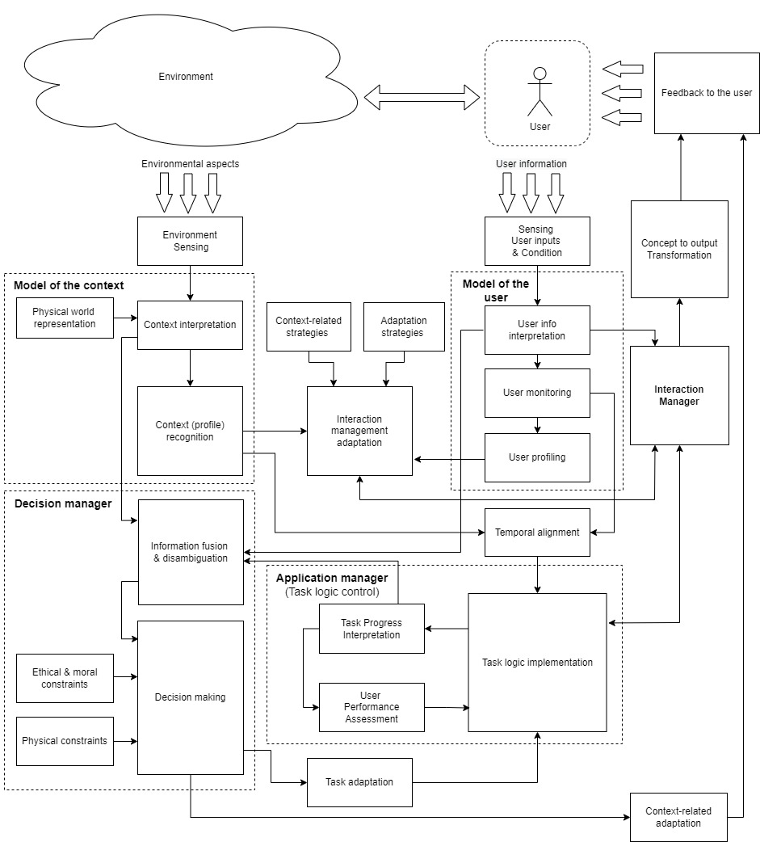

Slide 11
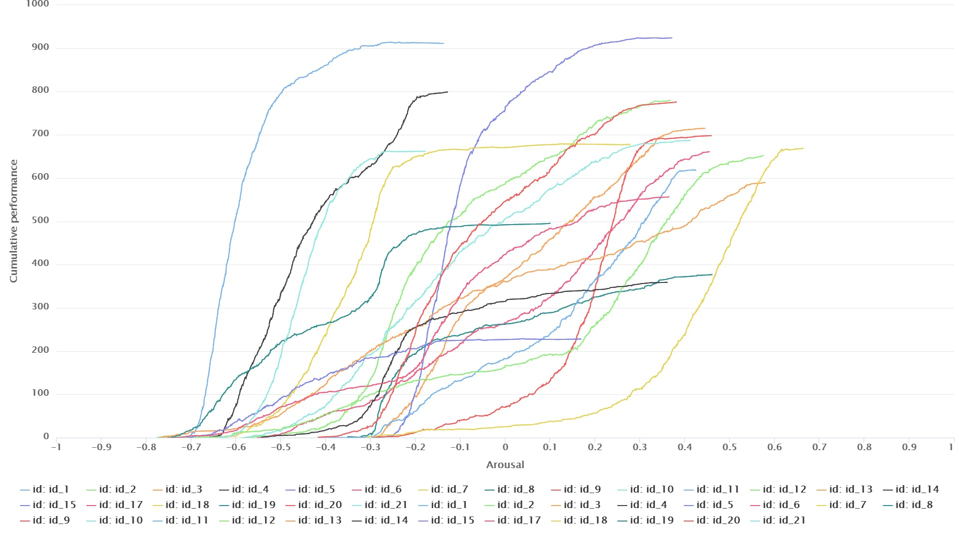
Towards implementation of emotional intelligence in human-machine collaborative systems
The Arousal-Cumulative performance of a person

Slide 12
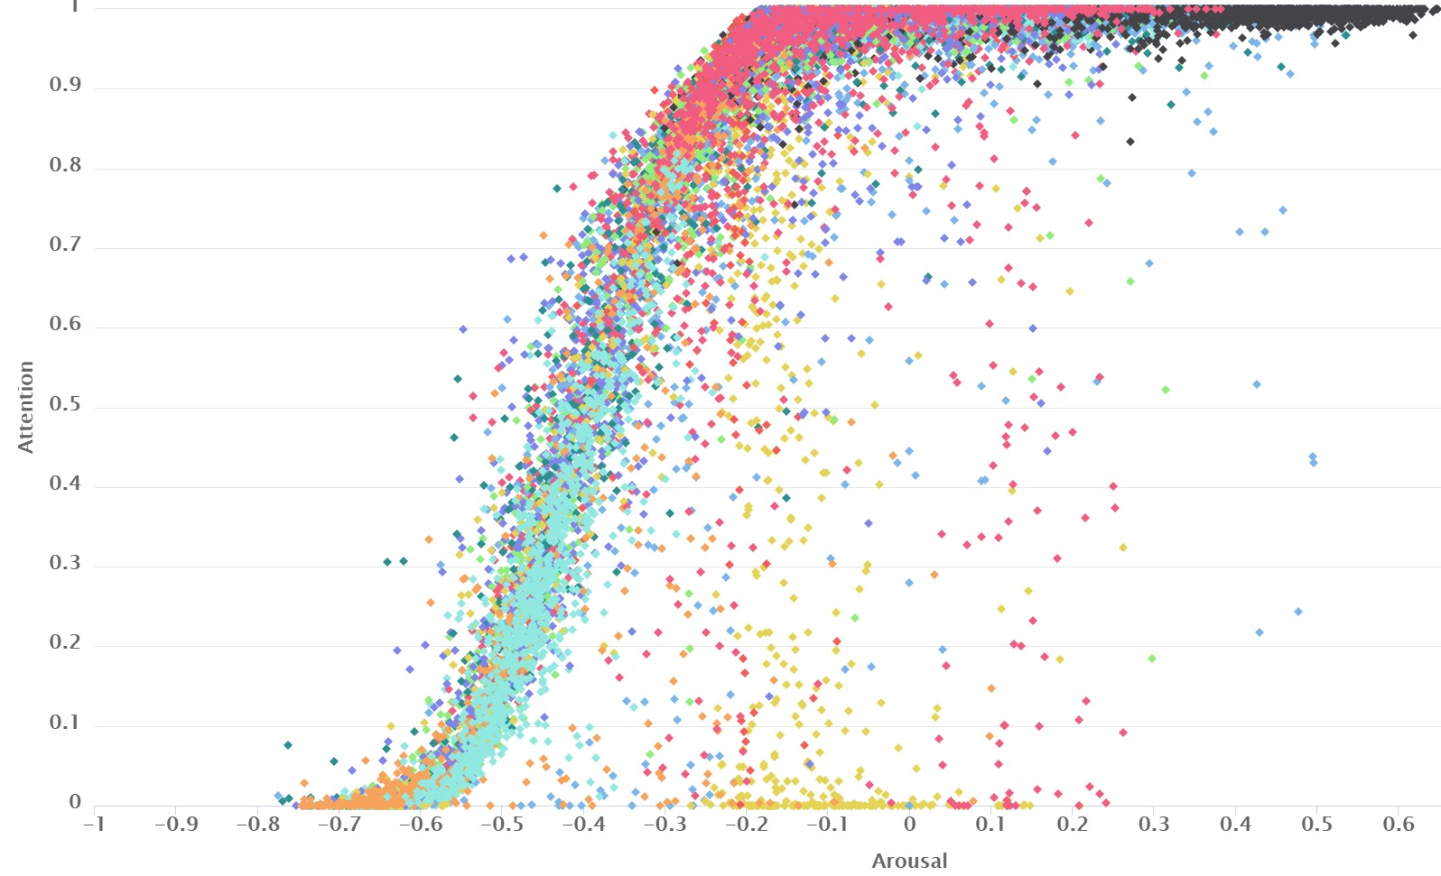
Towards implementation of emotional intelligence in human-machine collaborative systems
The Arousal-Attention plot by person

Slide 13
Towards implementation of emotional intelligence in human-machine collaborative systems
The Arousal-Attention plot by person

Slide 14
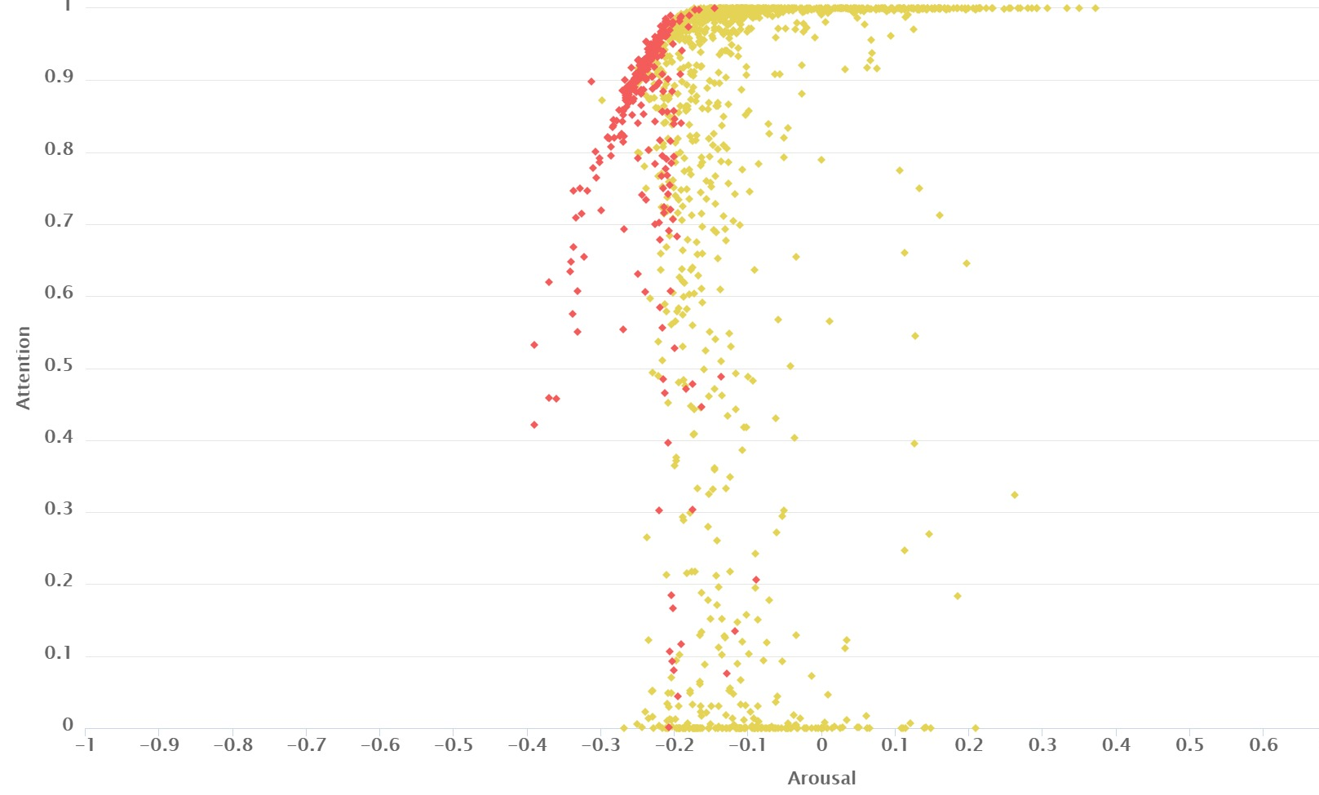
Towards implementation of emotional intelligence in human-machine collaborative systems
The Arousal-Attention plot for the left-handed people

Slide 15
e-Learning Setup
e-Learning framework with advanced technological support to personalisation of training

Slide 16
Implications
Human features, such as Attention, Emotional state, Stress level, Cognitive Workload, and Fatigue, vary significantly with time
The momentous state of mind is a critical factor for achieving good Performance
The adaptive e-Learning System that is aware of the momentous state of mind will adapt to the momentous state of the person to preserve an optimal level of cognitive workload
Adaptation will permit better efficiency of human-computer interaction
Applications in Education, Industry, High-Risk Missions etc.

Slide 17
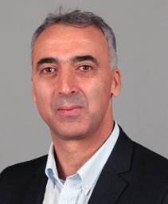
http://ailab.tu-varna.bg/
Thank you!
Prof. Todor Ganchev
E-mail: tganchev@tu-varna.bg

