Slide 1

Innational educational forum topic:
“Innovative educational area trough the prism of the emotional intelligence’’
Изготвил Камелия Йорданова Димитрова
старши учител от ДГ50”Зорница”

Slide 2
Innovative educational area
Nowdays we live in a time , in which we have to give our kids possibility to show their potential and imagination in special fulfilled area. The aim of the process of learning is to bring gladness and development of individual opportunities. If we want to reach everything we have to give our kid freedom instead of being based in the frame of the state standart.

Slide 3
The emotional intelligence of the kid
Emotional intellect is ability to identify , use and understand our emotions and we are able to control them. It is directly connected with the happiness and the success in life, because as well as we know us, it is easier to get for us happiness. Emotional intellect helps us to produce strong connections and harmonic relations with people in our vicinity. Also we can reach easier our targets and get success in our job/school. Fortunately , the emotional intellect can be developed.It cannot be given by birth. Daniel Golman– The real titan of learning of the emotional effect says that it can be fullfiled, since it is directly connected to the nerve pathways of the brain which develop themselves to the area of the human life. As a result of this reason it is very important to be noted that in earlier age we have to do our best for the development of the emotional intellect of the kid.

Slide 4
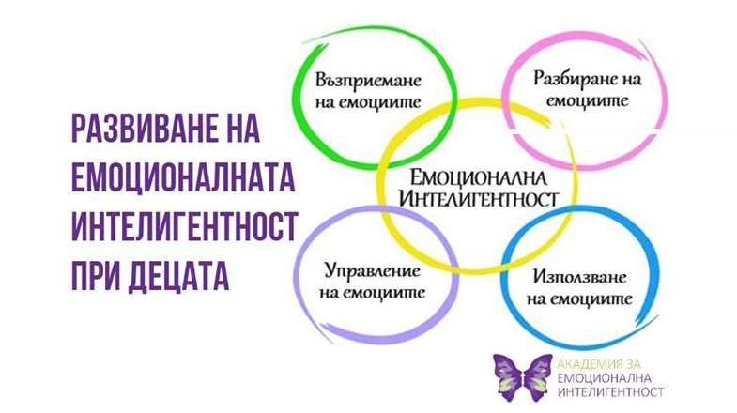
Perceiving of emotions
Understanding of emotions
Development of emotional intelligence of the kids
Emotional intelligence
Control of emotions
Using of emotions
Scheme of emotional intelligence

Slide 5
Development of emotional intelligence of the kid
№1- We have to be able to reduce the stress.
№2- We have to be capable of understanding our emotions and catch them.
№3 – We have to find out contact with the people in the vicinity with non – verbal communication.
№4 –We have to use the humor and the game in order to achieve with the challenges and overcome the obstructions.
№5 –Positive solution of the conflicts.

Slide 6

What else we don’t know about the emotions?
Usually When the parent makes a direct conversation with the kid about his feelings, the kid must be in a situation that the parent desperately wants to solute. Also , if the kid is not preliminary prepared to react adequate in moment like this its brain starts being in protecting mode. In this mode it is not available to make something else apart from protection and run away from the problem.

Slide 7
Innovative educational area is relation between kinder garden and family
The modern educational tendencies and educational strategies guess that forming of persons who successfully appropriate to the new dynamic and fast- changing area. They offer forms of educational relation in which the attention directs trough vitally important for the kid situations. We go on to dominate on the idea for entire development of the person with stimulating, adaption, individualization and integration of his activity in the area in which it lives and develops.

Slide 8

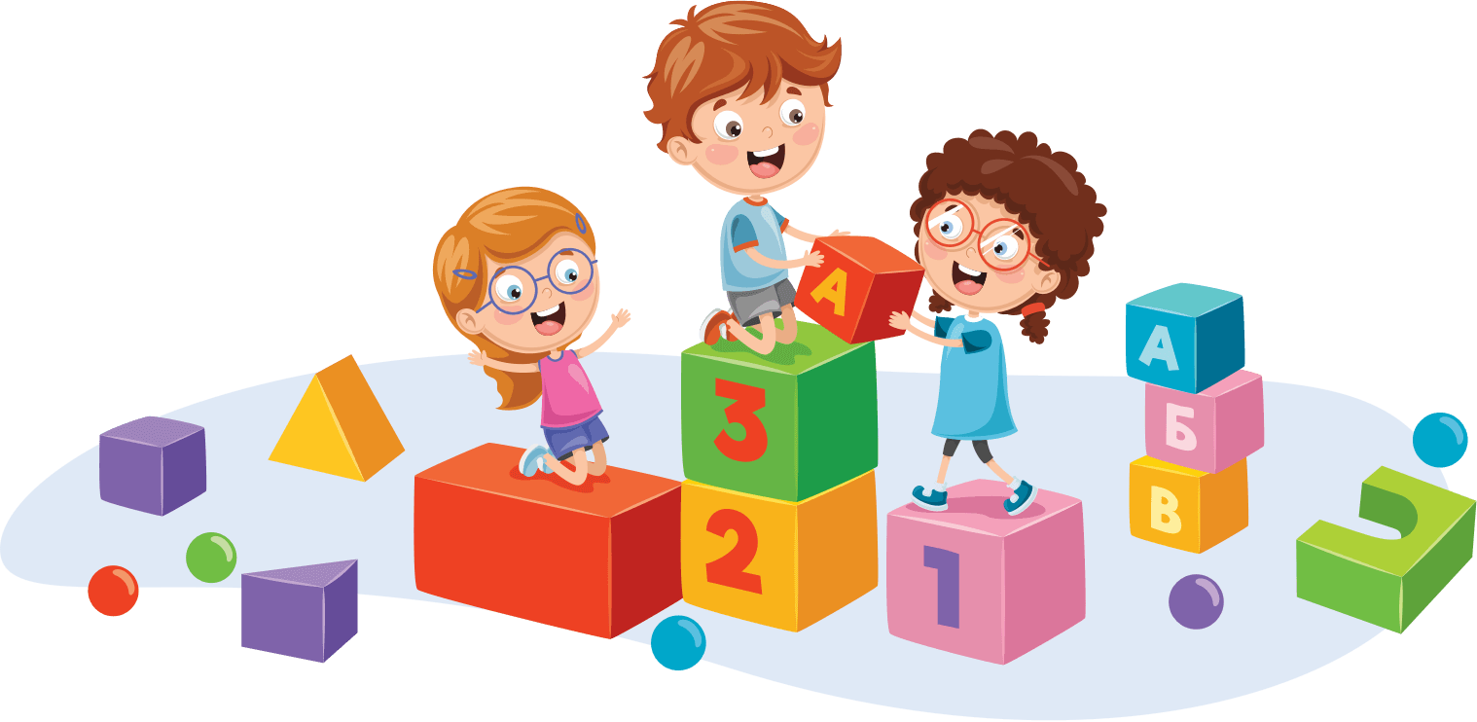

Slide 9

The kids are our future

Slide 10
STEM EDUCATIONS
Using the methodology of STEM the students take participations with experiments and they are supported to share their ideas. This helps to development of group projects directed to getting knowledge of the world among them.

Slide 11

THANK YOU FOR YOUR ATTENTION

