Slide 1




Second International Educational Forum
„Quality of Education in the Conditions of Digital Transformation
and the Specifics of Generations“
Transforming the Educational Environment through Club Activities
Трансформиране на образователната среда чрез клубна дейност
Представя:
Златинка Лефтерова Димитрова
Детска градина № 23 Иглика
Варна, България
Presented by:
Zlatinka Lefterova Dimitrova
Kindergarten № 23 Iglika
Varna, Bulgaria
September 7-9, 2022

Slide 2


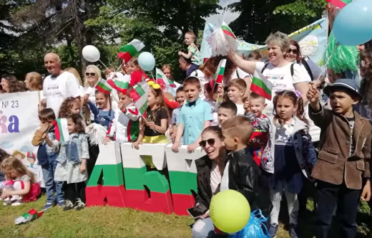
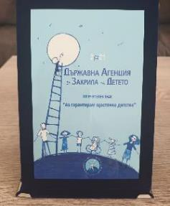
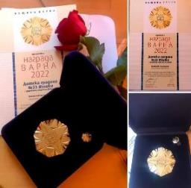
Iglika Kindergarten and Créche ‒ Varna is an educational institution working fervently towards providing a modern, innovative, creative positive and supportive educational environment and equal access to quality education and upbringing of each and every child.
We strive to make optimal use of all available resources, and constantly enrich and improve our educational process, so that Iglika Kindergarten be a happy childhood home for the children of our community.
We are proud that our work has been highly appreciated and we are winners of the I guarantee a Happy Childhood ‒ 2021 Badge of the State Agency for Child Protection and the Varna Award Team of the Year in Preschool Education 2022.

Slide 3
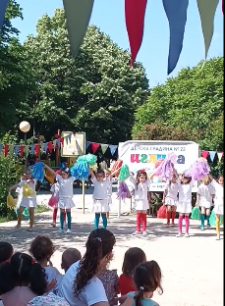
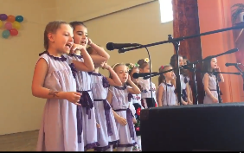
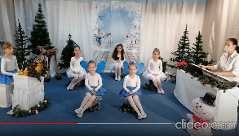
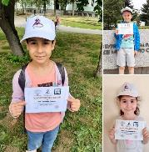
THE CLUB AS A PLACE AND A COMMUNITY
Over the past few years, we have paid special attention to the development of clubs and ateliers as an opportunity to transform the traditional frontal methods of working with a large group of children and enrich the educational interaction. We develop our clubs by:
• providing appropriate physical space and equipment for their functioning;
• creating small communities of children and adults, united in their common needs, interests and goals.
The abilities and talents of the children in the kindergarten are stimulated and developed through additional activities in:
Iglika Cheerleader Formation led by the music teacher
The cheerleader dance group revitalizes every holiday imparting vividness and delight. The participant children also develop their musical-motor culture and aesthetic taste.
The Iglika Vocal Group led by the music teacher
The group is for musically gifted children and gives performances at competitions, festivals and holidays.
Ulybka Vocal Band, led by a music teacher.
Created for the Russian-speaking children in the kindergarten, for our work on the international
project Children in a World Without Borders and the intercultural education activities.
Mathematics Club, headed by a pedagogical advisor
This circle enhances the development of ideas, skills and preparation for participation in competitions of children with outstanding abilities in the field of mathematics.
Along with the gifted children, we, in Iglika Kindergarten, take care of the inclusion of children with learning and emotional-behavioral difficulties. To support their personal development, our specialists - a psychologist, a speech therapist, a resource teacher, and a pedagogical advisor work in specially equipped offices.

Slide 4

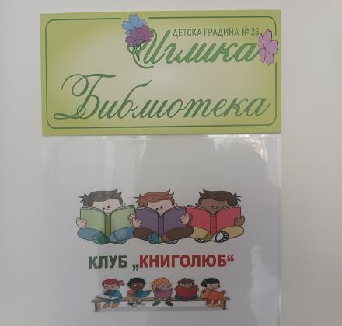
THE CLUBS AS A STEP TO DEALING
WITH THE 21ST CENTURY CHALLENGES
Learning takes place where the child feels well accepted, supported, protected, successful, where his/her natural interests, curiosity, needs and impulses to know and transform the world and him/herself are satisfied.
The contemporary dynamically changing world requires a dynamic pace of transformation in the educational sphere.
The Covid 19 pandemic with its isolation, disease-related stress, and online learning have created new challenges.
During the academic year 2021-2022 our team has taken initiatives that have turned into causes uniting our small community for cooperation in the name of creating better conditions for the children's development and overcoming the consequences of the pandemic.
As a result, on April 12, the Aviation and Astronautics Day, a newly equipped
SENSORY STEM room was opened to the public.
A month later, on the eve of May 24, the Day of the Bulgarian ALPHABET and literature the newly created
Iglika Children's Library opened its doors.

Slide 5
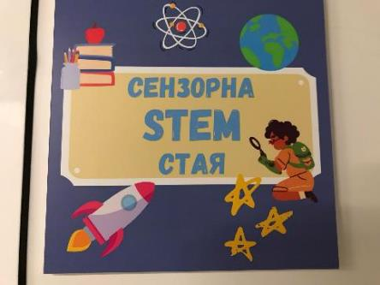
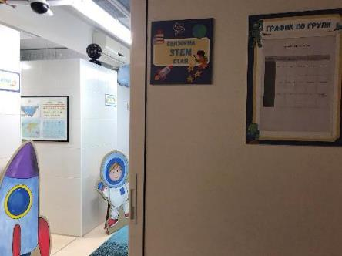
A SENSORY STEM ROOM
A combination of sensory and STEM environment is not common and proved to be a successful way to employ a room rather misused and neglected until then; a room which has been completely renovated and refurbished, and in which the two environments smoothly and harmoniously complement one another.
In the common room two separate areas are set up:
Sensory room ‒ a hall furbished according to the requirements for this type of environment;
STEM room ‒ comprised of atelier areas. All ateliers have a theme and are arranged and bound together in the sequence of the STEM abbreviation.
The sensory / STEM room is attended according to a schedule that includes all groups from first to fourth, children from 3 to 7 years old.
Teachers are free to choose the directions and topics of the weekly curriculum and extra-curricular activities and organize them as clubs which require an interactive environment and working in smaller groups of children. The children are divided into two subgroups beforehand. This allows for an optimal opportunity for participation of each child and the benefit of an individual approach to each and every one of the children.
While the situation with the first subgroup takes place, the other subgroup are in the care of the psychologist and the speech therapist, who work with them on such topics as emotional intelligence, speech culture, social and behavioral skills, etc.
The schedule provides time for the psychologist to perform individual and group work with children with special educational needs.

Slide 6
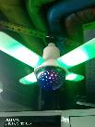
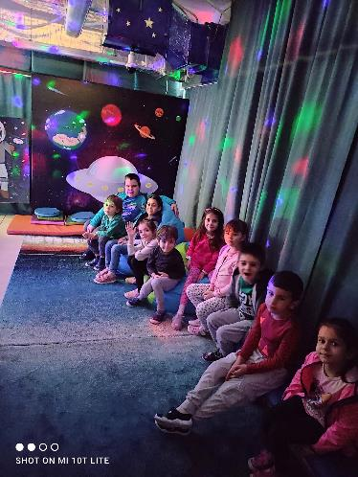
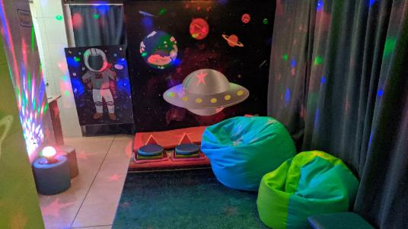
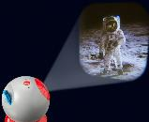
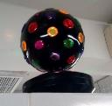
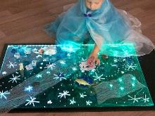
SENSORY ROOM
Equipment:
The equipment suitably coloured, comfortable and safe.
The children can sit on the floor on a soft carpet, special modules or on a pouf chairs.
The room is equipped with space-themed light projectors, audiovisual lamps ‒ which can change the modes of sound and light, LED strip lights and spherical lamps, which allow for dimming and design of images and lighting effects.
If necessary, there is an aroma diffuser, which also contributes to a relaxing atmosphere.
A sensory path, a "dry pool" with colored balls and modules for active play and psychomotor skills comprise the rest of the main furniture.
Purpose:
combining passive ‒ relaxing and calming, and active ‒ restorative and stimulating activities;
stimulating perception through the senses ‒ sight, hearing, smell, tactile senses;
developing the ideas about the surrounding world and one's own body, fine and gross motor skills, the vestibular system, etc.;
working towards mastering one's emotional states;
a place to relax in a protected environment, etc.
Coming soon:
A1 size cordless writing board that provokes all sensory levels in an unconventional way, shining in seven different colors for engaging and collaborative drawing and writing activities.

Slide 7
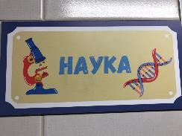
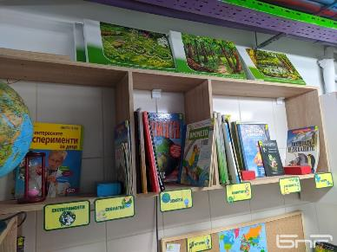
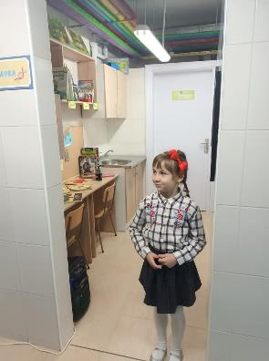
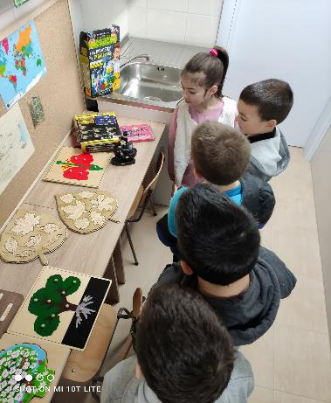
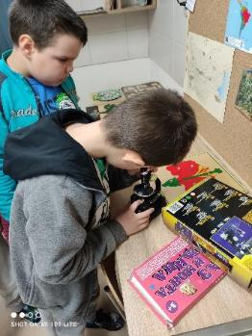
The first STEM Atelier - S for Science
Equipment:
workstations with tables and chairs suitable for individual and group work;
cabinet with sink, for convenience when conducting experiments;
rich collection of encyclopedias, boards, maps, puzzles and other didactic materials related to different sections of science and arranged thematically on shelves;
a children size microscope, magnifiers, droppers, utensils and other tools for observations and experiments.
Purpose:
club activities, game and practical situations;
experiments;
research activities;
interactive discussions and other activities:
for getting to know the natural world and mastering the scientific method as an approach to problem solving.

Slide 8
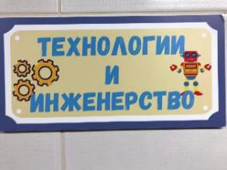
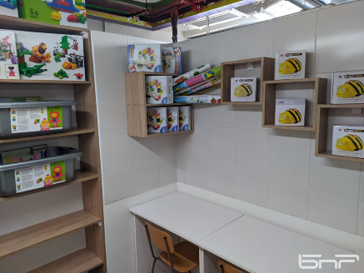
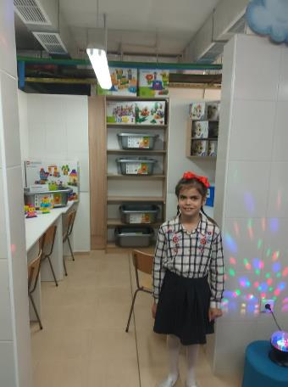
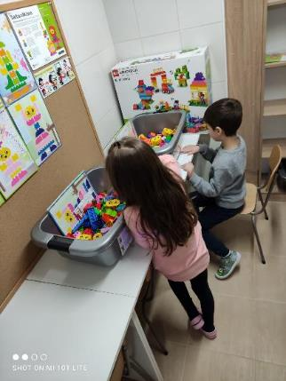
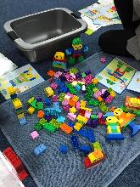
The second atelier T for Technology
and E for Engineering,
united in one zone
Equipment:
programmable floor robots Bee Bot;
a rich set of LEGO-Education construction toys;
other types of construction toys ‒ wooden, metal;
various hand materials for making models, and constructions.
tables and chairs for individual and group work.
Purpose:
club activities, game and practical situations for mastering initial competencies in the field of technology and engineering;
development of spatial and algorithmic thinking;
problem solving skills;
socio-emotional study.

Slide 9
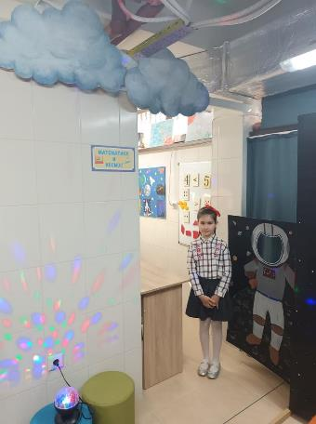
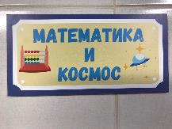
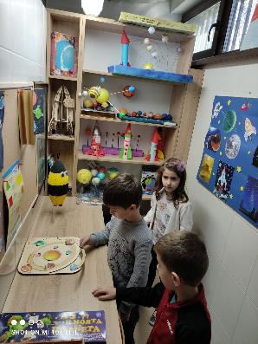
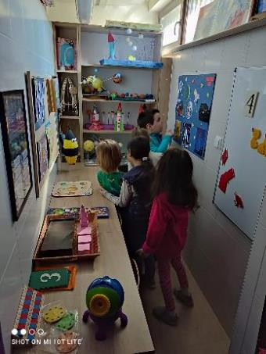
The third studio M for Mathematics and Space
Equipment:
• Montessori-based materials for mathematical literacy ‒ number strips, pink tower, brown ladder, sandpaper numbers, etc.;
• magnetic boards and various didactic games;
• "Montessori" rugs;
• tables and chairs for individual and group work;
• a collection of models of the Solar System made over a period of three years during the realization of our Space Tale Project and other games and materials on the topic of space.
Expected results from the activities in the STEM workshops:
enriching the children's knowledge of the world around them;
supporting the development of social and emotional competencies, teamwork skills, communication skills;
mastering basic concepts of mathematics, science, and technology;
developing problem-solving skills, logical, creative and critical thinking.

Slide 10
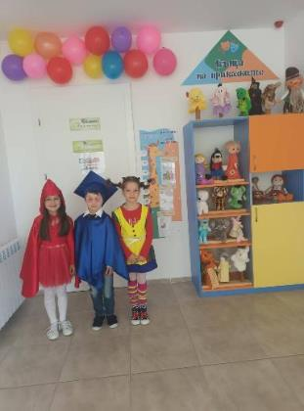
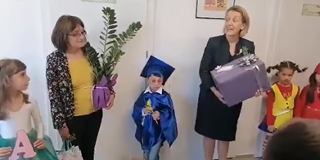
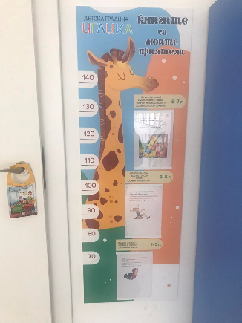
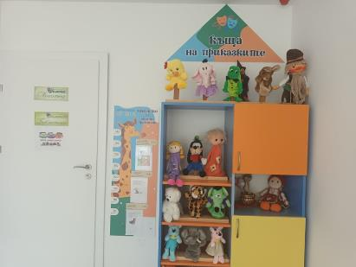
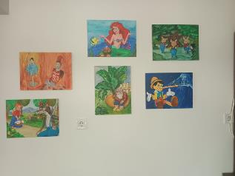
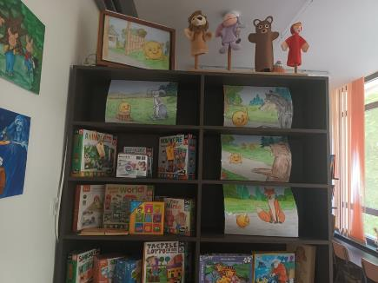
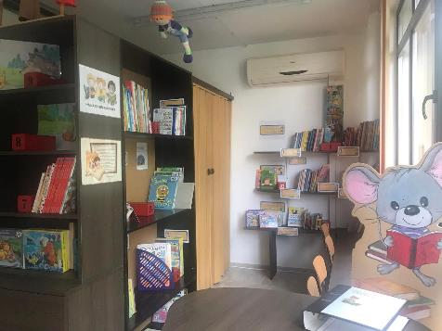
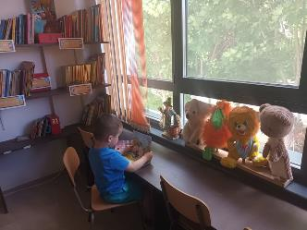
IGLIKA CHILDREN'S LIBRARY
On the eve of May 24, the Iglika Children's Library opened its doors, whose godparents were our friends and partners in numerous initiatives for promoting interest and love for books, the librarians from the P. Slaveykov Regional Library.
The library has turned into a real home of fairy tales with an art gallery with illustrations, Kamishibai Theater ‒ a Japanese theater with pictures, puppets, puzzles and games with favorite fairy tale characters.
The giraffe at the entrance invites young visitors to choose a book suitable for their age. The shelves are arranged in age groups from 1 to 3, from 3 to 5, from 5 to 7 years, and the books for the youngest children are placed on the lowest shelves.
A Karlsson doll flies over the cupboards and watches how the children feel and take care of the books.
The children, divided into smaller groups, visit to the library during their time for extra-curricular activities.
The work area of ​​the speech therapist is also in that same room is, as the therapist includes activities with books in his/her work with children.

Slide 11
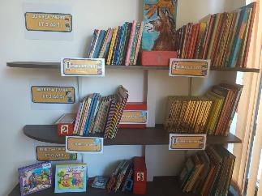
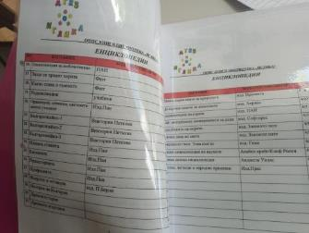
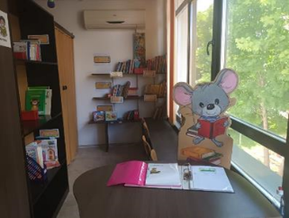
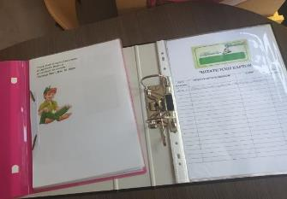

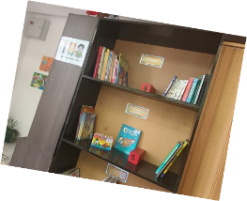
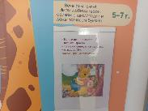
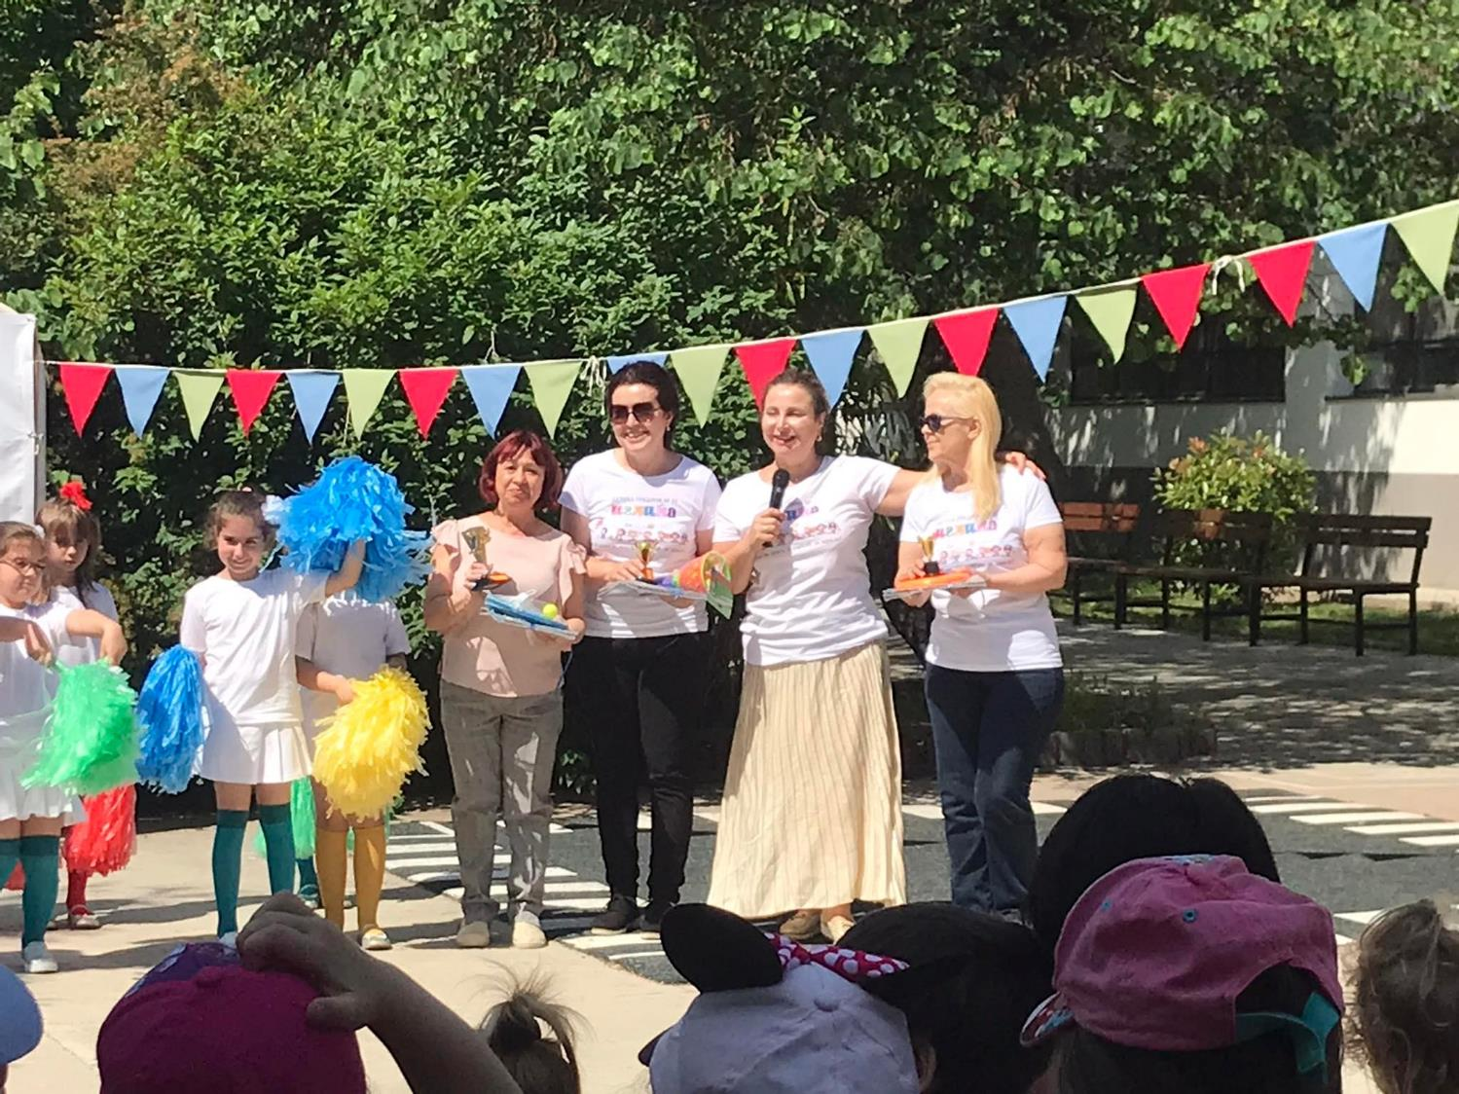
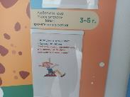
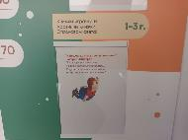
The library has been created according to the requirements for library work with:
- an inventory of all books which have been given call numbers;
- reader cards for the groups;
- in the future reading cards for children wishing to take a book home.
The book fund contains editions for children in Bulgarian and English and is over 600 strong, with the number constantly increasing. The books are divided into sections:
- Fairy-tale world
- Poems and riddles
- Encyclopedias
- Magic letters and numbers
- Children's magazines and comic books.
The rich book fund was raised through the Wonderful Book For Every Child's Hand Campaign, with the participation of parents, friends of the kindergarten, the teachers and staff body.
The most active groups were awarded trophies on June 1st ‒ the International Children's Day.

Slide 12


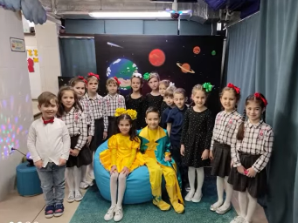
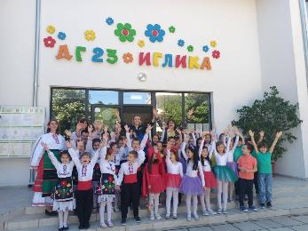
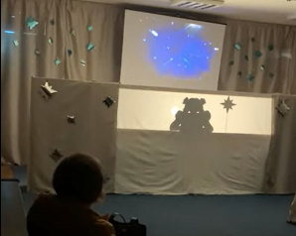


The impact of the initiatives to create a Sensory/STEM Room and Iglika Children's Library on our small community of children, teachers, parents and friends of kindergarten is positive and it encourages us to plan the development and upgrading of our club activities.
We have developed the concept of a new project: Transforming the Educational Environment through Club Activities, with the financial support of the It's nice in kindergarten National Park, so that we manage to gradually equip our ateliers with a full range of Lego-Education kits for ages 2 to 7 and increase the qualification of teachers in connection with their application.
Implementing the Lego techniques for learning by building and making and learning though experience, we will develop the club's activities in three trends:
Using the Lego-Build me Emotions ‒ development of the children's emotional intelligence. Enriching the resources and topics in the sensory room and combining the work in it with emotional cards from the Mediation in the Kindergarten Project. It is carried out by the pedagogues and psychologists of the kindergarten;
Using the Lego ‒ Story Tales Set with Storage ‒ development of language skills and vocabulary, which will also be used in the existing Book Lover Club and in our children's library, assisted by the kindergarten's speech therapist;
Using the Lego Education STEAM park, Lego Education Coding Express and Lego Education SPIKE Essential Set ‒ it will be possible to develop the potential of gifted children in the STEM ateliers, as a Lego club activity. Also, during the regular attendance of all groups ‒ enrich the design and technology situations.
Official Opening of the library
Thank you for your attention!
See you soon!
Official opening of the Sensory/STEM Room

