Slide 1

THE QUALITY OF EDUCATION IN THE CONDITIONS OF DIGITAL TRANSFORMATION AND THE SPECIFICS OF GENERATIONS
07 - 09 SEPTEMBER 2022, Varna
Collaborations for the development of the professional mathematical community in Varna
Pavlin Petkov, Sevdalina Georgieva Ph.D.
Union of Bulgarian Mathematicians – Varna, Bulgaria

Slide 2
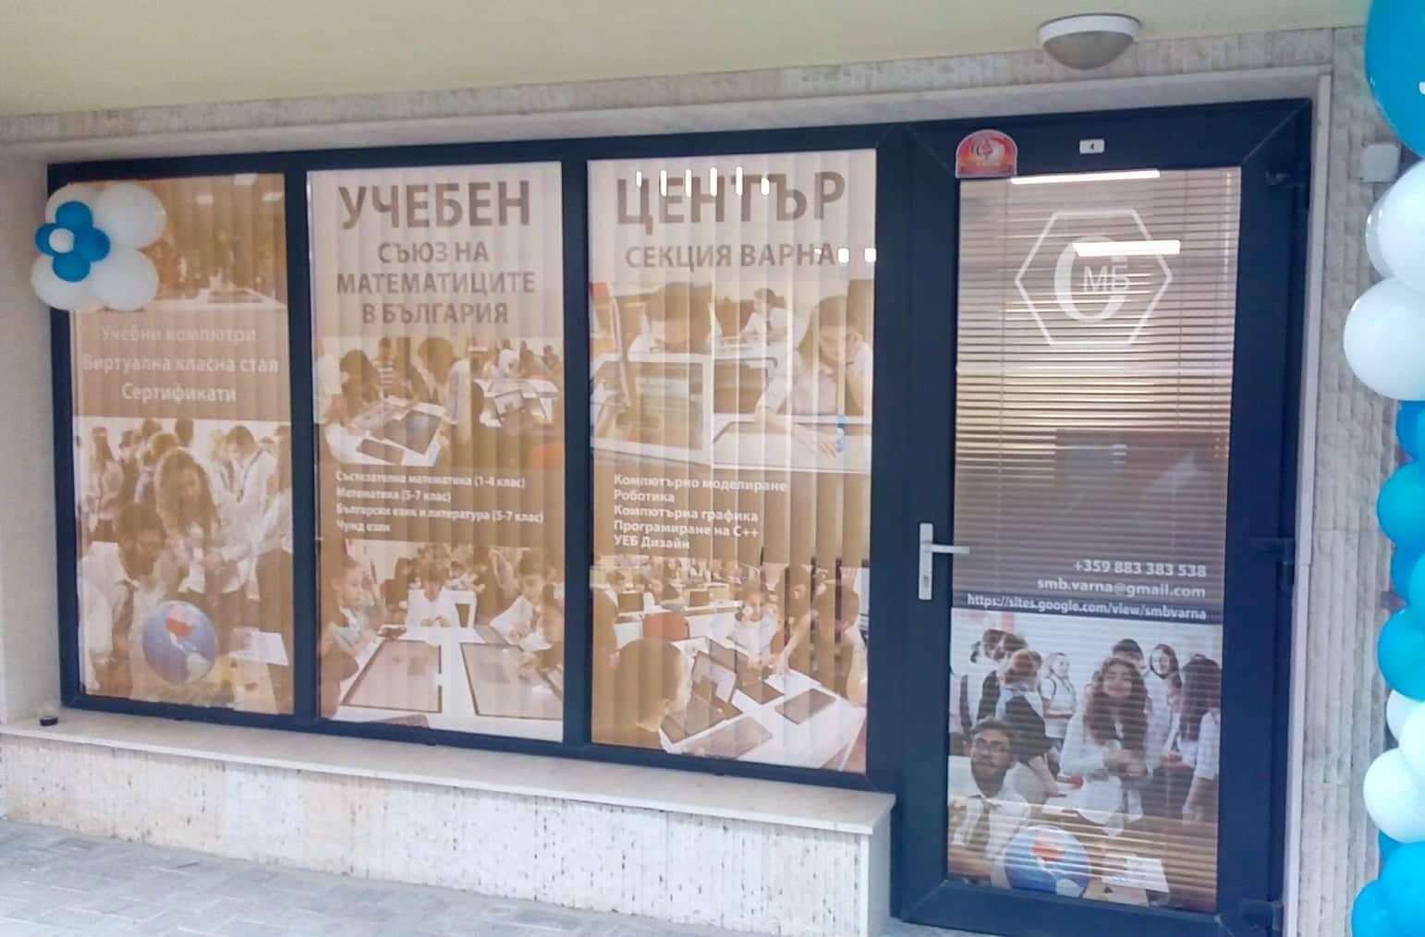

Union of Bulgarian Mathematicians - Varna section

Slide 3
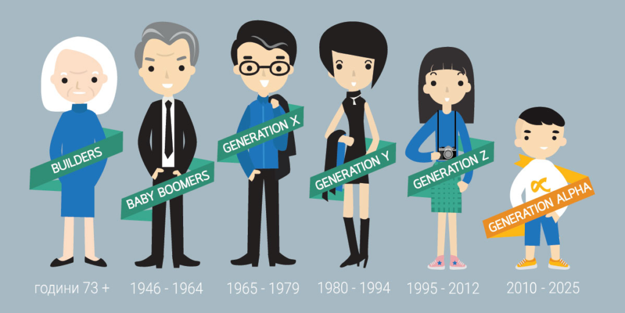
The modern generation and the challenges facing teachers

Slide 4

The modern education

Slide 5


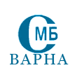
Mathematics in Electronic environment with GeoGebra Activity
Program The Next 10: Supporting Ideas that Matter in the Next Ten Years/ Online Learning

Slide 6

Web sait: www.smbvarna.eu

Slide 7



THE CLASSES ON THE MOON
ERASMUS+ PROJECT 2022-2024
KA220-VET Cooperation partnerships in vocational education and training
Project №: 2021-1-RO01-KA220-VET-00002817

Slide 8
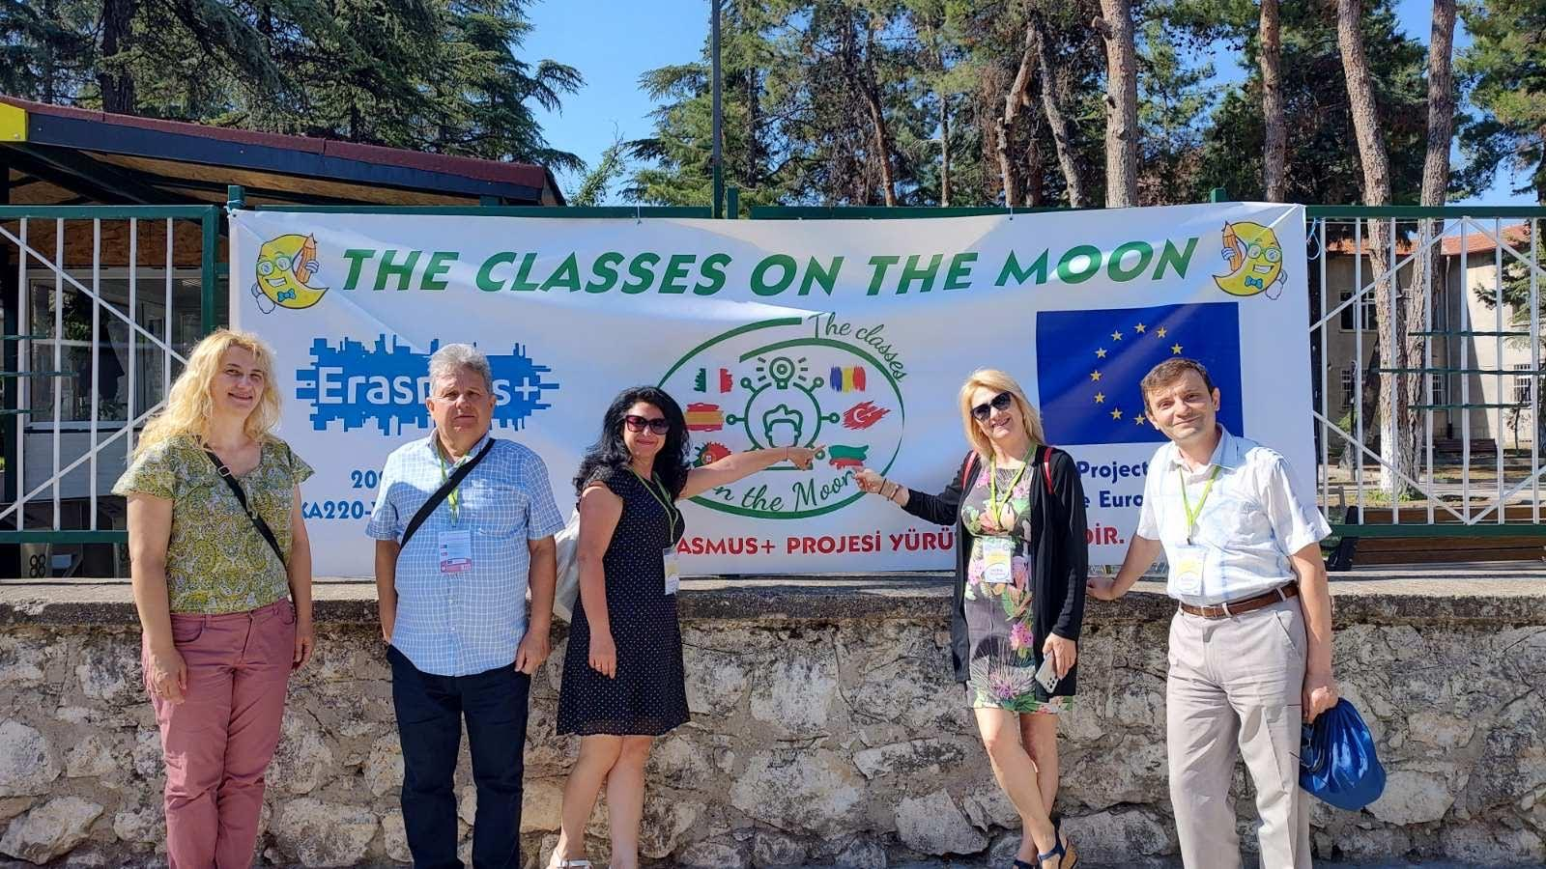
Burdur, TURKEY, 4-8.07.2022

Slide 9
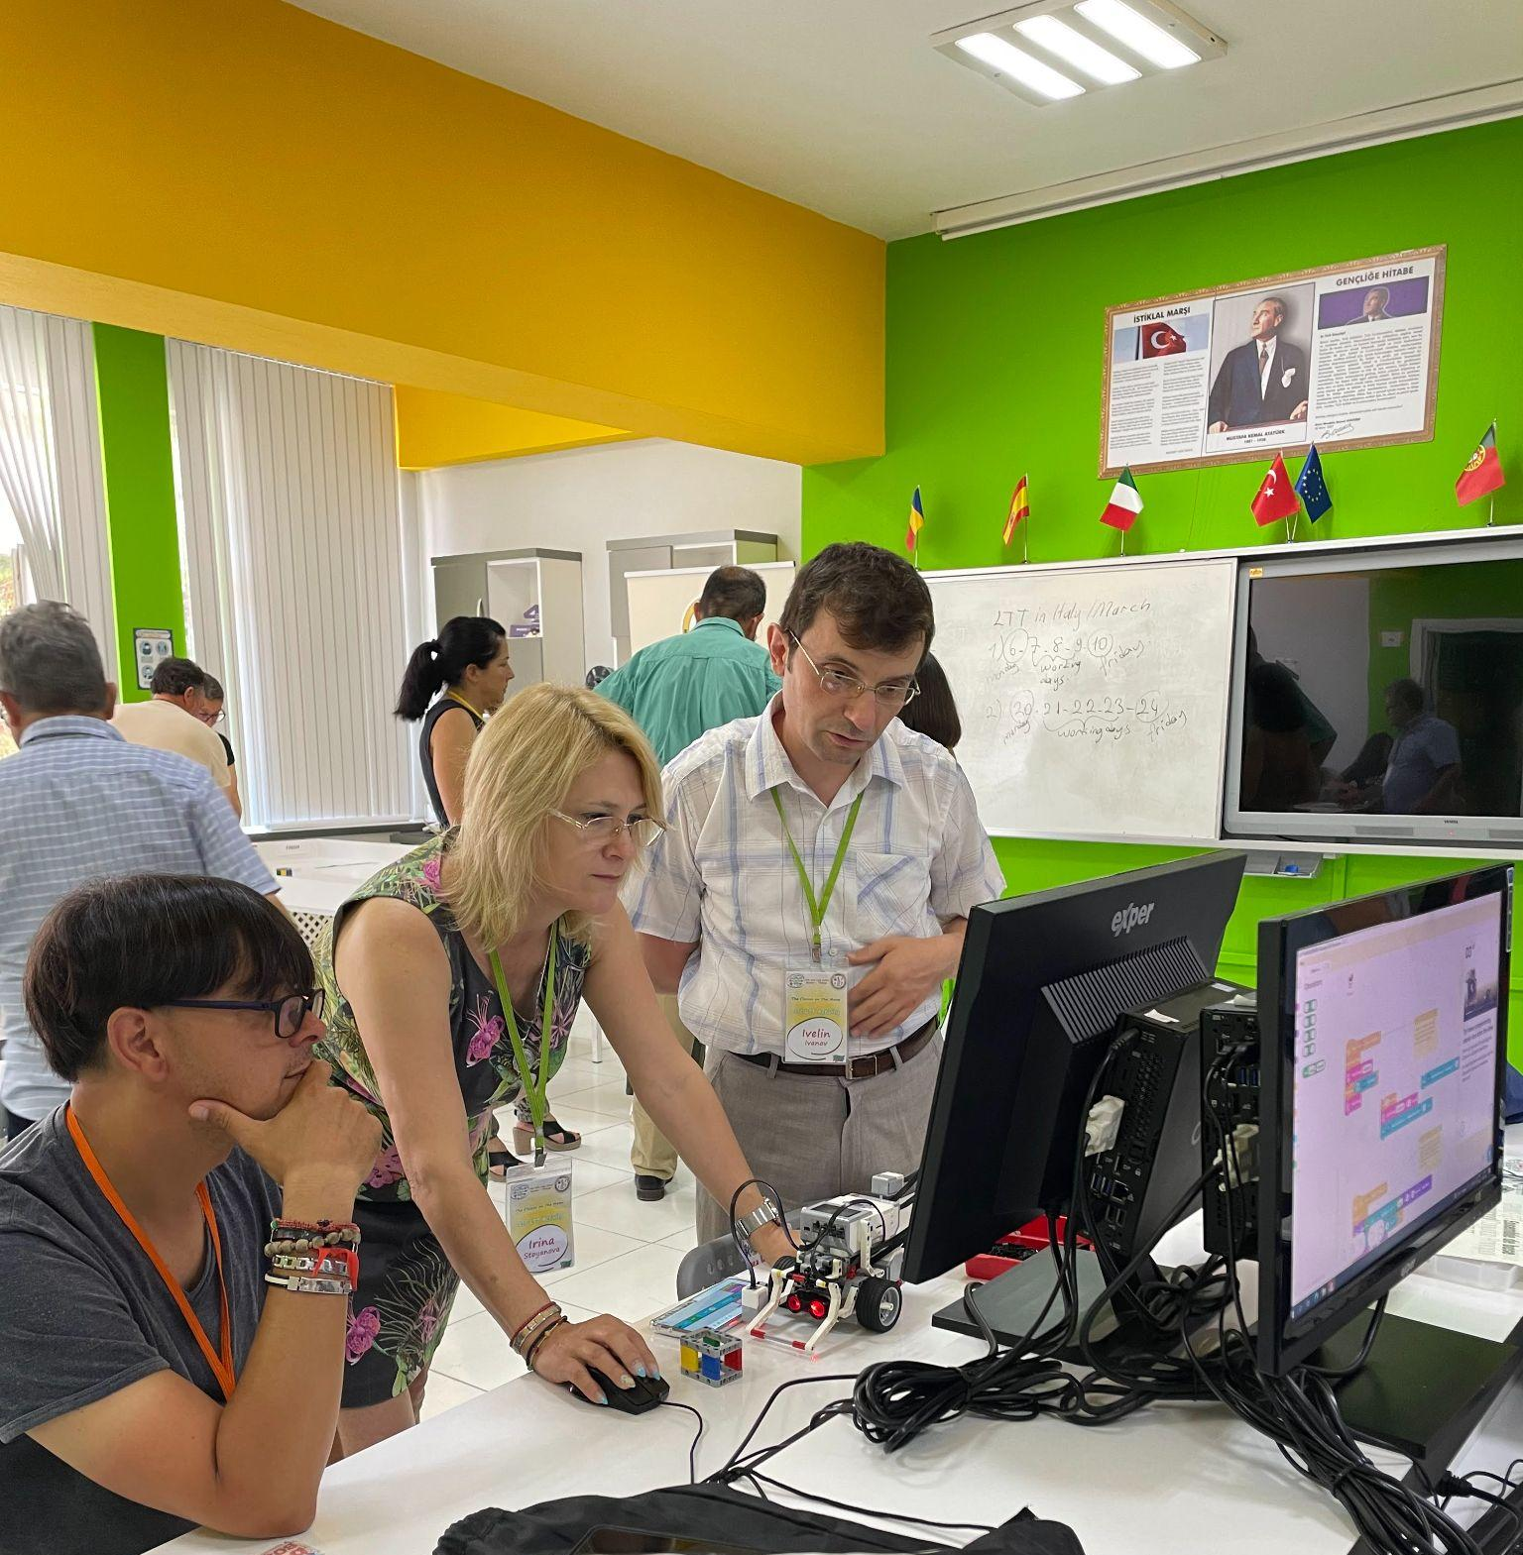
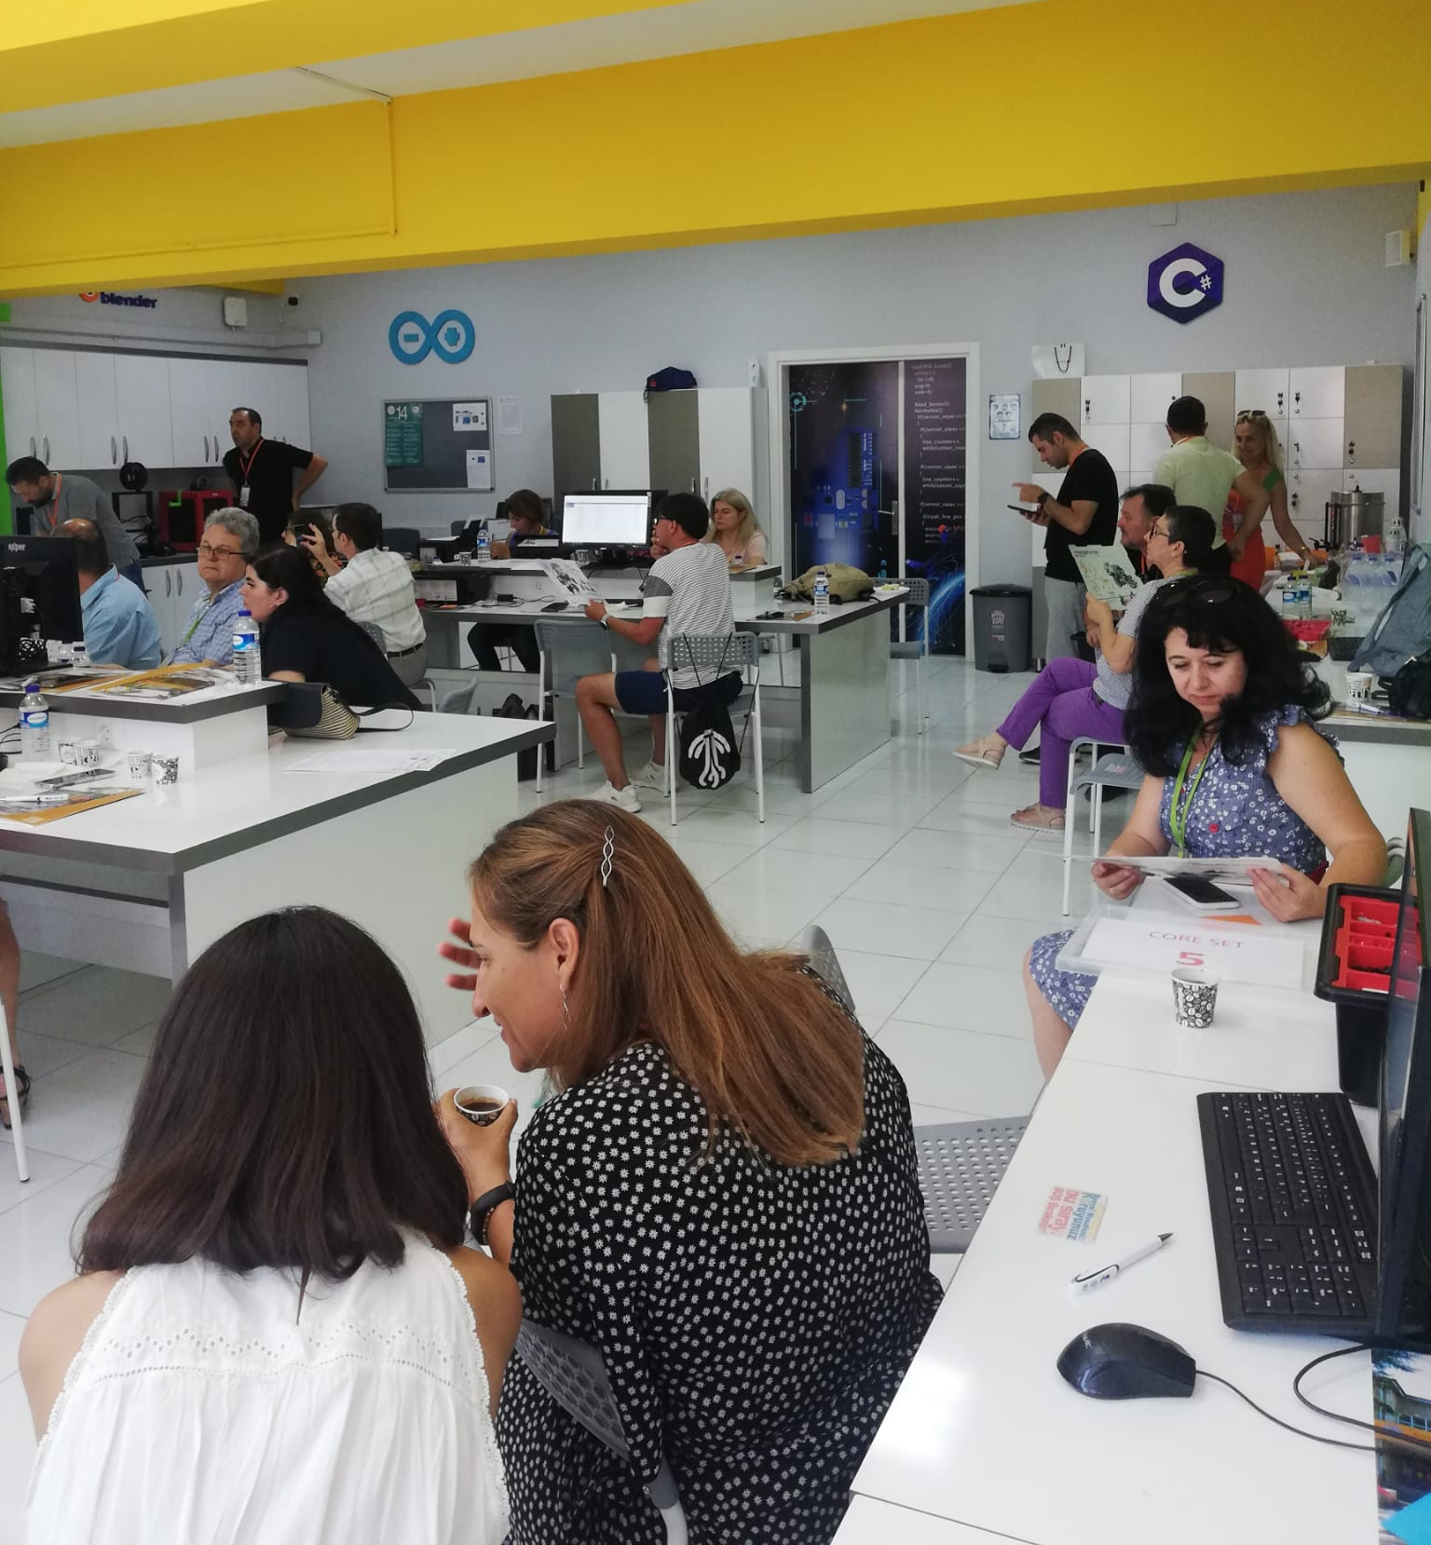
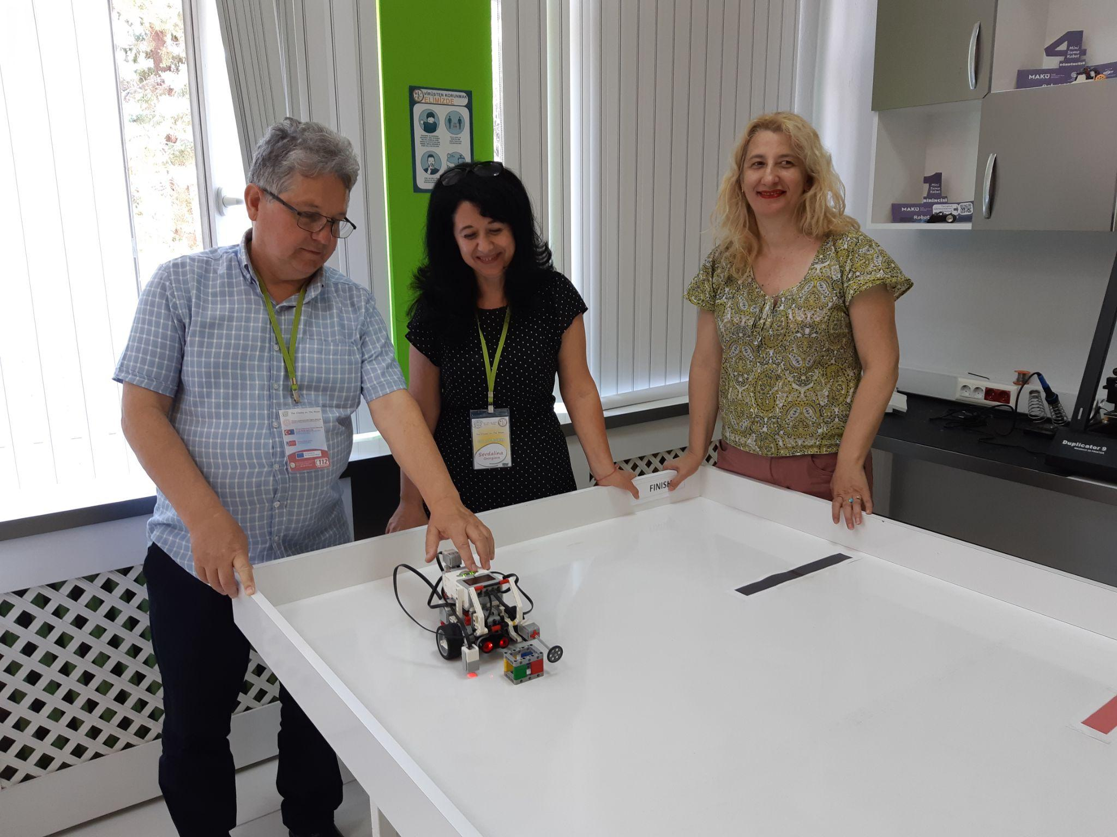
Science with Lego Robotics

Slide 10
Next…….
Web 2.0 Tools for Literature Literacy, ROMANIA
Methodological Experiences Gamification, ITALY
Adaptation to Sciences with Interactive White
Boards, PORTUGAL
Adaptation to Mathematics with "Scratch Programming Language“, BULGARIA

Slide 11

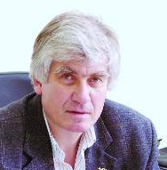
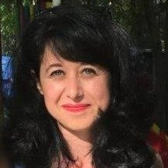
Pavlin Petkov
p.petkov.varna@gmail.com
Sevdalina Georgieva Ph.D.
sevdalina.m.georgieva@gmail.com

