Slide 1

Digital Solutions for Quality Education
"The quality of education in a digital
transformation and the specificity of generations", Varna 2022
Yanitsa Radkova Bakoeva
Stara Zagora Municipality
Stara Zagora, Bulgaria

Slide 2

Digital Education
Digital education focuses on interactive learning, which is provided by technology and hands-on instruction that helps build computer literacy and skills to use technology effectively.
Benefits:
Developing digital skills and competences from an early age
New approaches to teaching that awaken the interest of today's children
Facilitating administrative processes
Environmental focus
Strengthening the family-school bond
Easy access to information
Encouragement and willingness to seek new knowledge
Създаване на съдържание
Електронни учебници
Учене чрез правене
Хибридно обучение
Междудисциплинарно преподаване и обучение с помощта на облачно съдържание
Геймификация
Електронно обучение
Технологии в средата на обучение

Slide 3
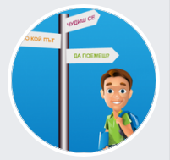
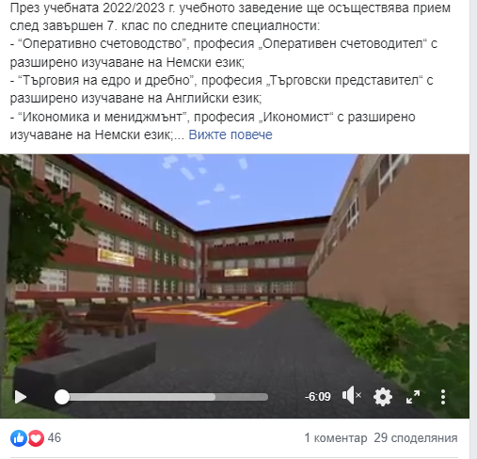
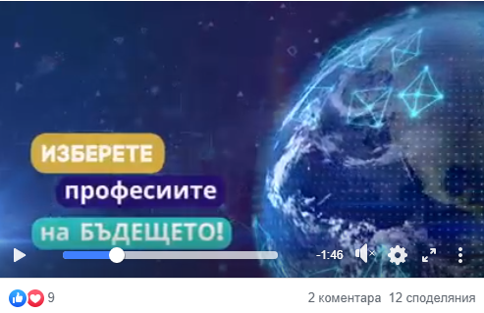


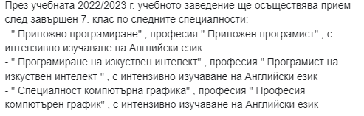

Virtual panorama of vocational education and career guidance

Slide 4
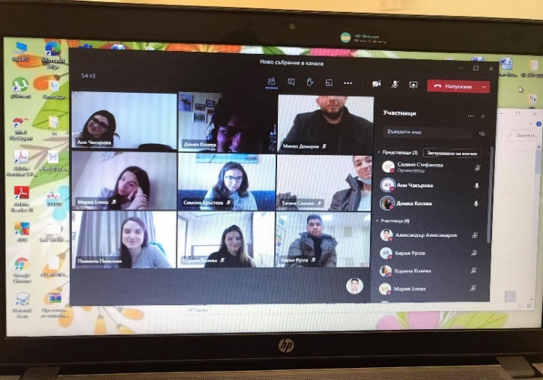

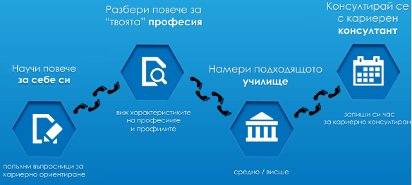
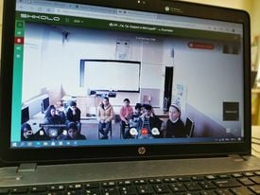
Career Guidance Centre
Career Guidance in school
Dynamic psychotraining "Increasing competitiveness and adaptation to the labour market"

Slide 5


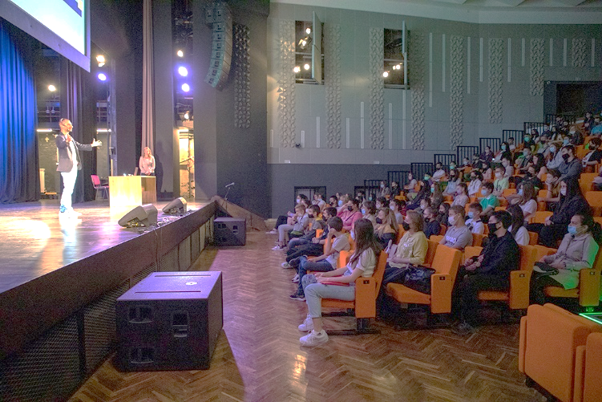


Events under the slogan "Let's keep the young people of Stara Zagora"
Visits of IT companies to schools
Information seminar "IT and YOU"
Coworking spaces
Building an IT community

Slide 6
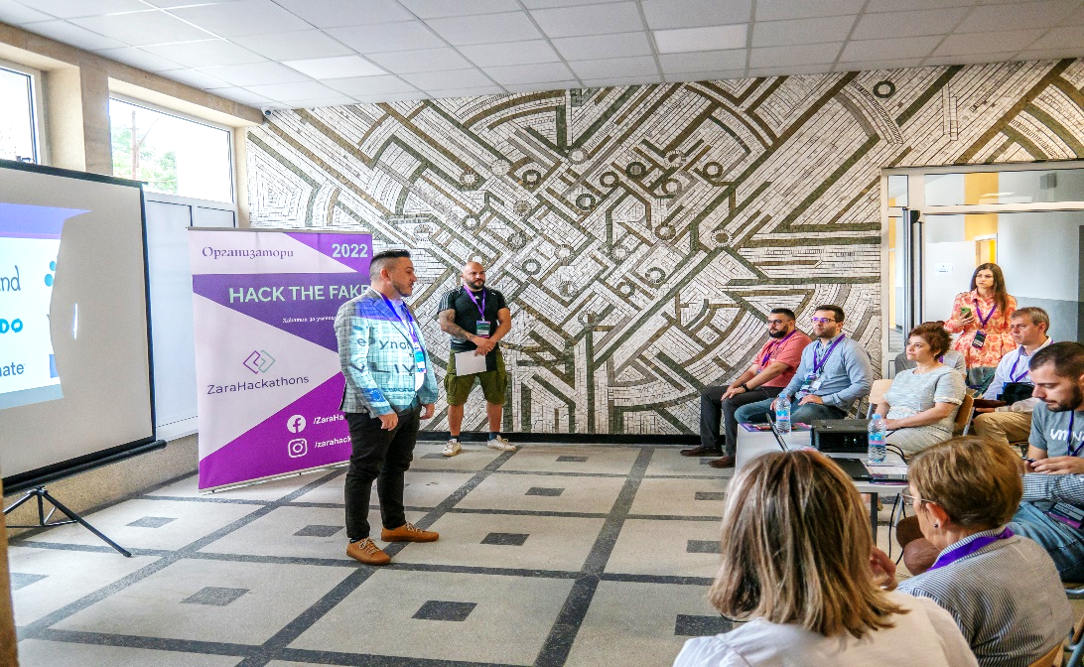

Hackathon
Python Workshop
Specifics of the programming language Python
Features of the basics of scripting languages
Competitive games in a dedicated platform
"Identifying fake social media profiles„
Creating an algorithm for a centralized verification solution
Team game with competitive nature

Slide 7


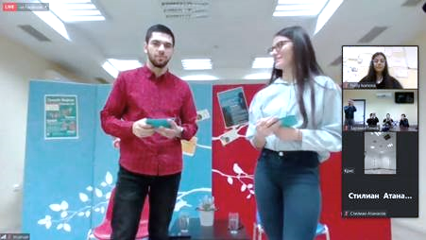


Informal Education
Digital resources
Unpopular digital instruments - menti, padlet и пр.
Standard platforms - ZOOM, Google meet, Bluejeans
Hybrid Environment Presentation Championship

Slide 8
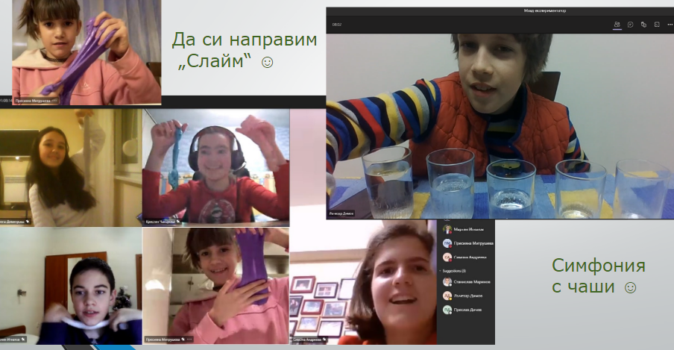
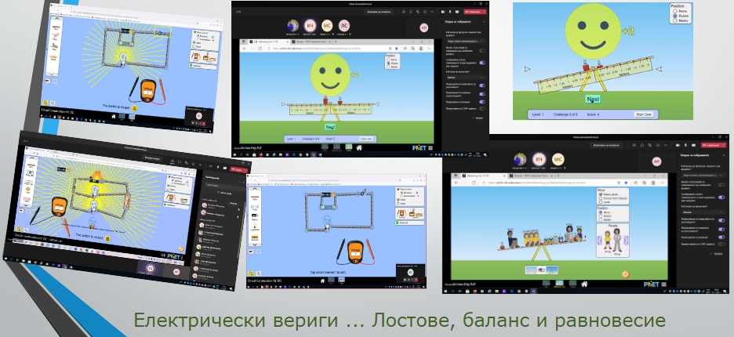
Informal Education
Trainings in a digital environment
Learning by doing - hands-on experiences

Slide 9
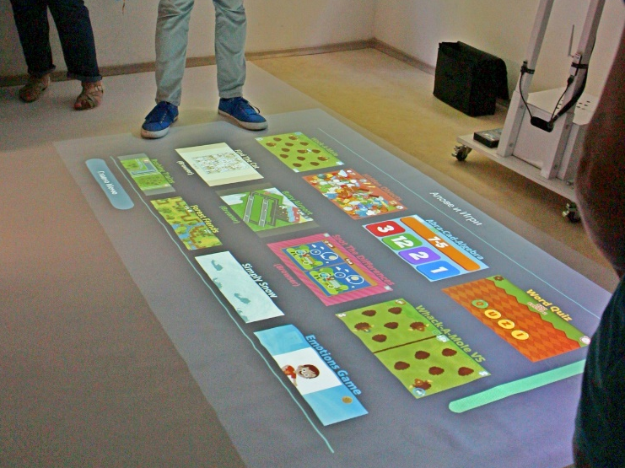
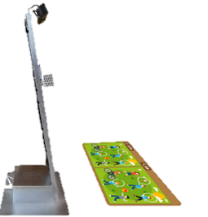
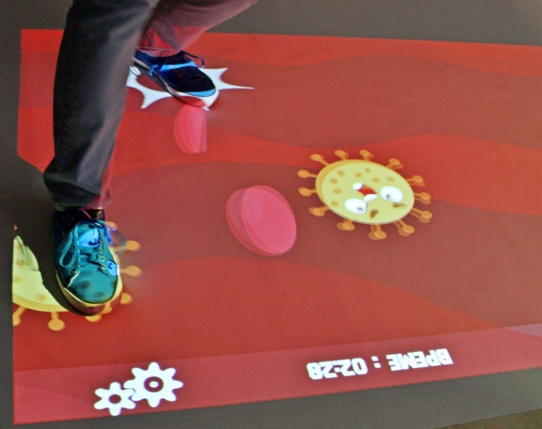
Interactive magic floor
Modular interactive platform based on the educational trend STEM
Games with different educational content - mathematics, biology, geography, physics, chemistry
Suitable for children with special educational needs
Implementation in kindergartens, schools, libraries and in various educational and commercial centers

Slide 10
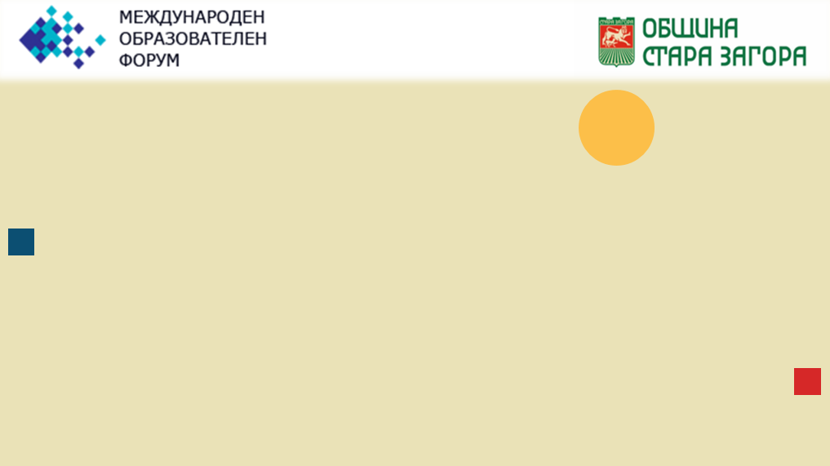




Telerik Academy
Quality and contemporary training
Transformation from consumers into technology creators
Preparation for the professions of the future
Development of logical thinking and creativity
Development of talents from an early age
Nurturing the growth and development of local companies
A modern learning program for the children of the region
Opportunity to settle and grow in your hometown
Programs:
Algorithmic programming - 4th-7th grade
Game Development - 4th-7th grade
Web Programming - 8th-12th grade

Slide 11



In Stara Zagora Municipality we work for quality
education and digitalization
Opening of a new vocational school of computer science and mathematical
analysis
Organization of free trainings for students
Opening a professional field with IT specialties at the Trakia University
Strengthening the school-university-IT business relation
Attracting new high-tech companies to support education

Slide 12

THANK YOU FOR THE ATTENTION!

