Slide 1
Learner-focused digitalization
– Examples from Finland for flexible, continuous learning
INTERNATIONAL EDUCATIONAL FORUM, VARNA 2022
DR. Sanna-Mari Renfors, Satakunta university of applied sciences, finland, pori
Notes:
Kansidia. KÄYTETÄÄN AINOASTAAN KERRAN, ESITYKSEN ALUSSA.

Slide 2
In 2030, Finland is a model country for flexible learning
There is a need for continuous learning and for raising the level of knowledge, competence and skills in the different levels of education and age groups.
Thus, Finland will restructure its higher education over the next decade by means of digitalization.
This Digivisio 2030 is an ambitious and long-term programme (44 million €), where all Finnish higher education institutions (n=38) are building a future of learning together.
It is aimed at renewing Finnish higher education to bring greater opportunities for all learners to learn flexibly.
Within the project, the joint operating models of higher education institutions are developed and a shared digital platform for services will be built.
Notes:
PERUSDIAMALLI. Lisää asettelumalleja saat napsauttamalla ”Asettelu”.

Slide 3
The Digivisio 2030 benefits the society as a whole
The higher education system will be developed as a platform for learners and continuous learning. The aim is that degree students, lifelong learners and those without a student place can study flexibly, selecting courses from all Finnish higher education institutions irrespective of organisational boundaries and geographical location.
  This shifts the focus from an organization to a learner – learning independent of time and place
It is an open, recognized learning ecosystem based on digital services, the joint study offering of higher education institutions and interaction with companies and society.
https://digivisio2030.fi/en

Slide 4
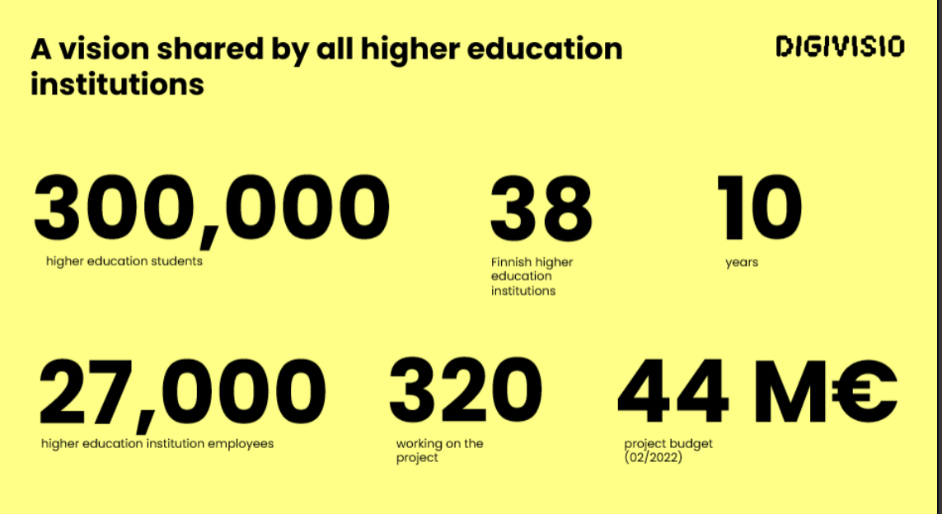
Learners & HEIs
In the new service, learners can:
  view and compare HEI’ education offering that does not lead to a degree
  find education offering that meets their situation, schedule and competence needs
The new service enables HEIs to:
  achieve a wider and more diverse learner base
  develop a more versatile offering that can respond to the different motivations and interests of continuous learners

Slide 5
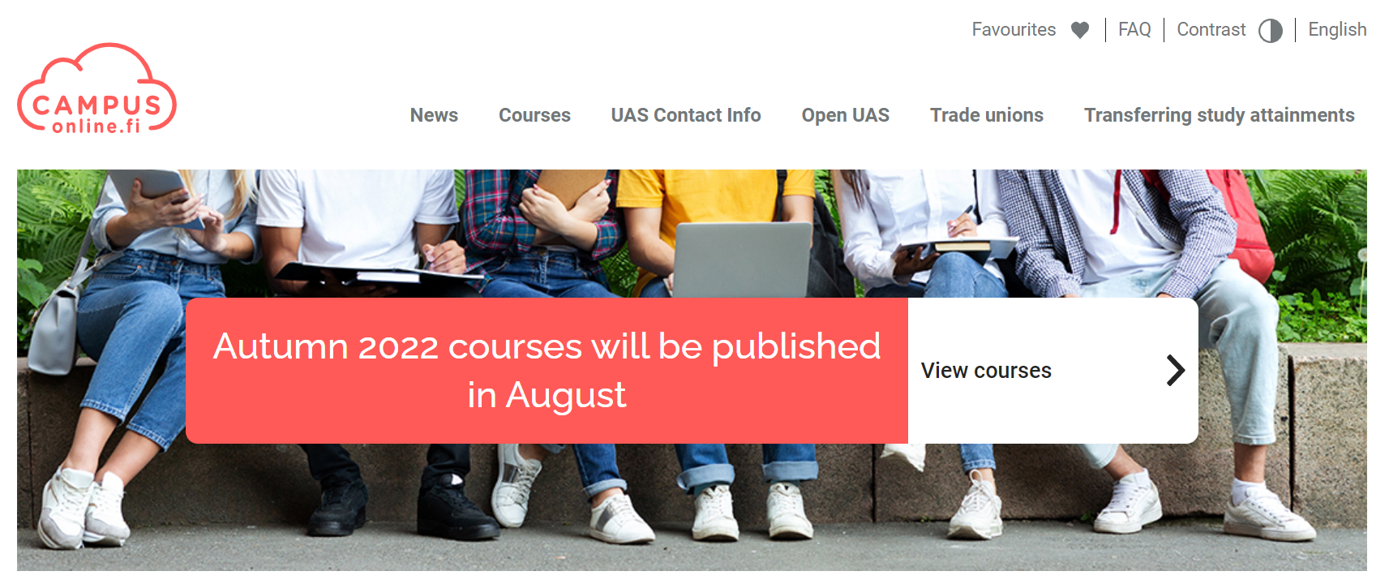
Campusonline.fi
Currently, another solution Campusonline.fi already offers the selection of online courses by 23 Finnish universities of applied sciences.
Degree students can select courses from another university of applied sciences free of charge and include these studies in their degree.
CampusOnline.fi makes it possible to study courses 100% online regardless of time and place – wherever best suits to the student.

Slide 6
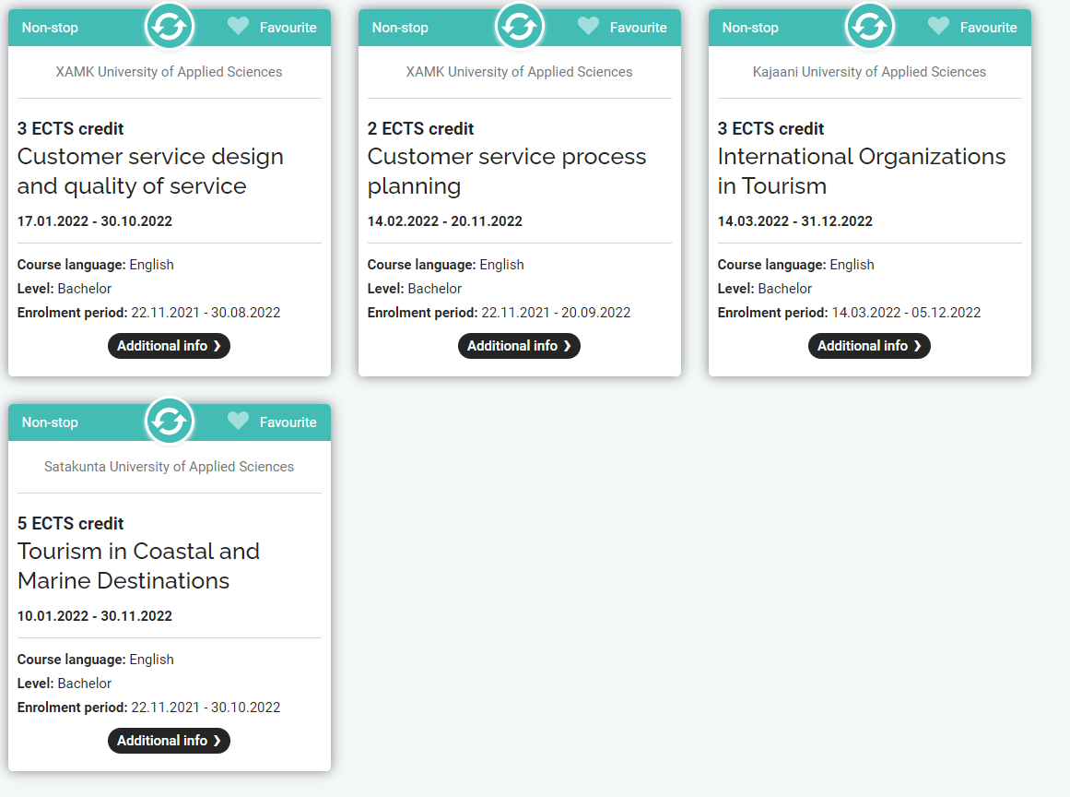
An example of non-stop tourism courses taught in English in Campusonline.fi

Slide 7
Approaches at SAMK

Slide 8
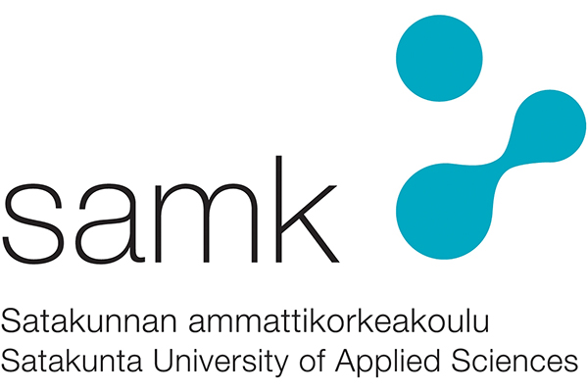
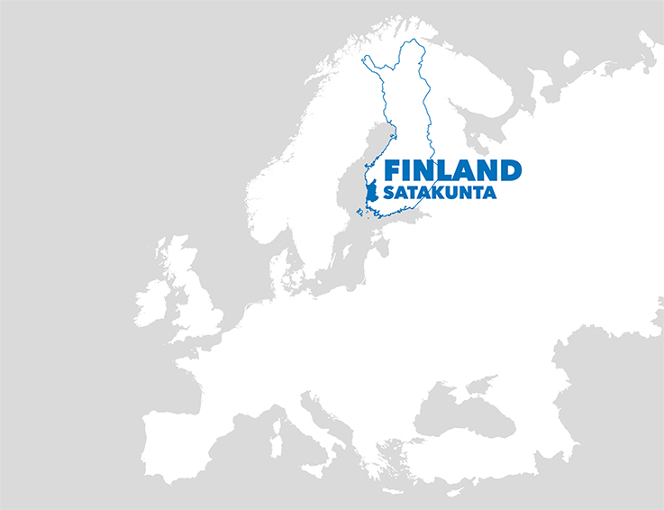
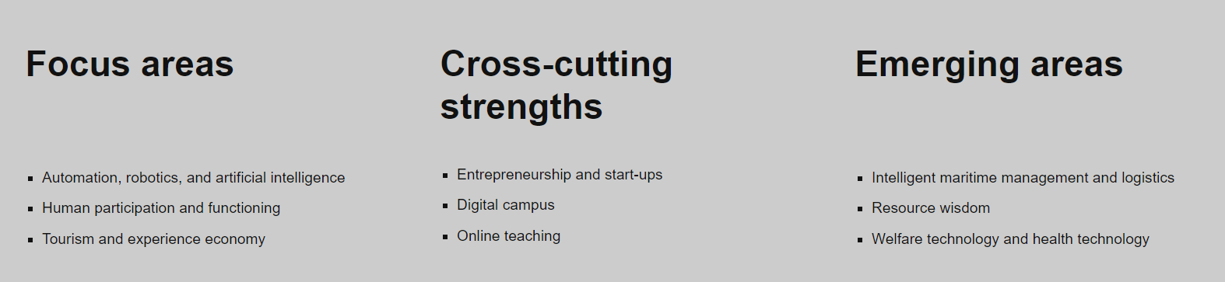
SAMK in figures (2021)
Staff 459, 4 campuses
Degree programmes 44, of which in English 14
Degree students 6 414

Slide 9
What continous learning means at SAMK?
Due to the flexible online studies, non-degree programme students can study at SAMK.
In 2021, 32 800 ECTS credits were studied as Open Studies (Open UAS) by people interested in developing their professional abilities (non-degree students). All together, more than 4 000 persons received higher education without enrolling themselves as degree students.
A prerequisite is productisation of HE as educational products suitable for different needs of learners.

Slide 10
Digital Campus
One of SAMK’s campuses is a Digital Campus focusing on adult learners who combine working with studying. It responds to the changing needs of the learners considered as customers.
Adult learners can study degree programme in business and administration 100% online.
This is accomplished by changing the pedagogy and creating new spaces for collaborative, interactive online learning.

Slide 11
Interaction in online studies
WebExHILL
EduHILL
Training Center
+ Moodle platform
Space for dividing students for group working
Web conference programme for online lecturing
The studies include real-time interaction in many forms.
Students’ private online rooms for group working
Korhonen & Kuohukoski, 2019

