Slide 1
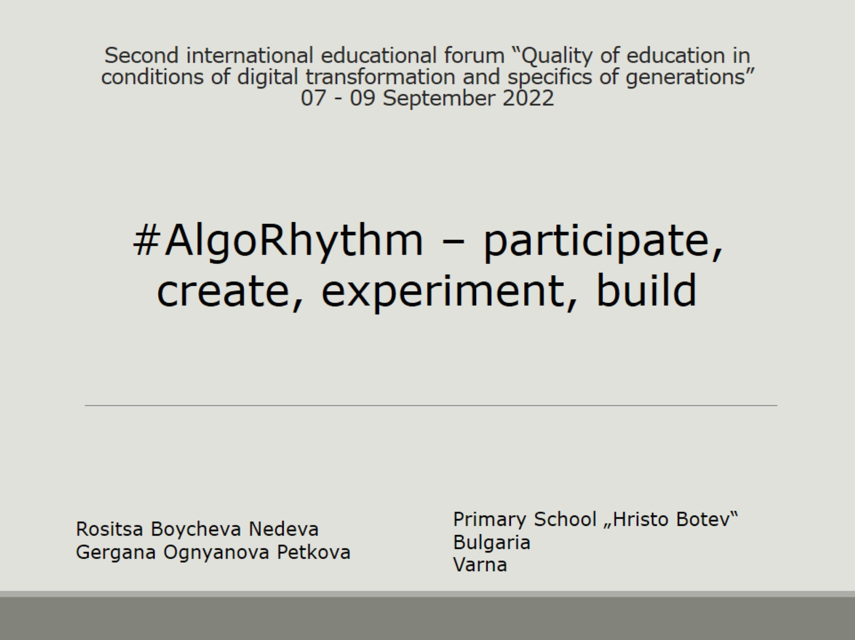
Second international educational forum “Quality of education in conditions of digital transformation and specifics of generations”
07 - 09 September 2022

Slide 2
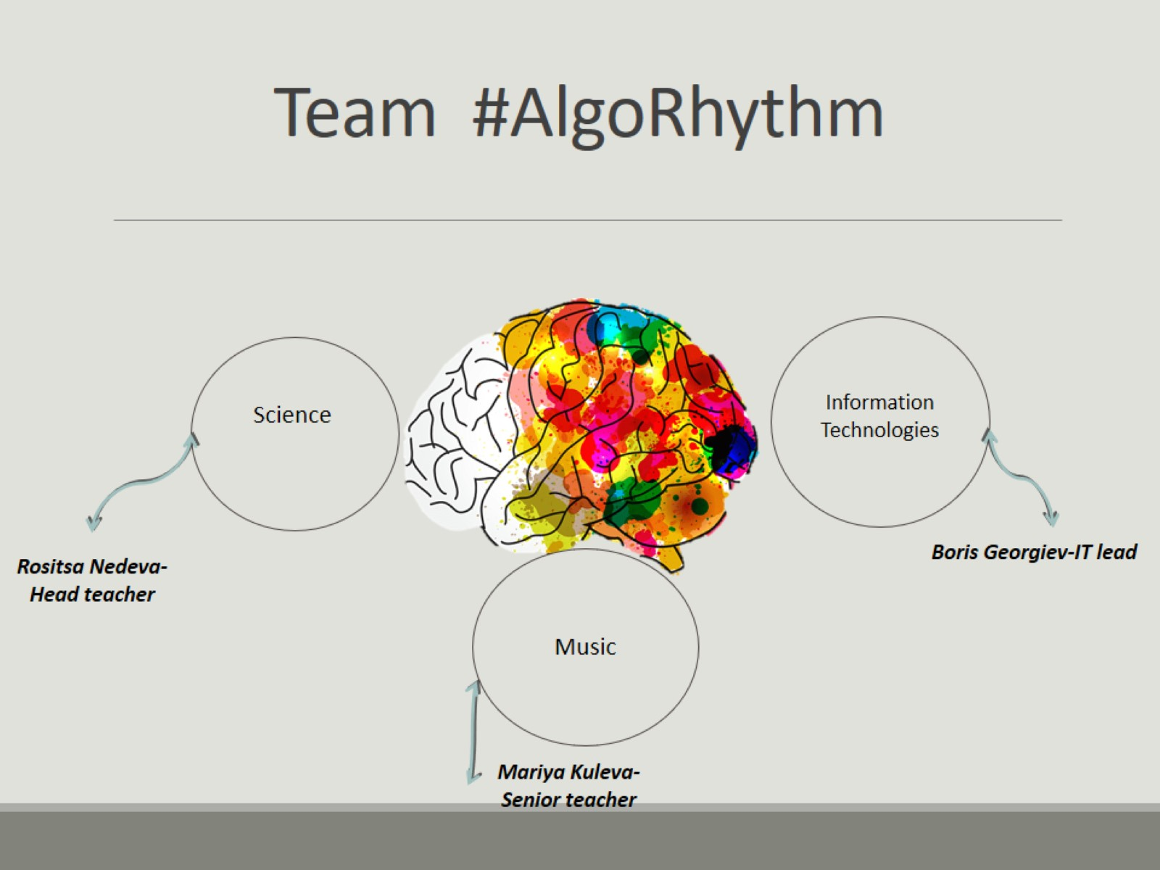
Team #AlgoRhythm

Slide 3
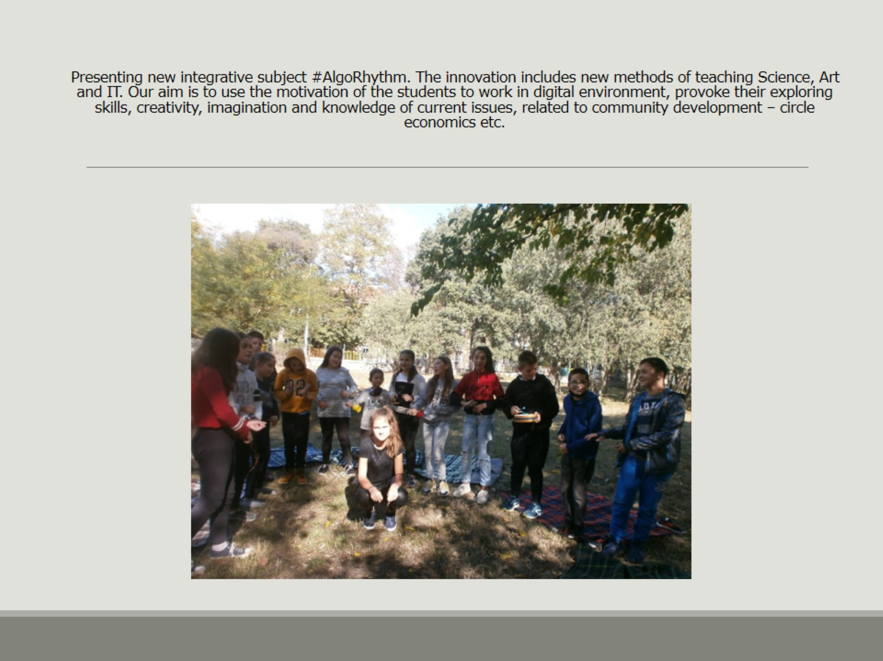
Presenting new integrative subject #AlgoRhythm. The innovation includes new methods of teaching Science, Art and IT. Our aim is to use the motivation of the students to work in digital environment, provoke their exploring skills, creativity, imagination and knowledge of current issues, related to community development – circle economics etc.

Slide 4
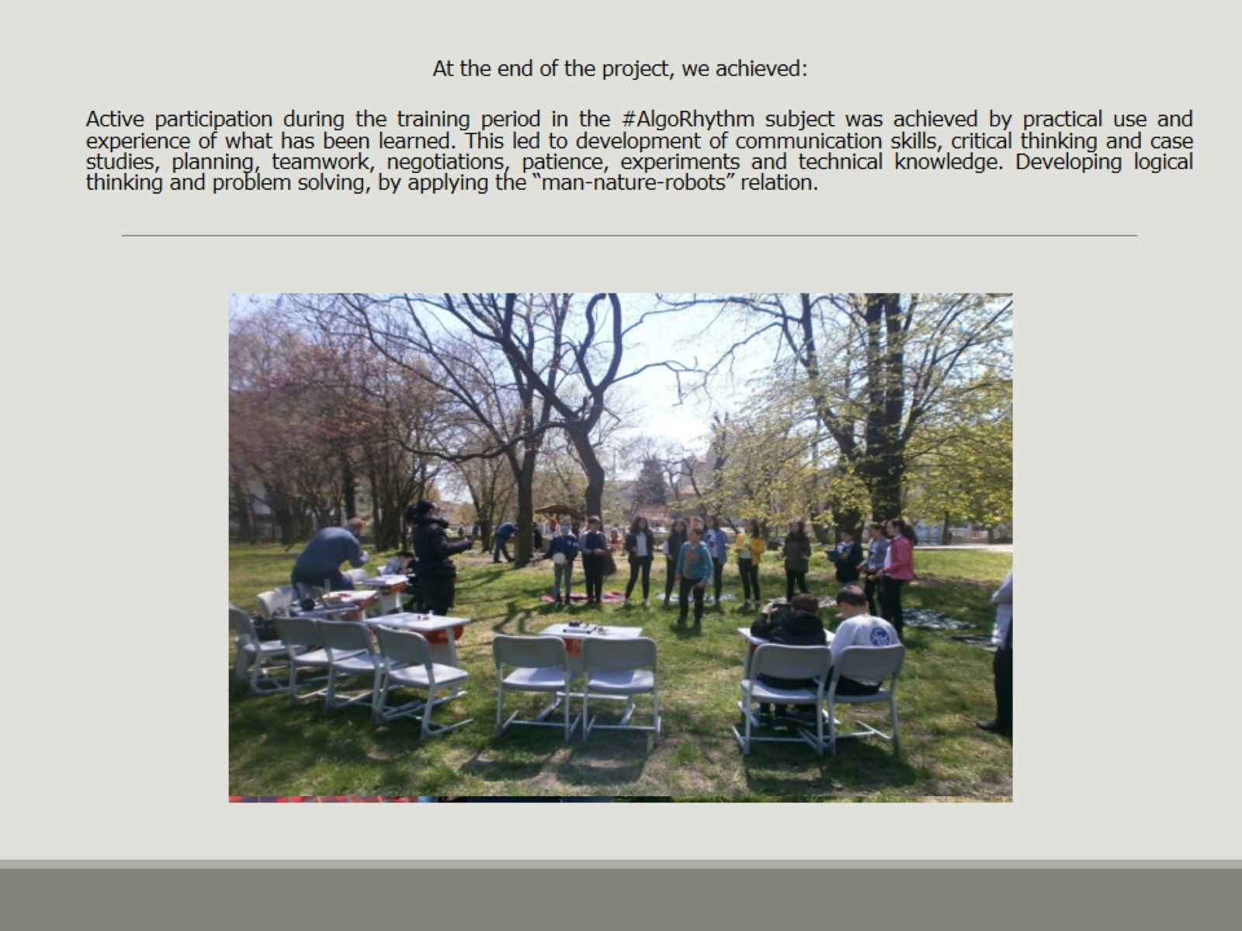

Slide 5
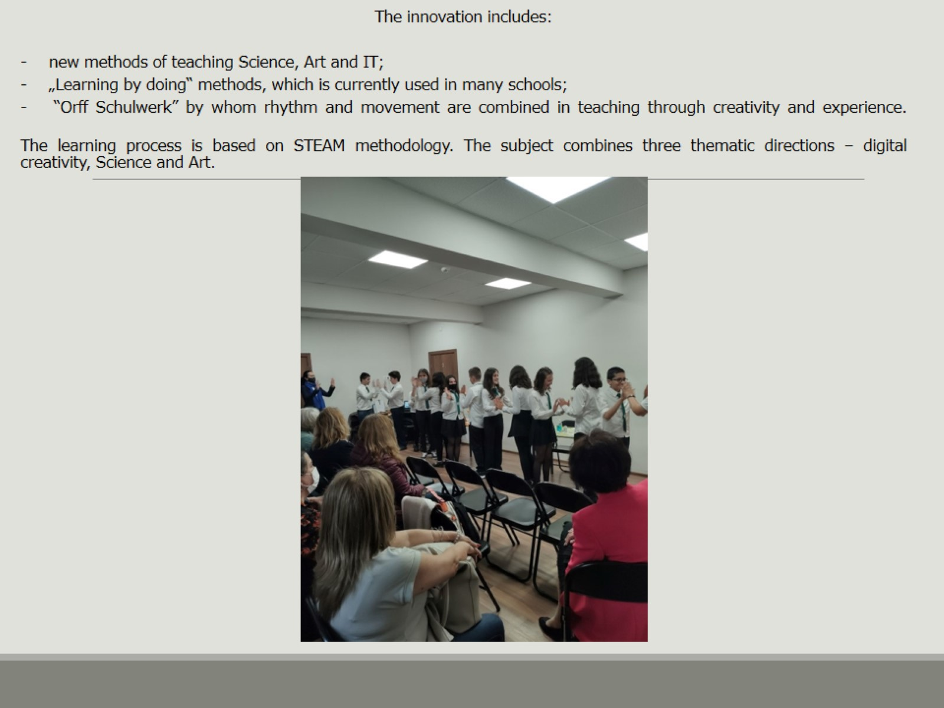

Slide 6
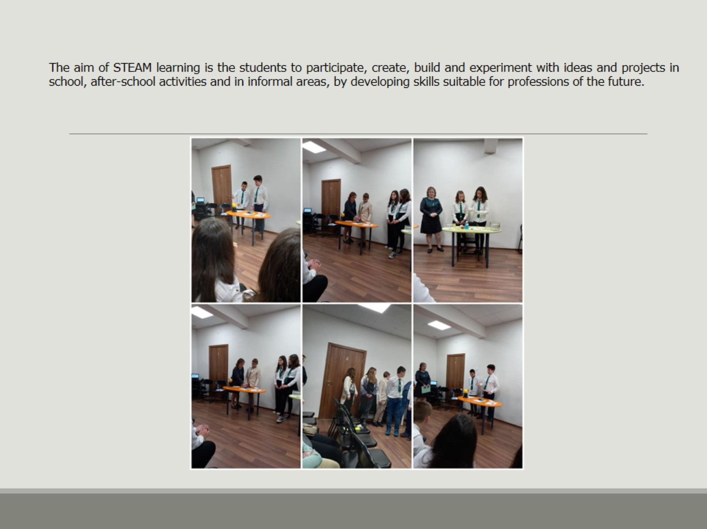

Slide 7
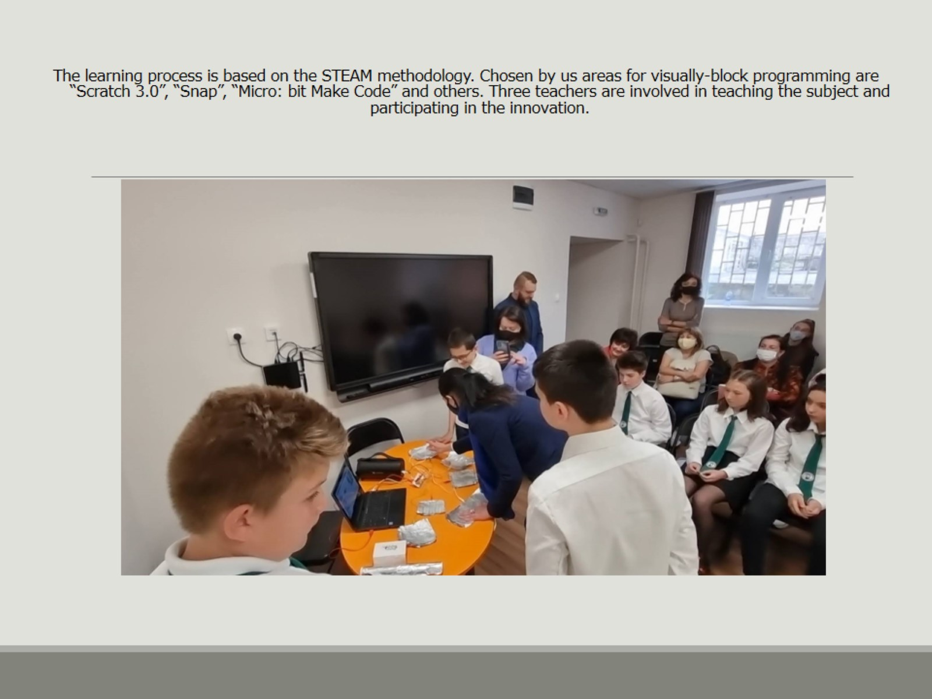

Slide 8
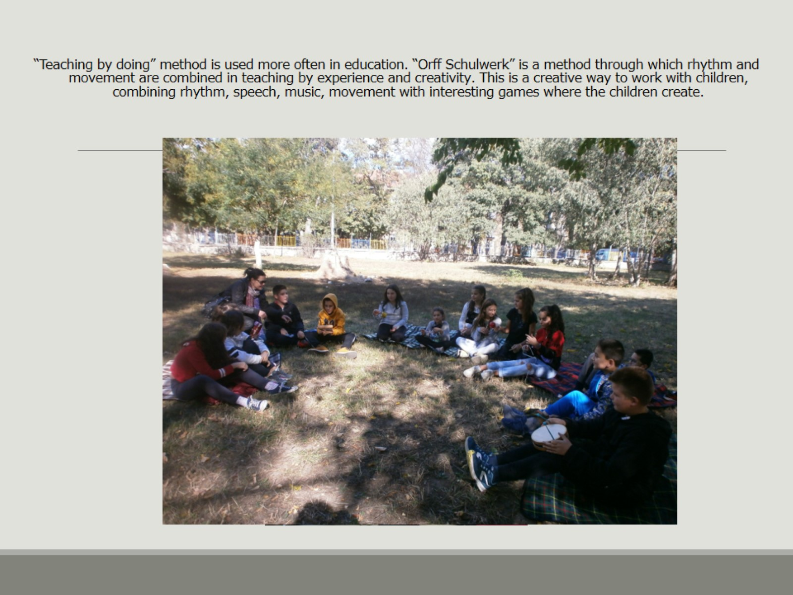

Slide 9
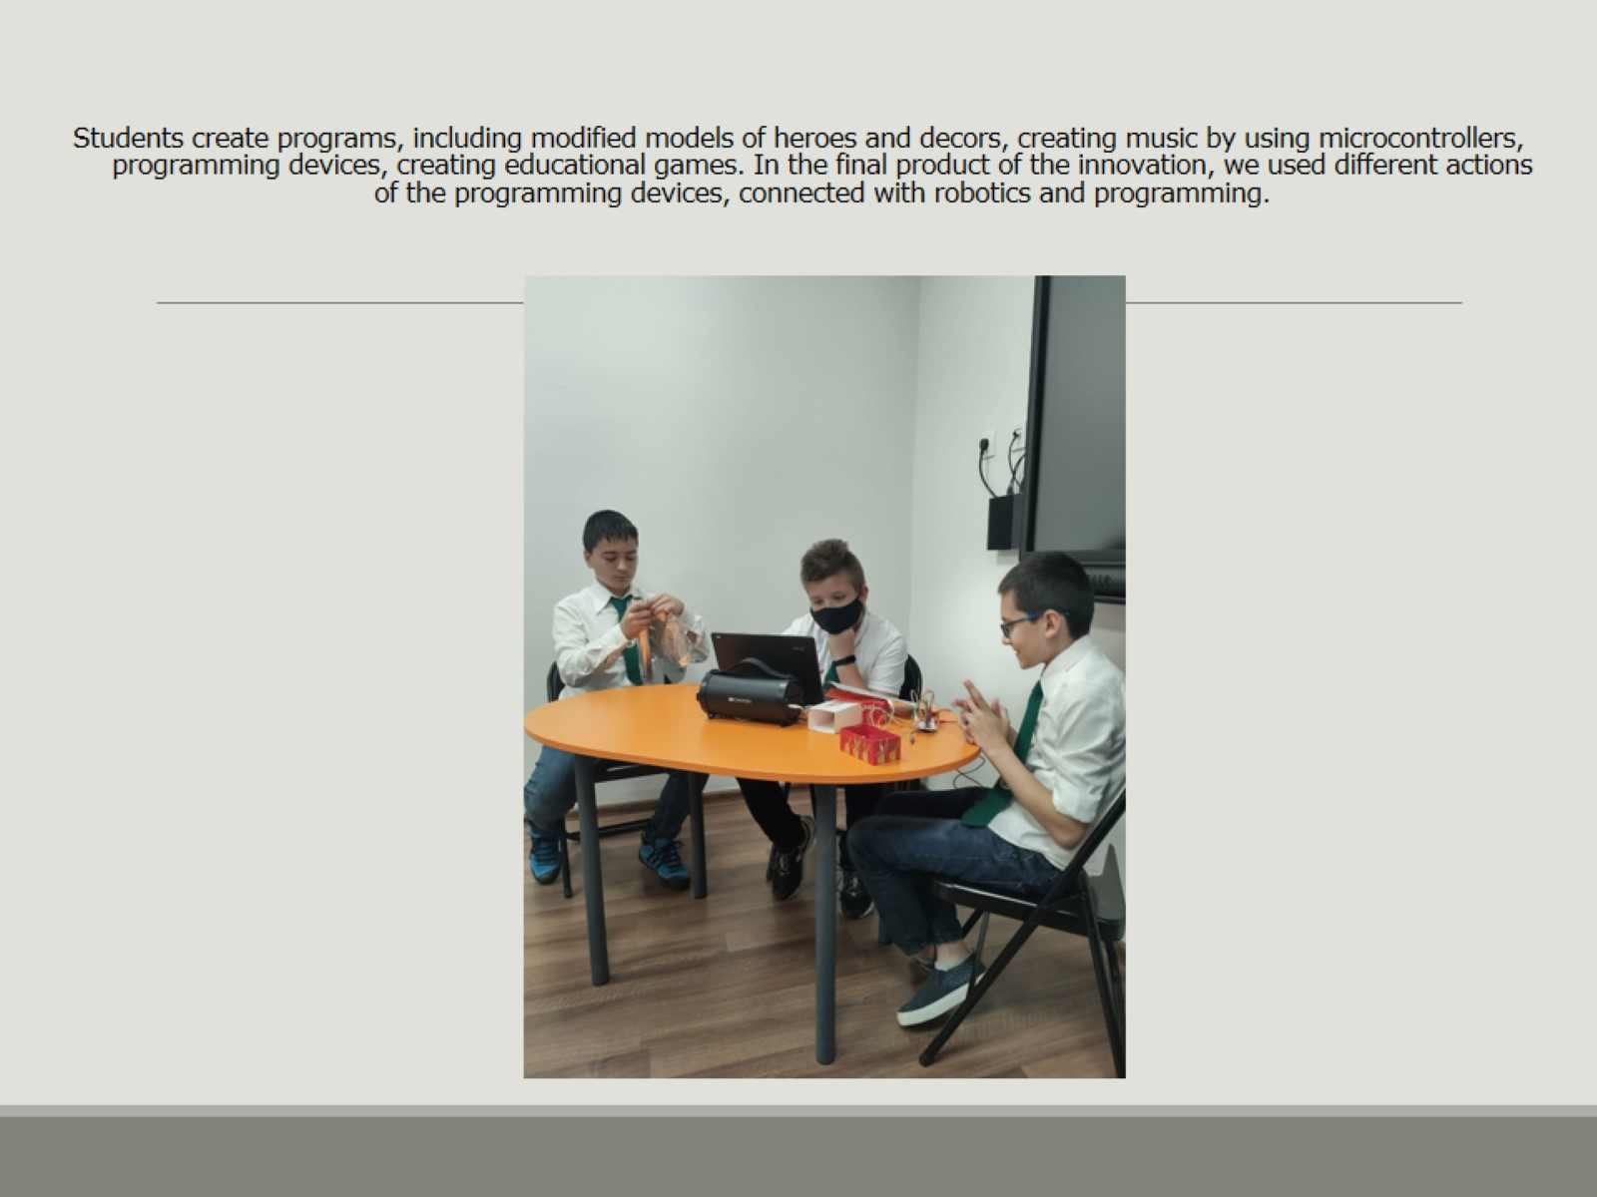

Slide 10
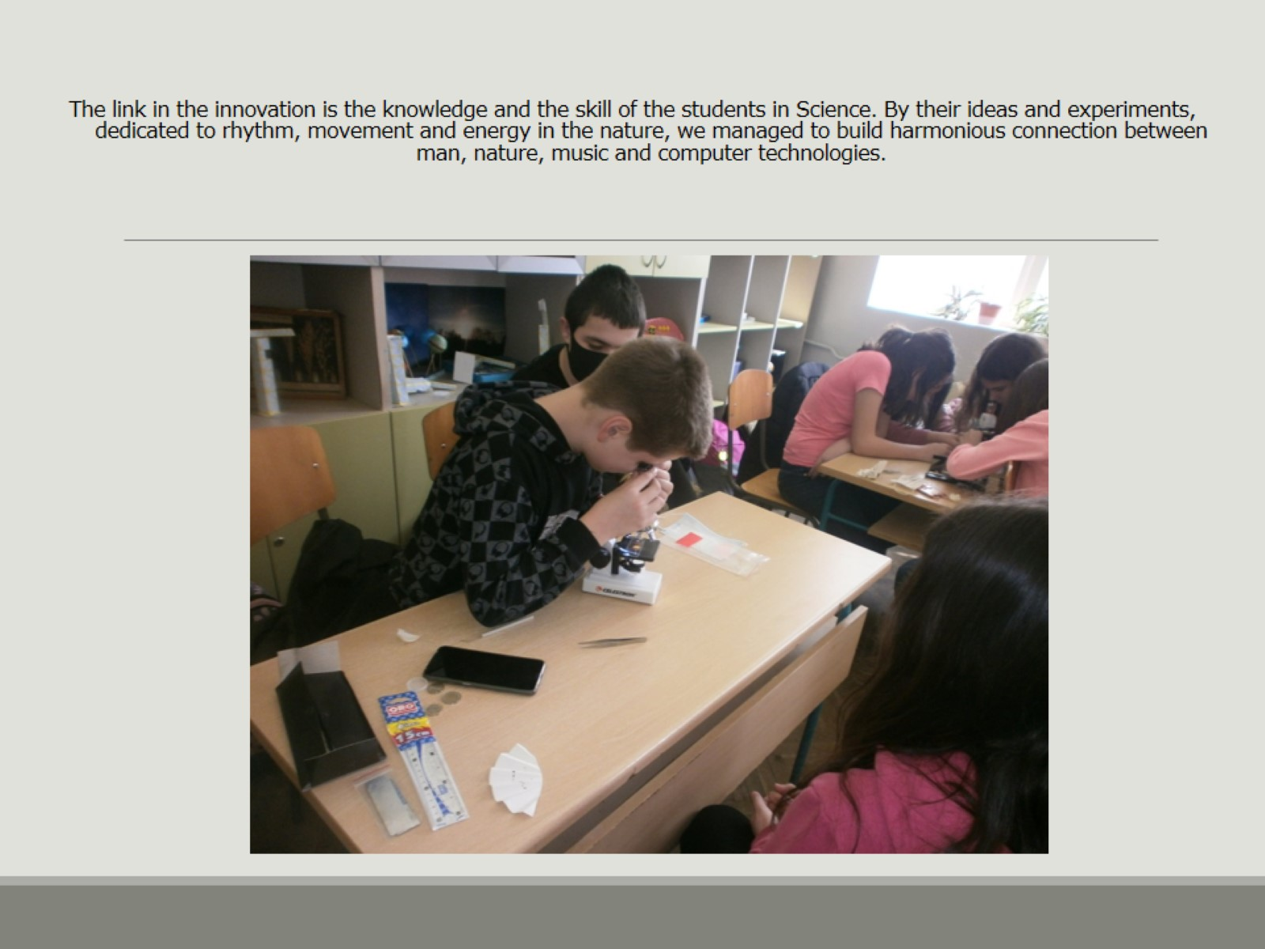

Slide 11
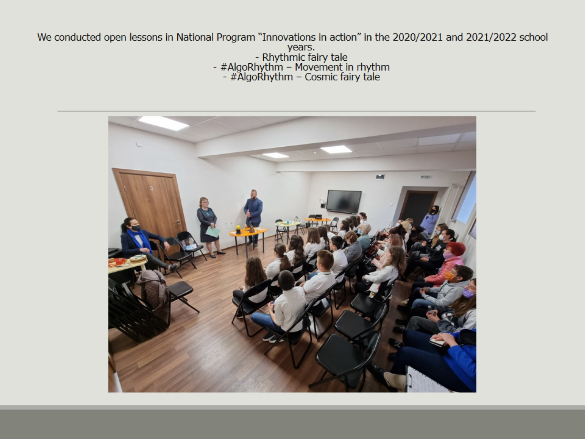

Slide 12
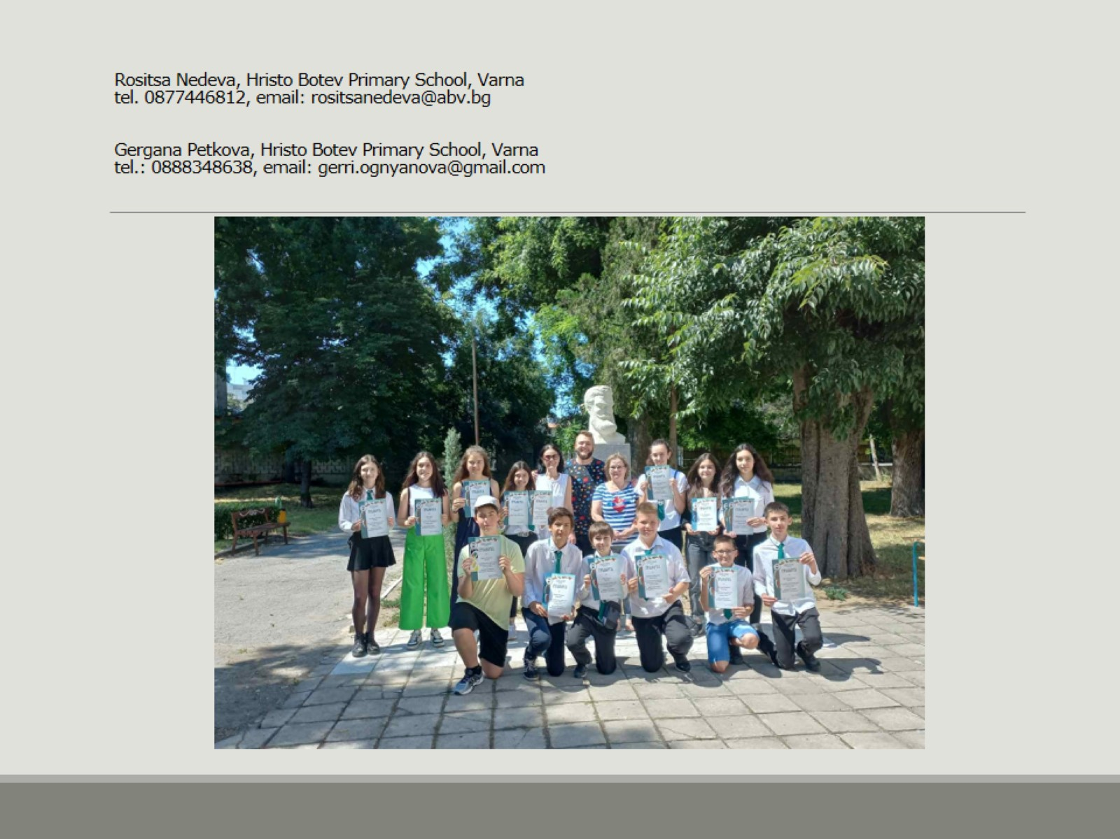
Rositsa Nedeva, Hristo Botev Primary School, Varna tel. 0877446812, email: rositsanedeva@abv.bg
Gergana Petkova, Hristo Botev Primary School, Varna tel.: 0888348638, email: gerri.ognyanova@gmail.com

