Slide 1


THE QUALITY OF EDUCATION IN THE CONDITIONS OF DIGITAL TRANSFORMATION AND THE SPECIFICITY OF GENERATIONS
digital children
digital kindergarten
Petya Hristova Kopanova
Stanimira Todorova todorova
Kindergarten №20 „mir“
Stara zagora /Bulgaria

Slide 2
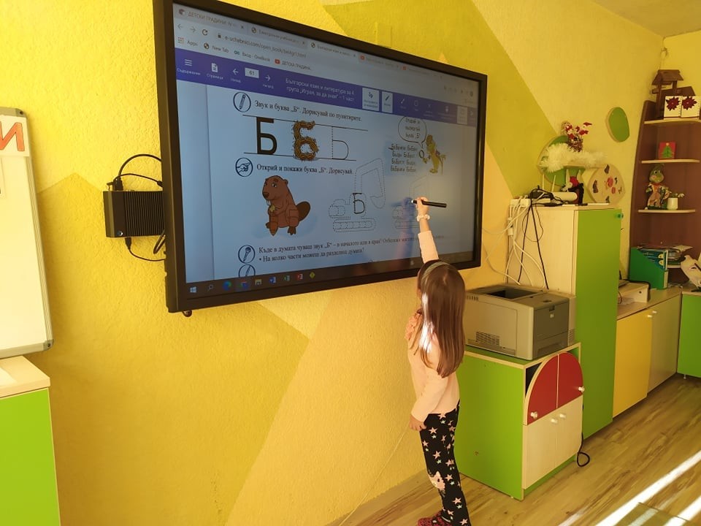
„digital children “
"Digital children" do not know the world before technology.
They learn how to use the computer, but they do not know the world around them without it.
These are the children who replaced the games in front of the apartment building with online games on the net.
Children who have the privilege of experiencing a digital childhood.
This is an evolution starting from an early age that the adults can not follow, because their connection with technology started later in their lives .

Slide 3
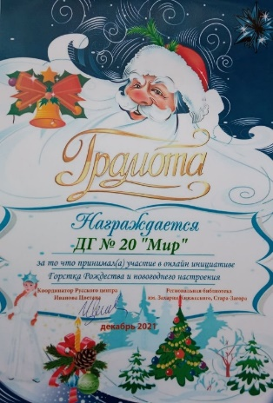
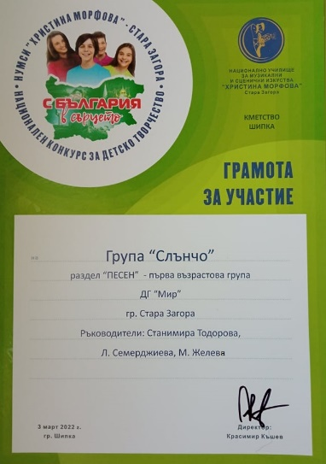
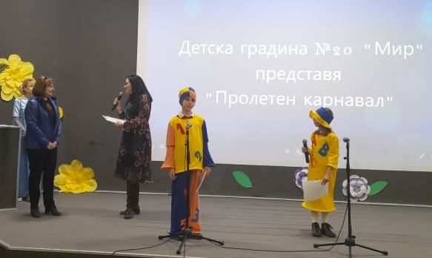
„DIGITAL KINDERGARTEN“
WE USE INNOVATIVE TECHNOLOGIES IN PRESCHOOL EDUCATION PRIMARILY TO MEET THE GROWING DEMANDS AND LIMITATIONS OF THE MODERN WORLD.
PARTICIPATION OF CHILDREN IN ONLINE COMPETITIONS, DUE TO THE PANDEMIC SITUATION
PARTICIPATION IN AN ONLINE COMPETITION – E-BOOK

Slide 4
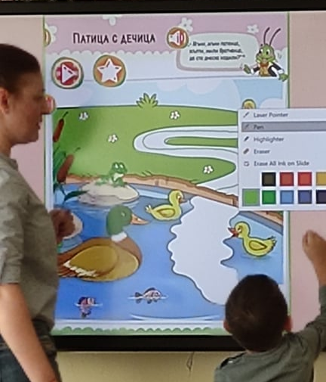

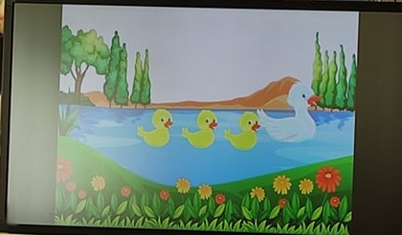
„digital children “
IN ORDER TO MEET THE INTERESTS OF "DIGITAL CHILDREN", TO MAKE THE EDUCATIONAL PROCESS IN KINDERGARTEN MORE DYNAMIC AND THE INFORMATION MORE MEMORABLE, WE CREATED MANY ANIMATED PRESENTATIONS;
WE USE VARIOUS INTERACTIVE TOOLS
DIGITAL MUSIC:

Slide 5
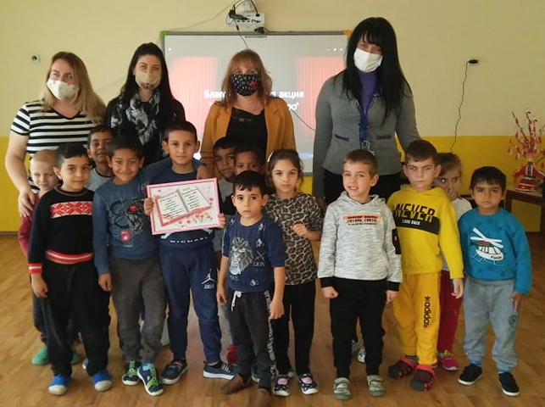
„digital kindergarten“
TO COMMUNICATE WITH YOUR FRIENDS FROM OTHER KINDERGARTENS IN STARA ZAGORA ONLINE.
IN 2021, FOR THE THIRD CONSECUTIVE YEAR, DG №20 "MIR" AND DG №16 “GORSKI KUT" - STARA ZAGORA BATHS CELEBRATED THE DAY OF THE CHRISTIAN FAMILY.
CHARITY EVENT 2020
CHARITY EVENT 2021:

Slide 6
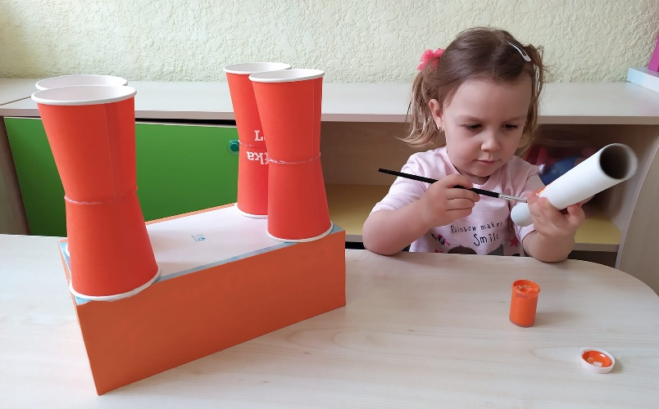
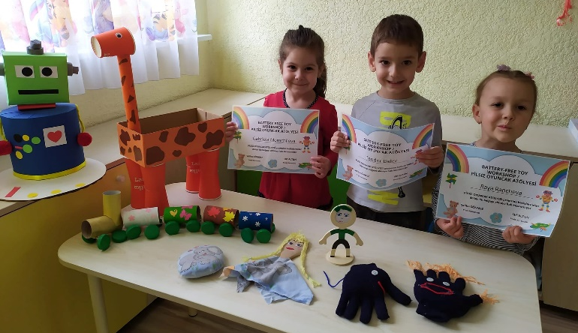
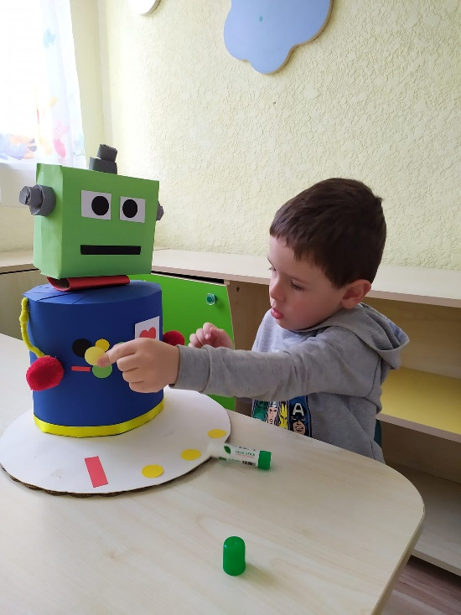
„digital kindergarten“
To communicate with their friends from Turkey and Albania through the e-Twinning projects "Will you dance with me?" and "Toys without batteries"
E-BOOK “Toys without batteries"

Slide 7
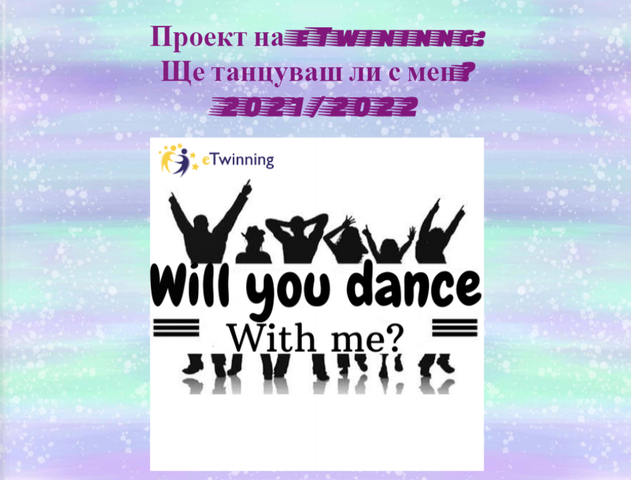
„digital kindergarten“
PROJECT “WILL YOU DANCE WITH ME?" - 2021/2022

Slide 8

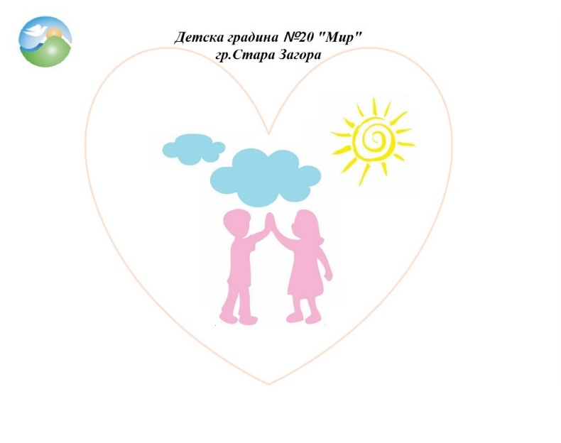
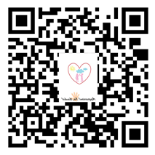
„digital kindergarten“
TO COMMUNICATE WITH THEIR FRIENDS FROM ROMANIA, THE REPUBLIC OF NORTHERN MACEDONIA, TURKEY AND ITALY THROUGH THE ERASMUS + PROJECT "AGGRESSION! NO THANKS!"
E-BOOK: “AGGRESSION GAMES"
PROJECT ERASMUS+ - "AGGRESSION! NO, THANKS"

Slide 9
„digital kindergarten“
„Kindergarten Breshia“:
Our joint productive work „Will You Dance With Me“:
Kindergarten №20 “Mir" - "Dragon Game":
Create a relaxing game for children who show anxiety and stress. Breshia E-Twinning Europe Project: "Aggression! No, thanks!"

Slide 10
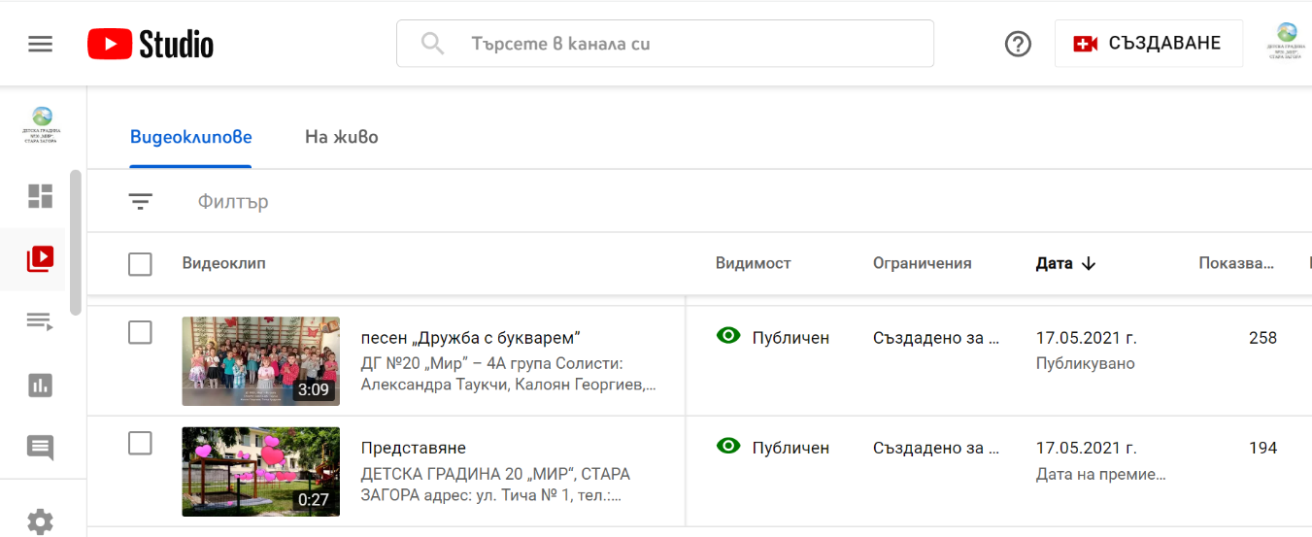
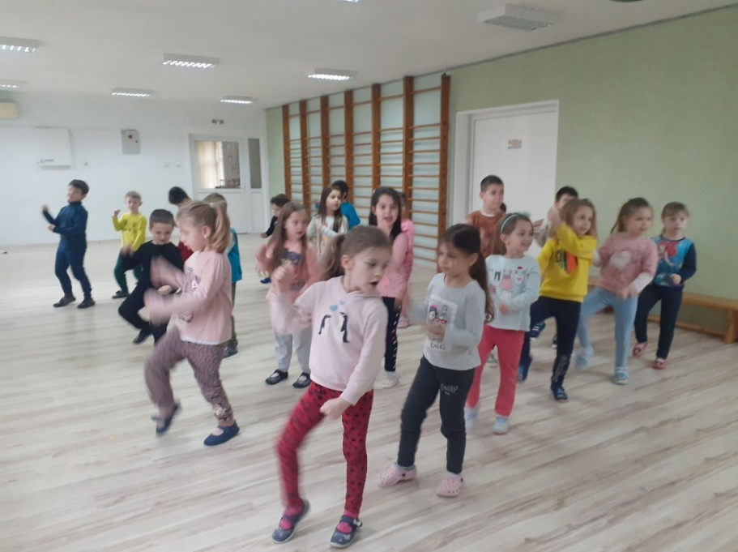
„digital kindergarten“
We have created a video channel on YouTube so that PARENTS CAN EXPERIENCE UNFORGETTABLE MOMENTS OF LIFE IN THE KINDERGARTEN WITH THEIR CHILDREN, INDEPENDENT OF THE FAMILY OFFICE.

Slide 11

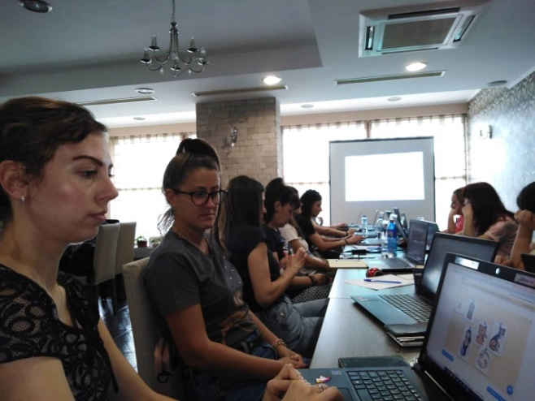
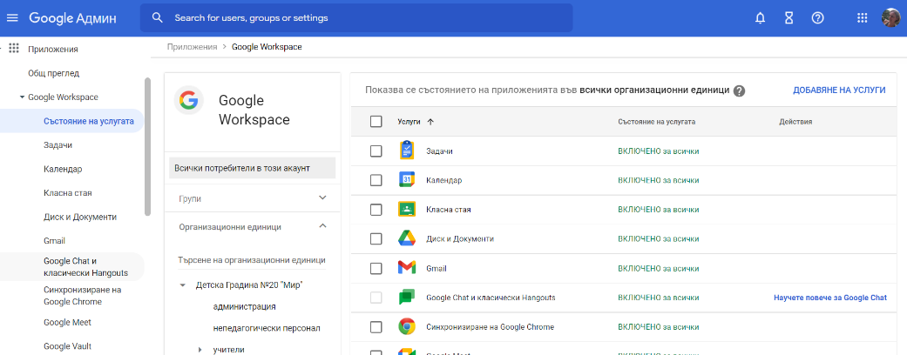
„digital kindergarten”
WE HAVE UNITED OUR COMMUNITY AND ENVIRONMENT IN THE CLOUD :
GOOGLE WORKSPACE FOR EDUCATION
WE HAVE CREATED A SET OF TOOLS THAT IMPROVE COOPERATION, COMMUNICATION AND LEARNING IMPACT
THE QUALIFICATION OF THE PEDAGOGICAL SPECIALISTS IS RELATED TO THE REQUIREMENTS OF THE DIGITAL WORLD IN WHICH WE LIVE

Slide 12
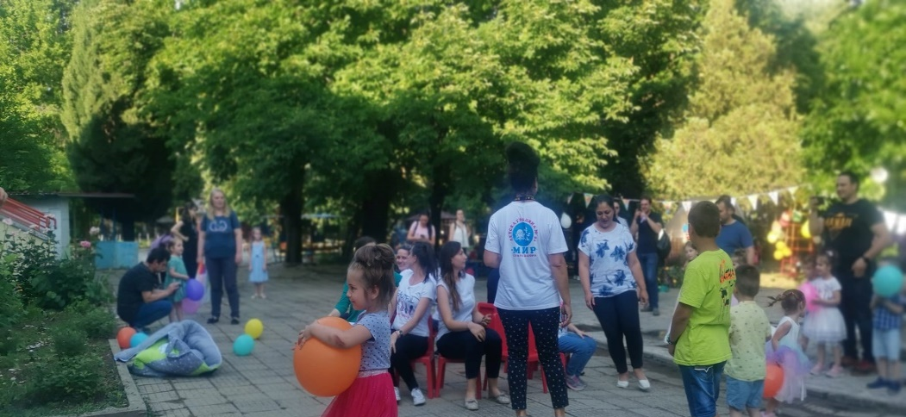
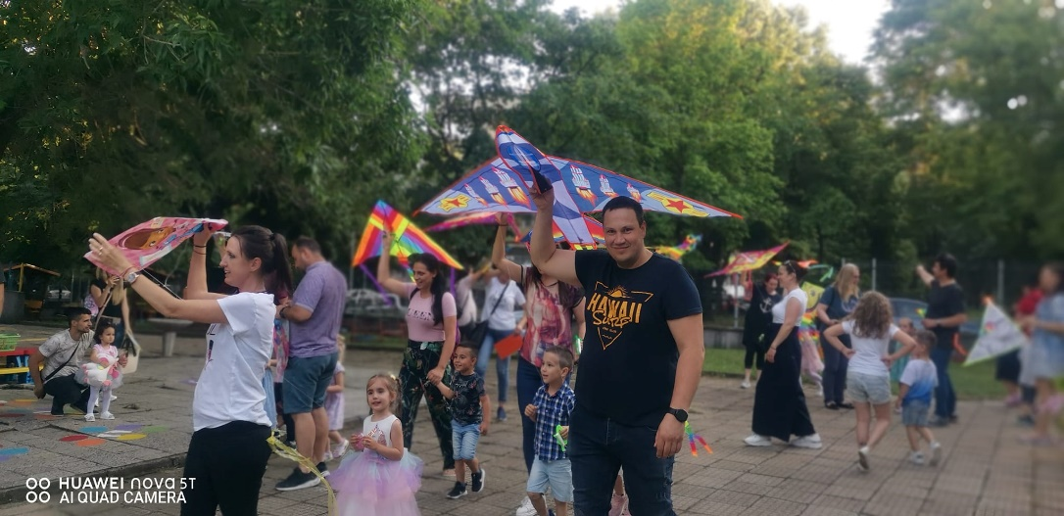
„digital children digital kindergarten“
IT'S STILL THE MOST FUN AND FUN WHEN WE ARE TOGETHER
E-BOOK – 1-ST JUNE

