Slide 1
#AlgoRhythm
“Hristo Botev”
Innovative and Eco- Primary school
Varna, Bulgaria
Kristiana Detelinova Stoyanova
Boris Dobrev Georgiev
Primary school "Hristo Botev"
Varna, Bulgaria
Rhythm, nature, computer
First Educational Online Forum,
8-10th of June 2021
Notes:
About us

Slide 2
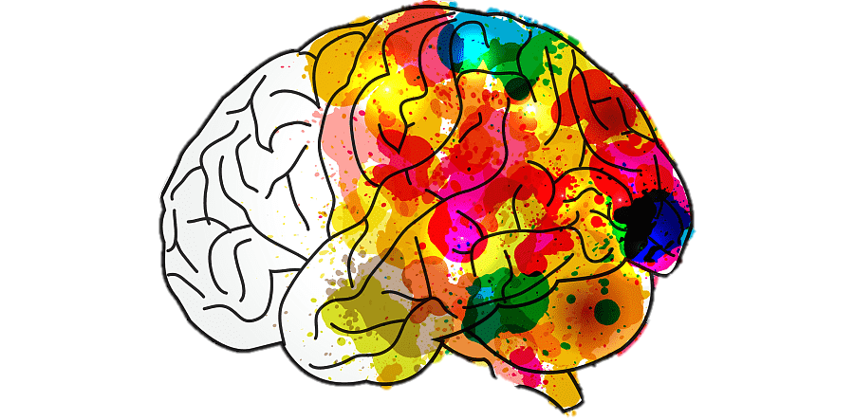
What is #AlgoRhythm ?
IT
Science
An innovative school subject that combines music, science and IT
Music
Notes:
What is AlgoRhythm?
. With it we aim to use the desire of students to work in a digital environment. We want to provoke their research skills, creativity, imagination and knowledge on current issues related to social development - circular economy, the formation of practical knowledge and attitudes related to observations in animate and inanimate nature and environmental behavior.

Slide 3
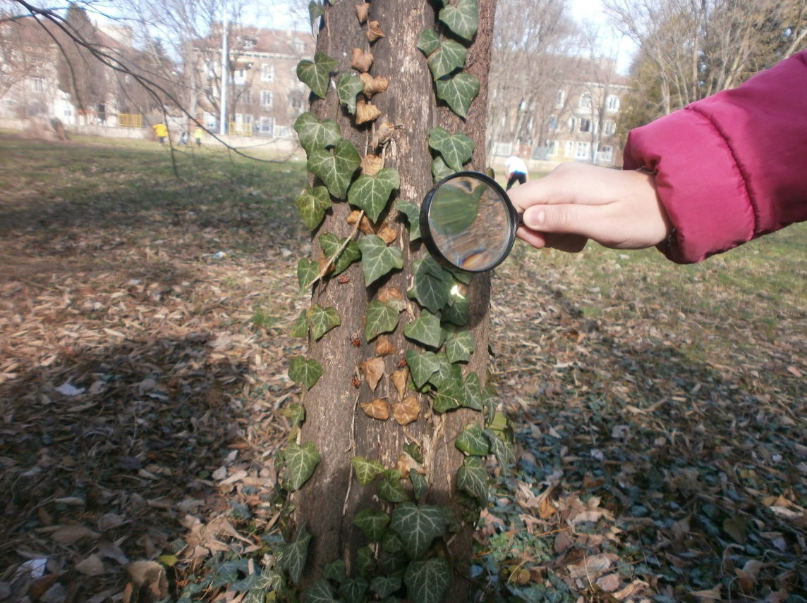
Why ? - Aims for the stakeholders
For the students:
To develop diverse skills, “learning by doing”
For the parents community:
Their children will have the opportunity to discover new talents
For the school community:
Students will increase their engagement and enhance their career development
For the society at large:
Deliver qualified students for the needs of today’s society

Slide 4
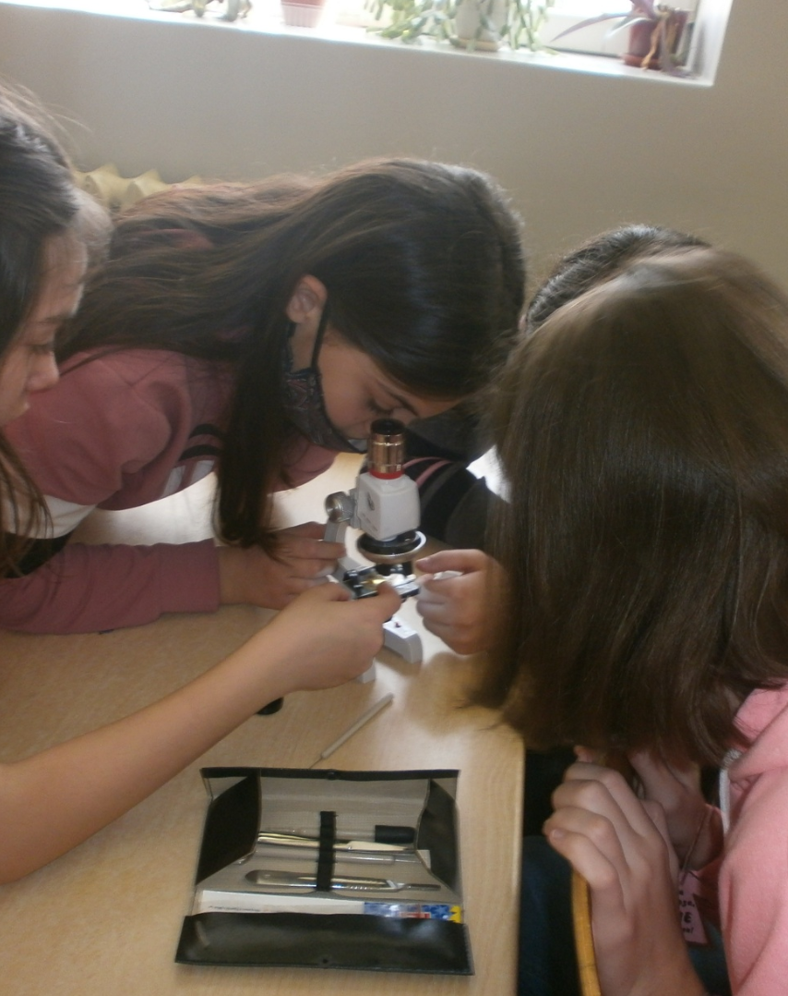
Science

Slide 5
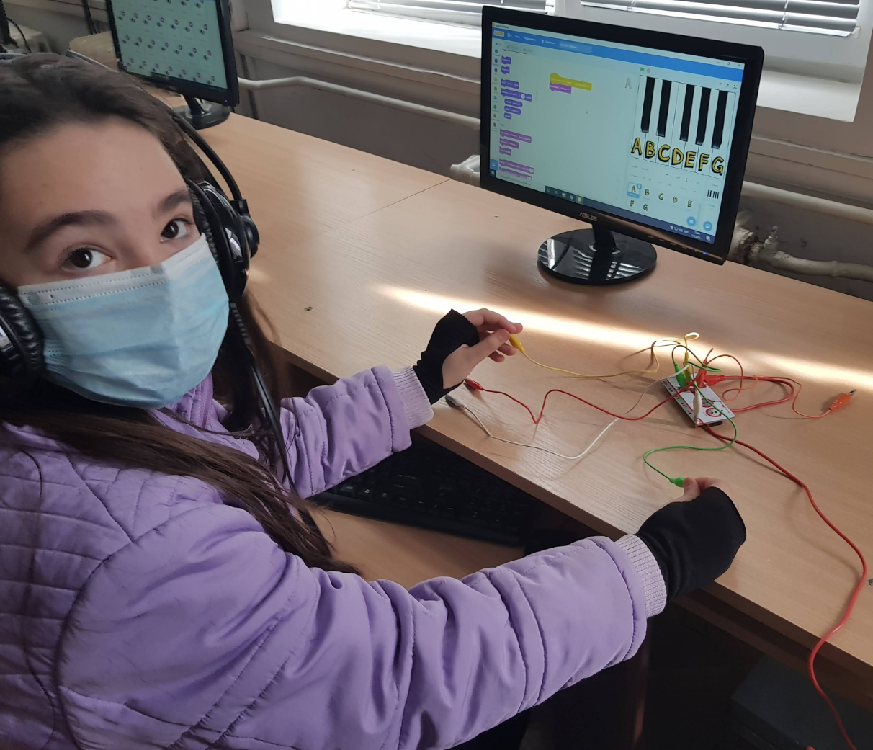
IT

Slide 6
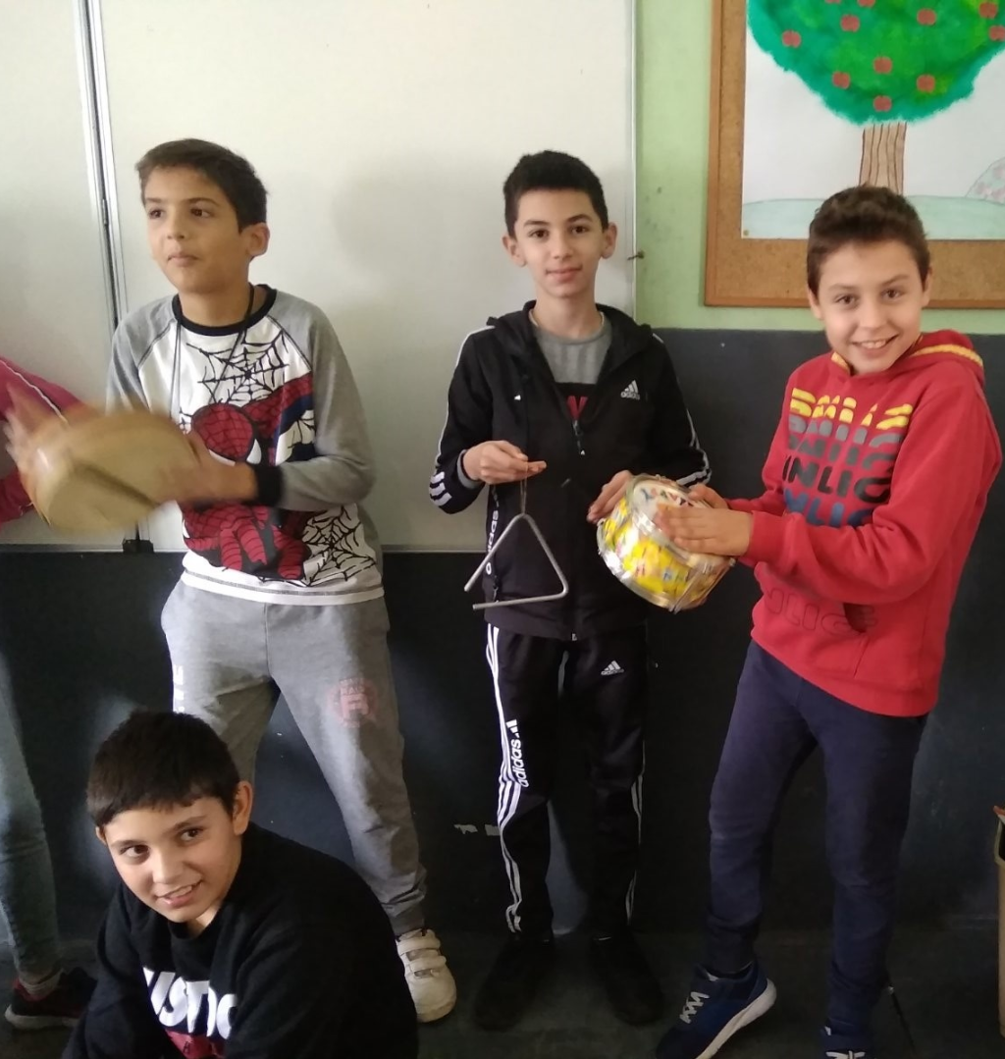
Music

Slide 7
Thank you for your attention!
If you have any questions, contact us at:
Kristiana Stoyanova, Primary school "Hristo Botev", Varna
stoyanovakrist@gmail.com
Boris Georgiev, Primary school "Hristo Botev", Varna
boris.georgiev94@gmail.com

