Slide 1


Digitalization and innovation
in education and science
Subject:
Digital practices in kindergarten
Ghildren
world
Head teacher:
Vanya Trendafilova Dimitrova
KG № 40 "Children's World" - Varna
Държава: България
град: Варна

Slide 2

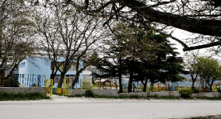
Modern children grow up surrounded by information technology – it is part of their being and a natural companion in their everyday life. The dynamics nowadays and necessity to adapt to the reality of the time we work in impose modernization of education through digitalization. All this provokes us to work hard in this direction. We have built a modern, safe and secure educational environment in the kindergarten with an interactive whiteboard, multimedia projectors, multiple mice software Envision platform, interactive bee-robots "Bee-Bot", communicators, and we have equipped each group with a printer and a laptop.
The latest digital acquisition of the kindergarten used to implement innovative teaching methods and pedagogical interaction is a touchscreen display - VESTEL (164 cm). We are proud to be one of the two kindergartens in Varna to have won this aquisition under the project "Education for tomorrow." We have the chance to work and teach our pupils in the spirit of the new time. The digital world is perfectly suitable for creating conditions in which new technologies could be used as a reliable tool in learning.

Slide 3
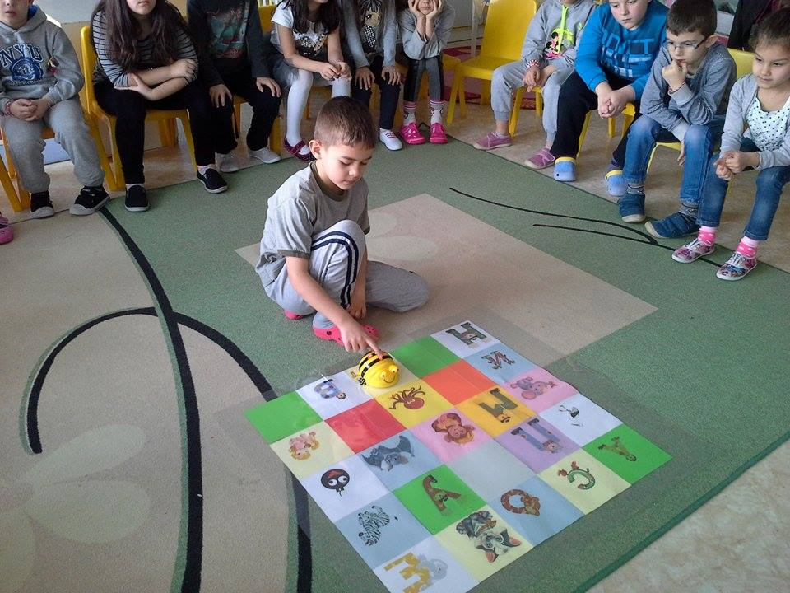
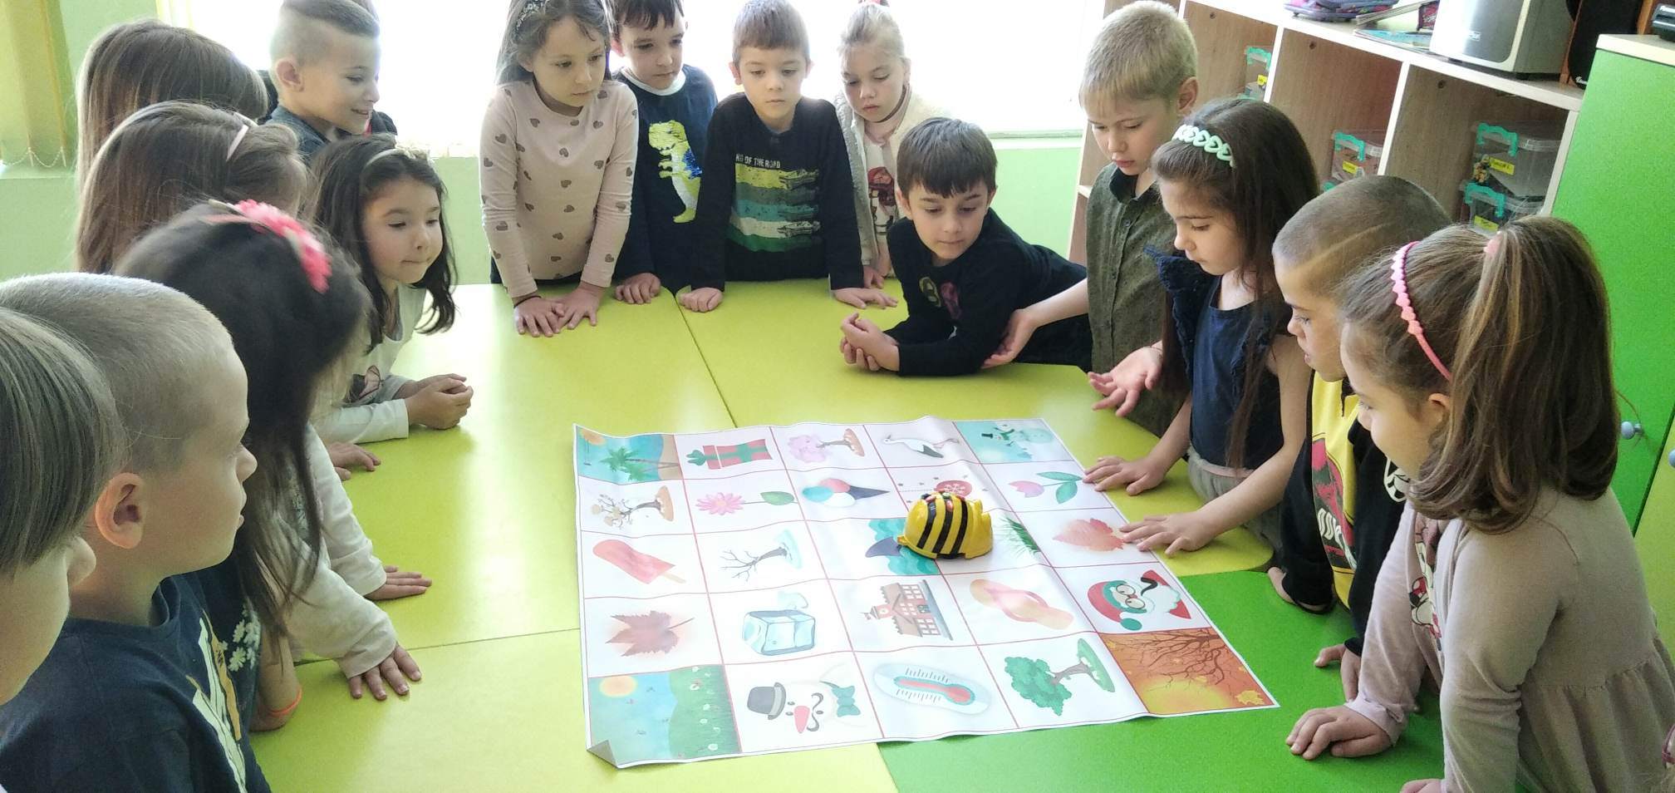
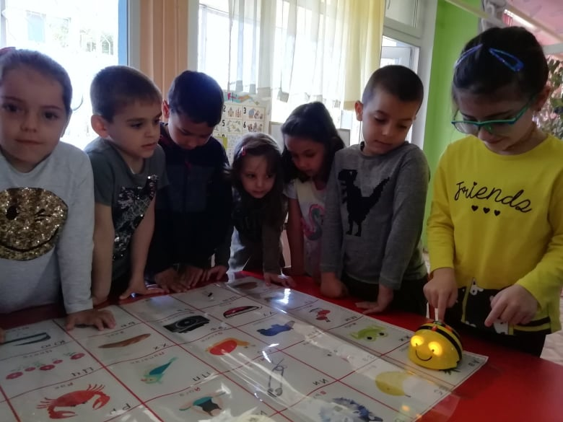
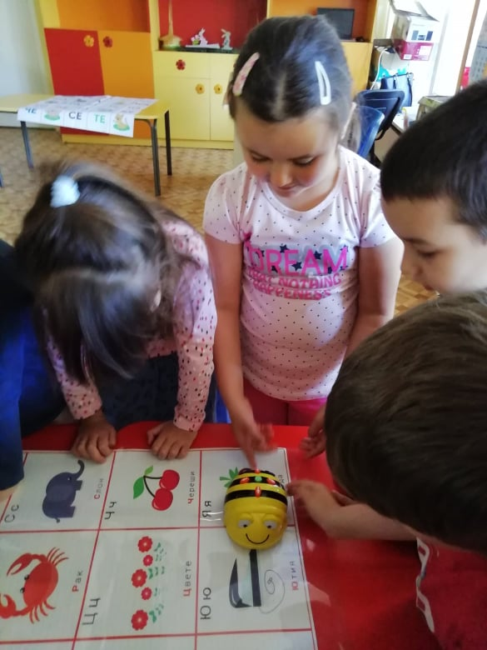
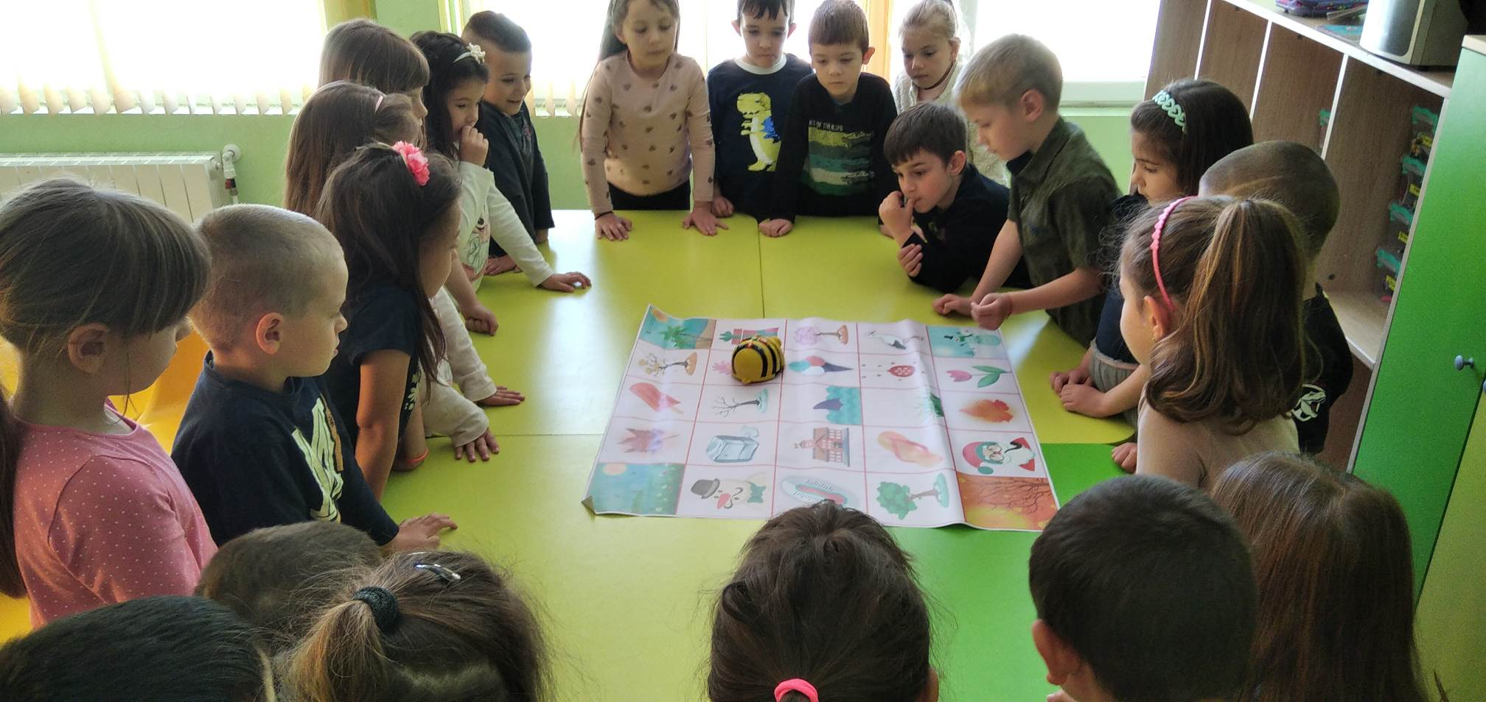
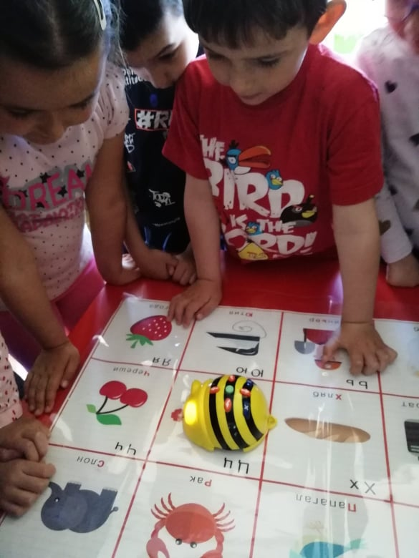
We have made the first steps in the programming in kindergarten through a interactive "Bee-Bot" emulator.
Bee- Bots give the opportunity of developing a lot of skills- to build an understanding of computer coding without even approaching a computer. It provides an opportunity of developing programming sequences, spatial awareness, logical thinking.

Slide 4
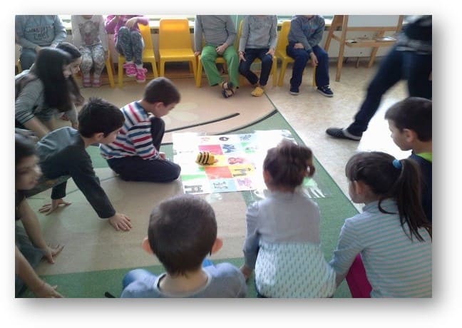
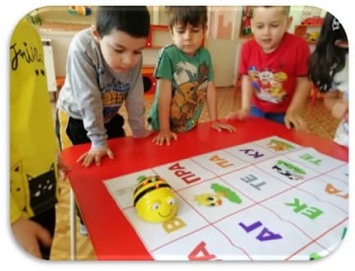
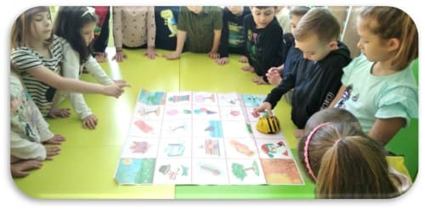
Our goal is to develop children's algometric thinking and spatial awareness skills.
Using Bee-Bot robots brings joy and satisfaction to children; it activates cognitive activity, broadens pupils’ horizons and increases the motivation of children; work efficiency rises to a higher level; it optimizes the educational process; the child is engaged and becomes an active part of the educational process.

Slide 5
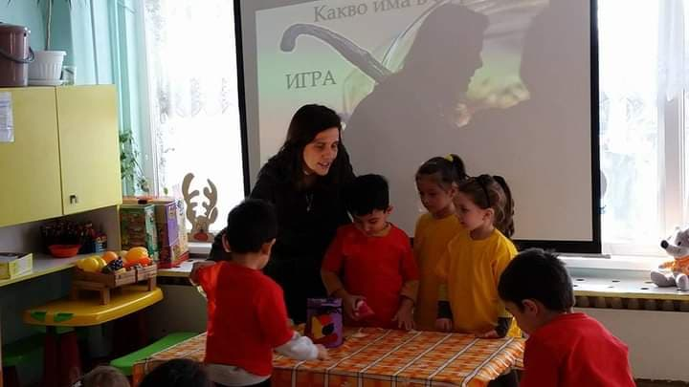
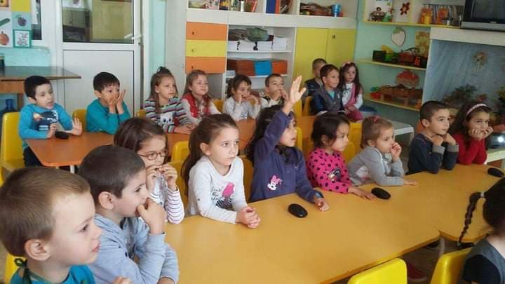
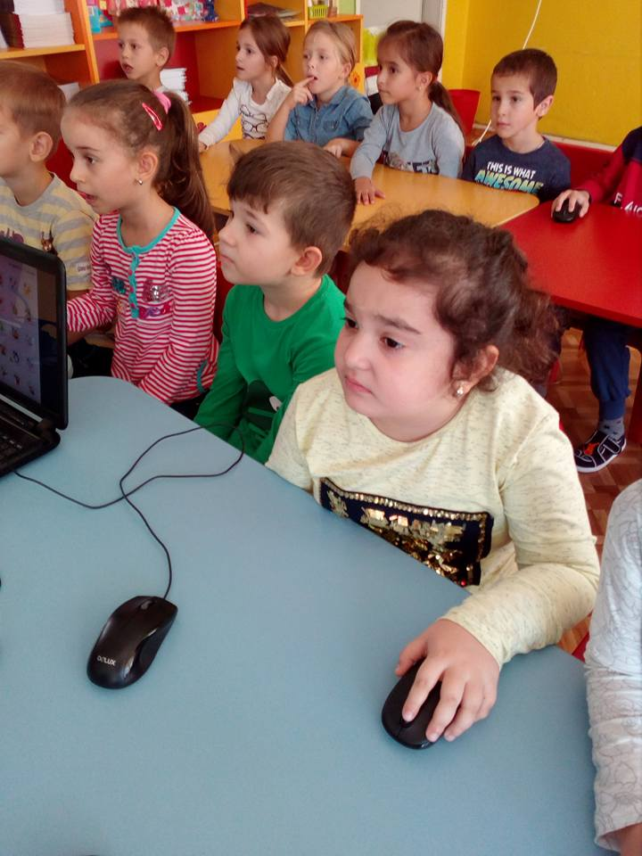
Use of interactive situations developed with the multiple mice software "Envision" platform in the educational process
The software "Envision" platform alone enables children to develop basic computer competencies and to diversify the learning process, which helps us to achieve better results in various educational fields - mathematics, Bulgarian language and literature and science. It fully engages children's attention, provokes thinking, takes a constant interest on their part throughout the situation and each child achieves a certain didactic result.

Slide 6
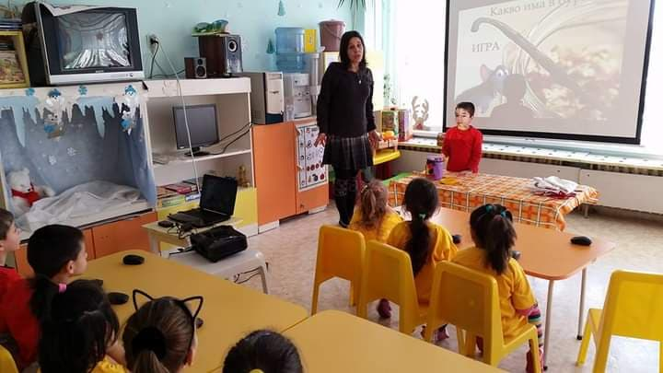
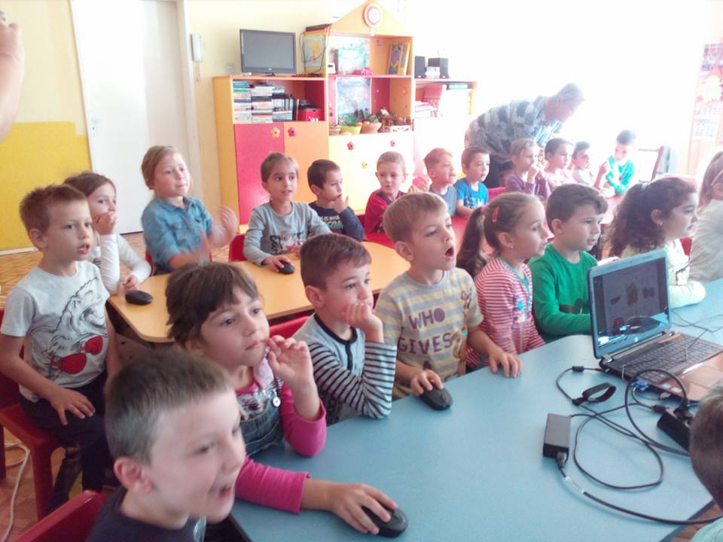
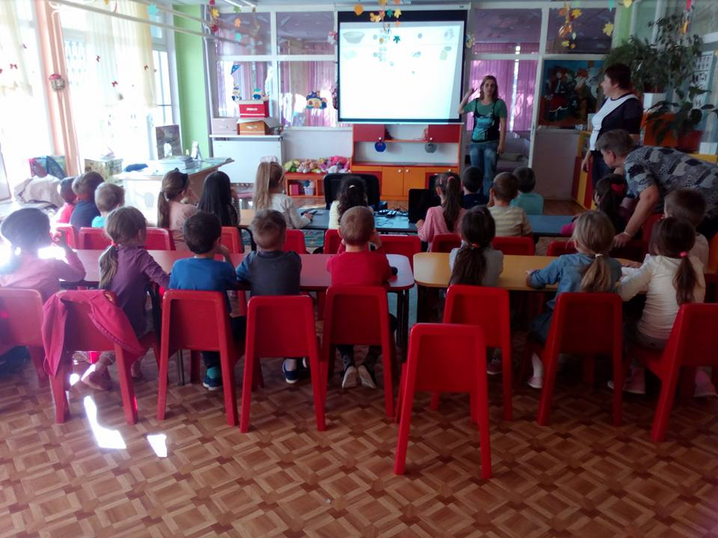
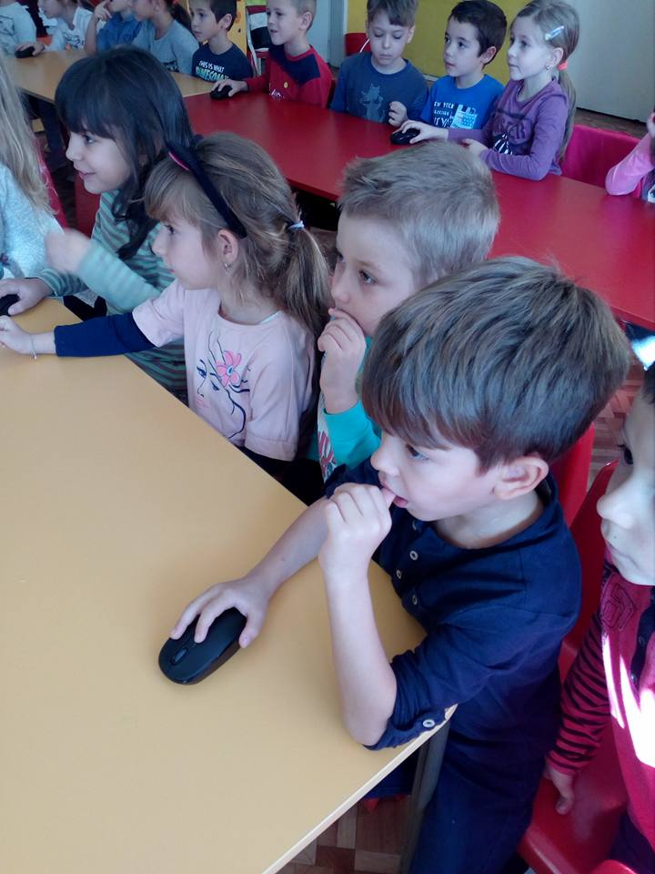
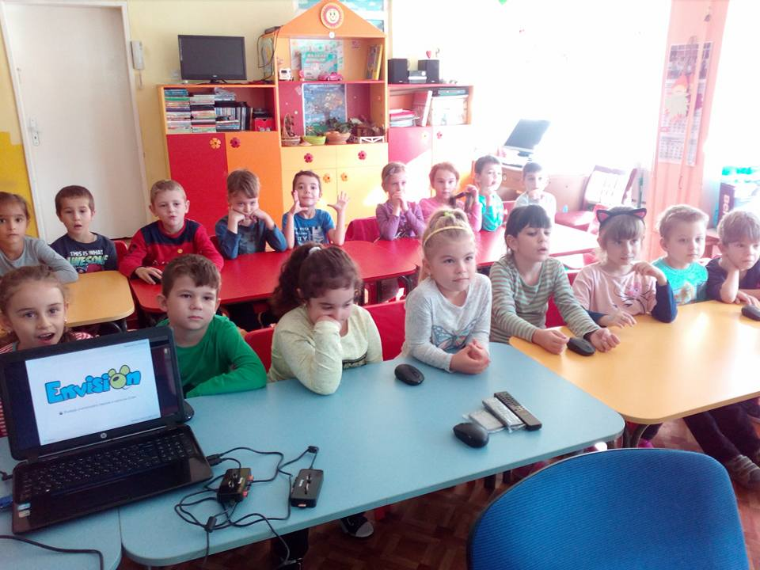
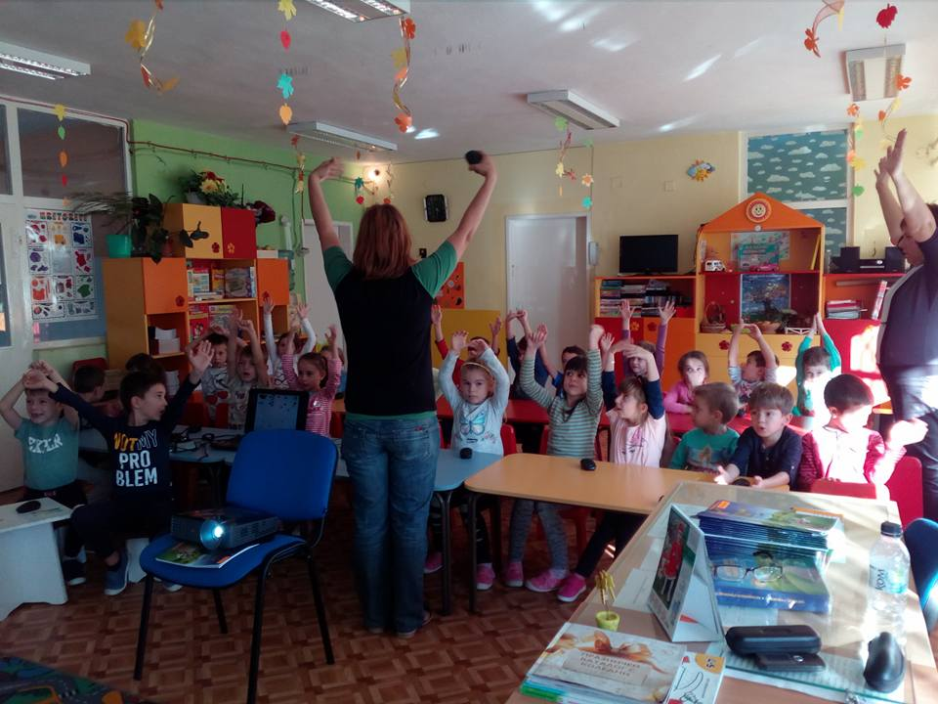
Work using the educational Envision platform continues because it is fun, interesting and useful for children.

Slide 7
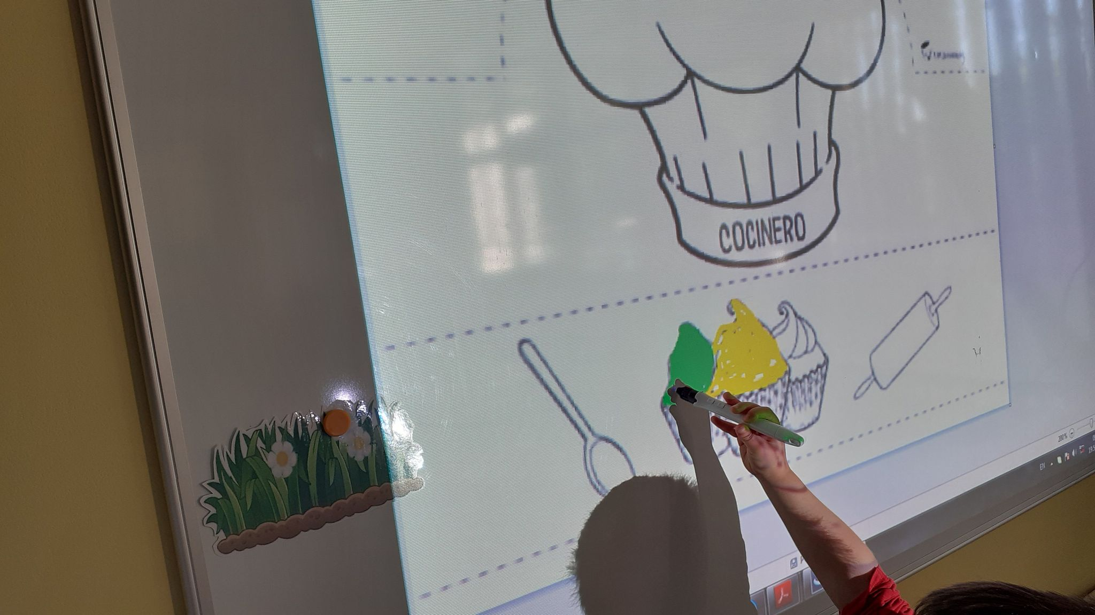
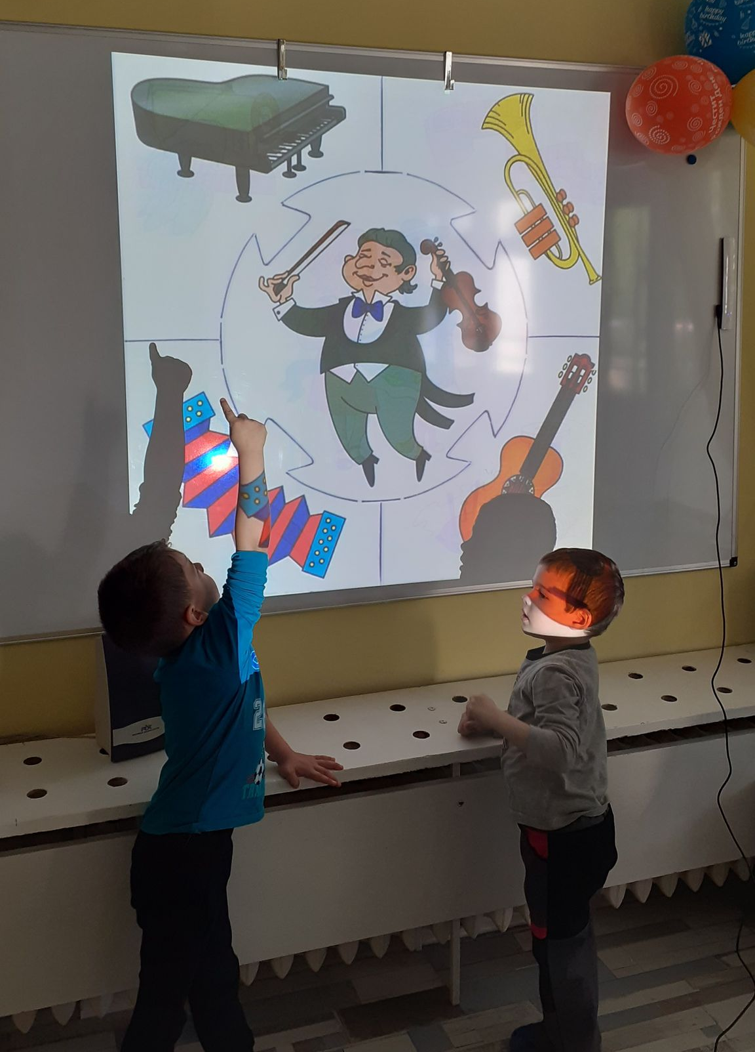
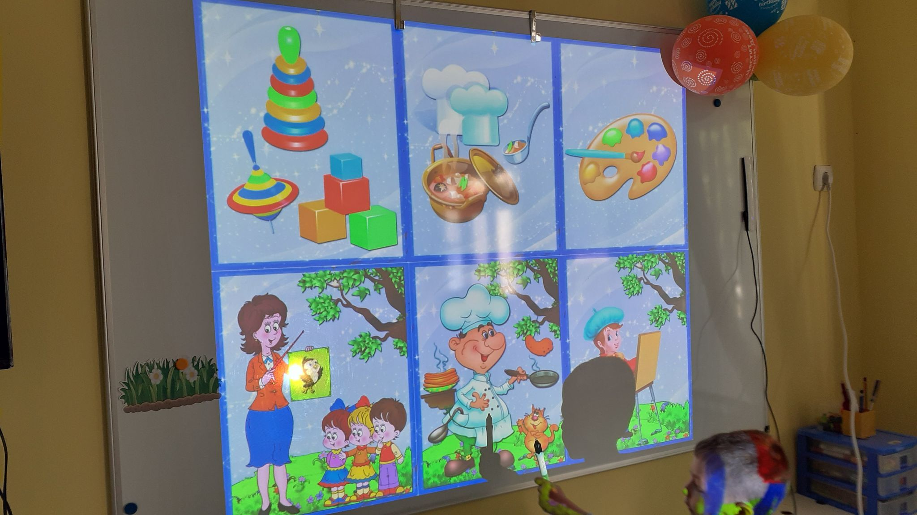
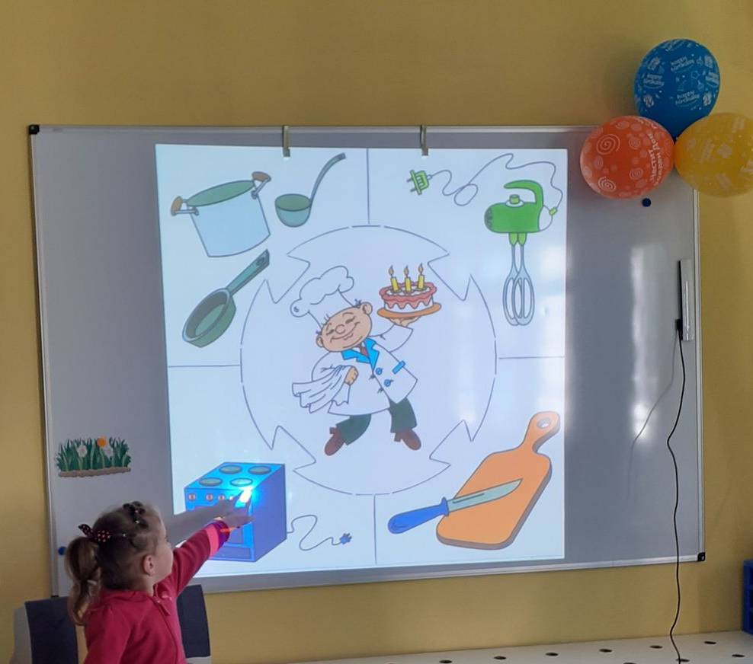
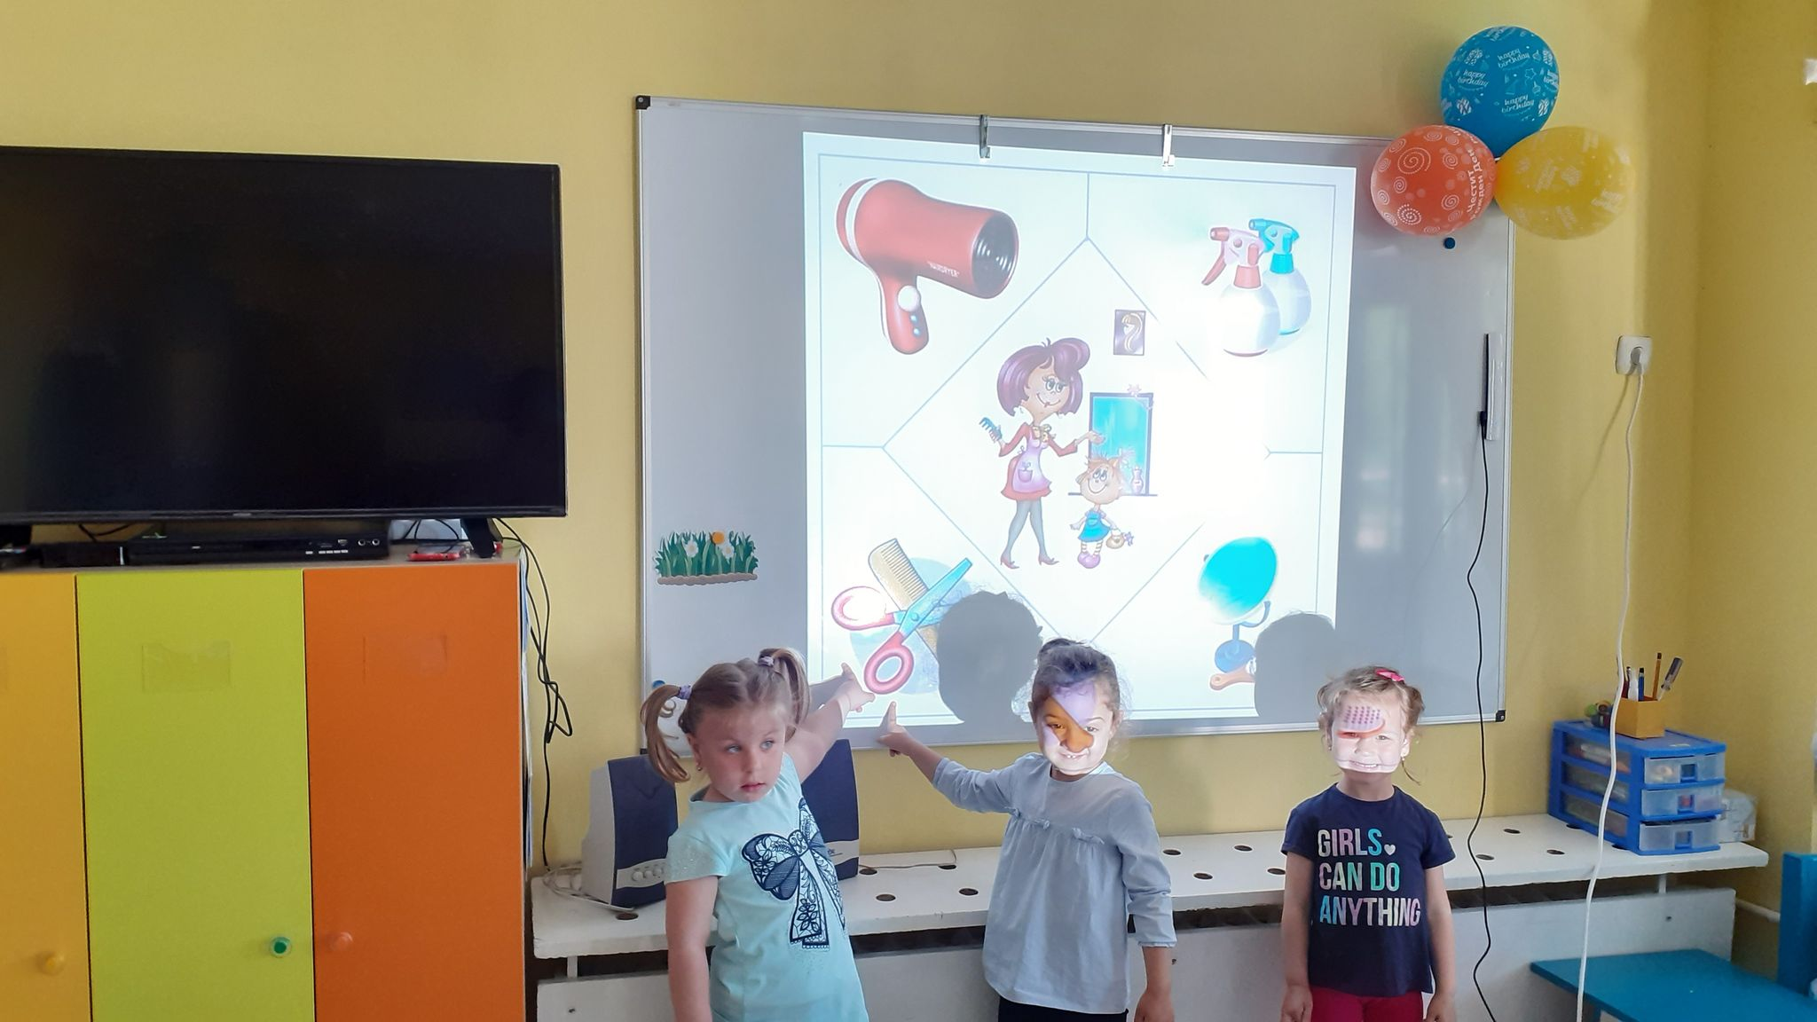
The interactive whiteboard provides great opportunities to develop and present pedagogical situations in a much more interesting and dynamic way.

Slide 8
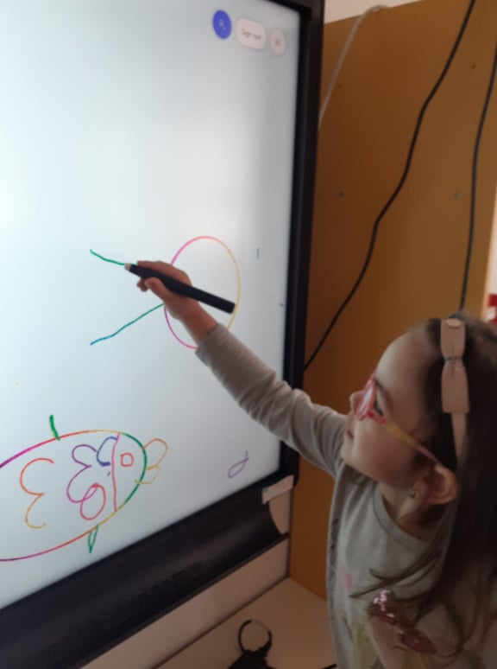
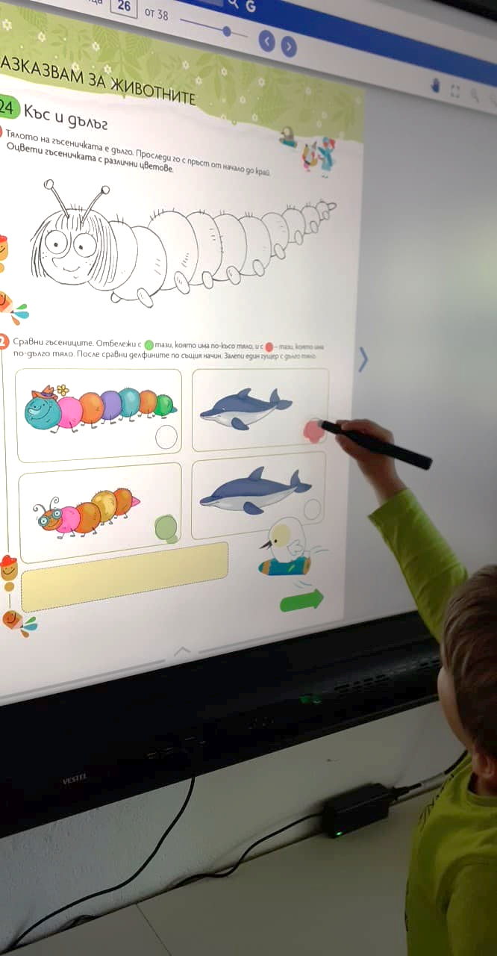
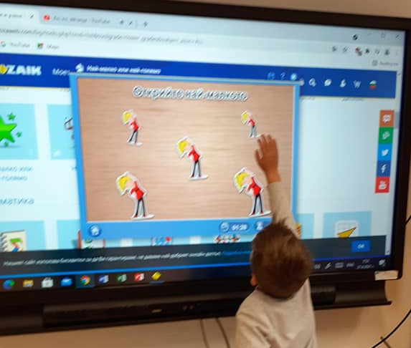
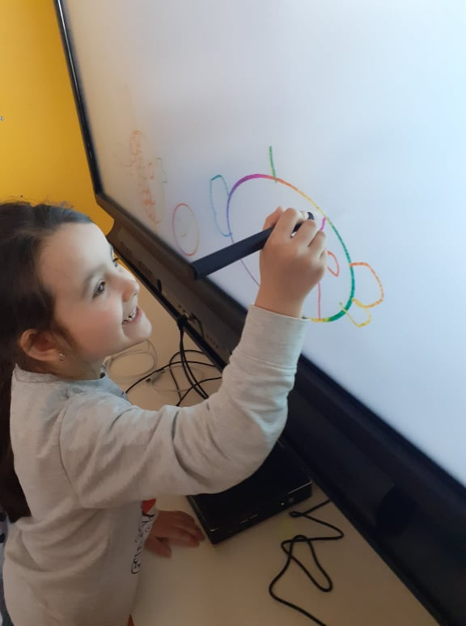
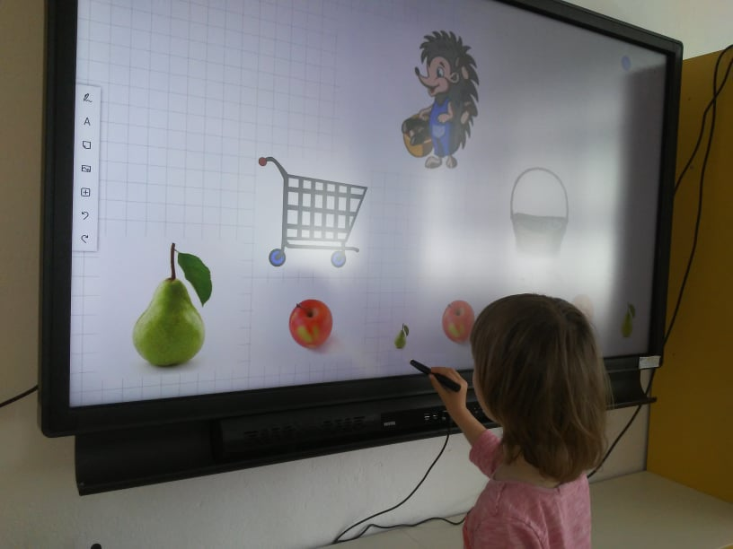
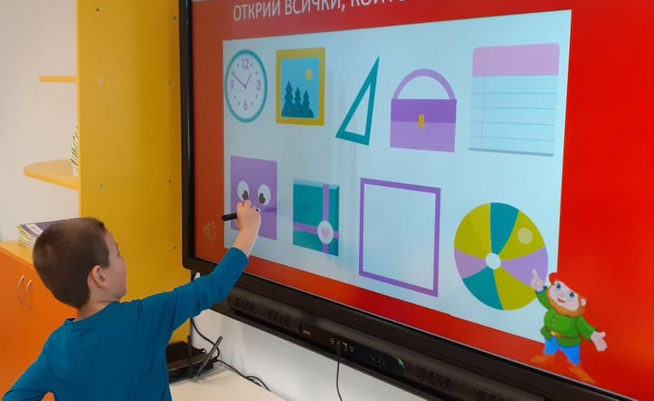
Interactive display – an interactive whiteboard, a projector and a computer – all combined in one!
Why to use an interactive display in kindergarten?
• Return on investment from ‘invested funds - maximum scope’ prospective.
• Call for methods and means to keep the interest of children.
• Increasing penetration of digital textbooks and online platforms in the learning process.

Slide 9
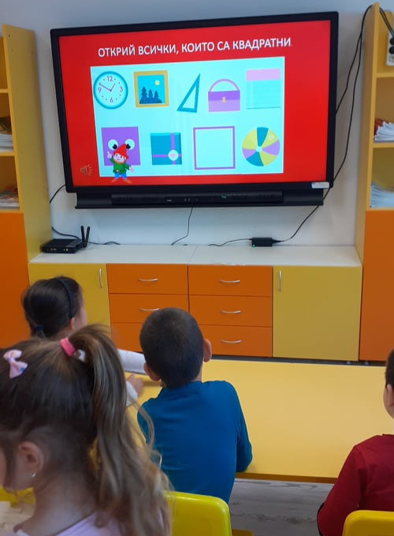
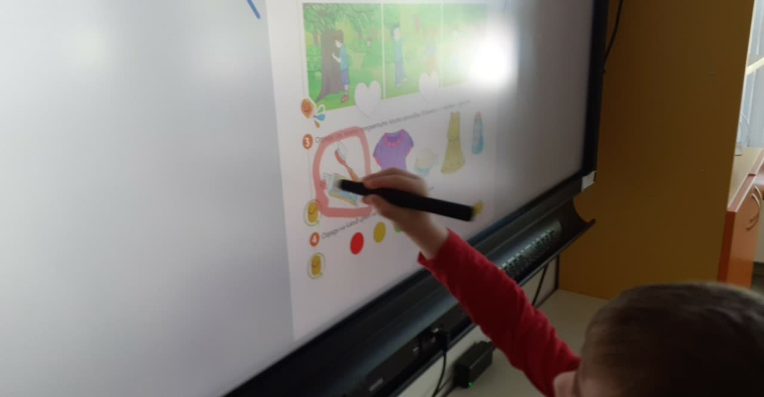
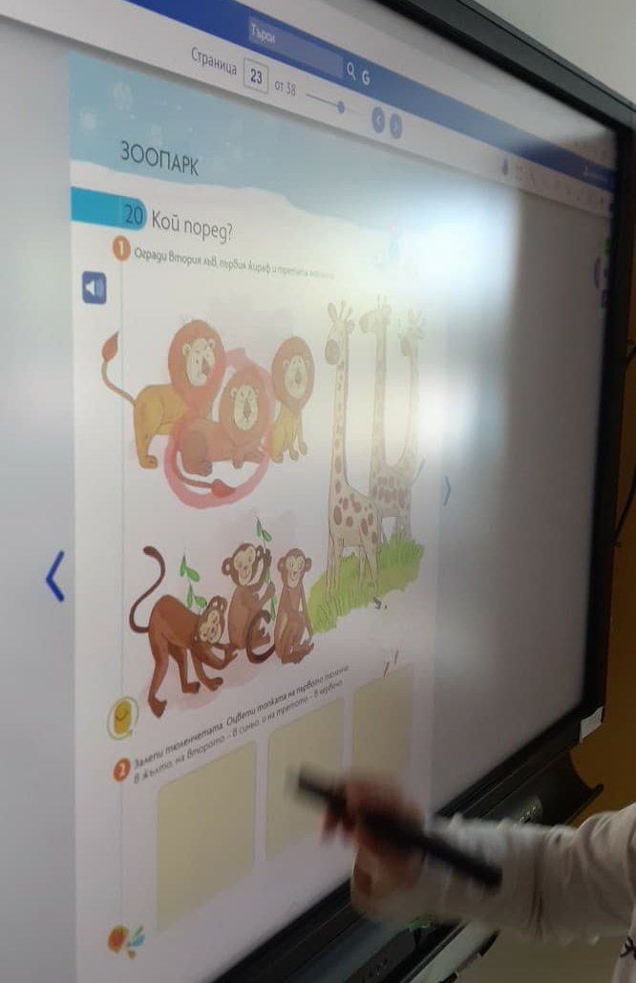
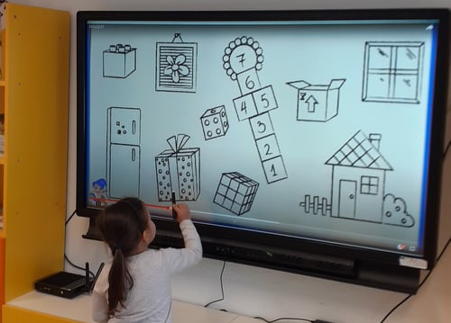
The interactive display provides a new and modern approach to acquire knowledge in kindergarten, while at the same time eases communication between teachers and children in an innovative way.

Slide 10
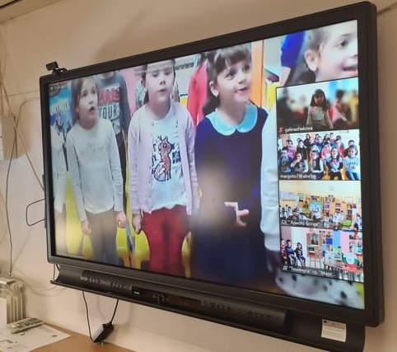
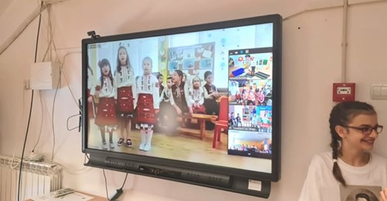
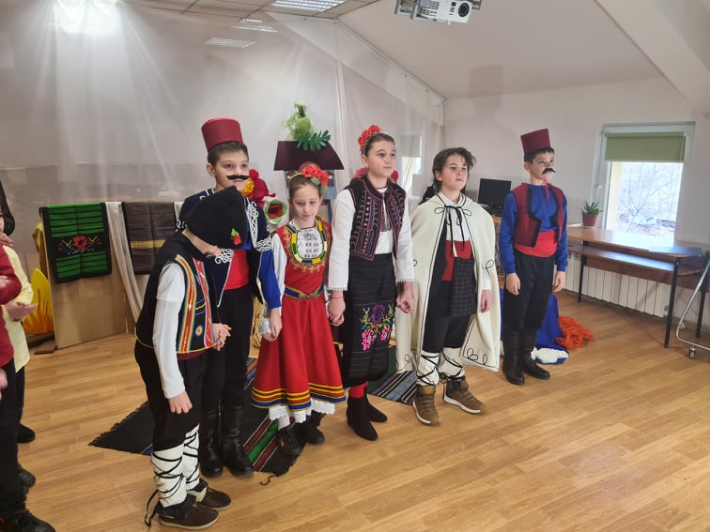
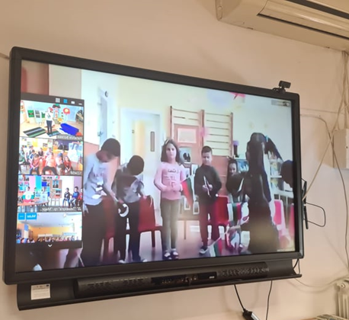
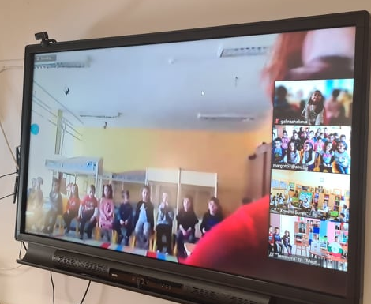
The emergency situation caused by the Covid-19 pandemic is also a catalyst for the accelerated entry of digitalization into kindergarten. That is why we had to implement ZOOM meetings not only between the groups in the kindergarten, but also between cities.
On February 19, 2021, we took part in online meeting on the occasion of 148 years since the hanging of Vasil Levski. The event "connected" children in Pleven, Varna, Vratsa and Montreal.

Slide 11
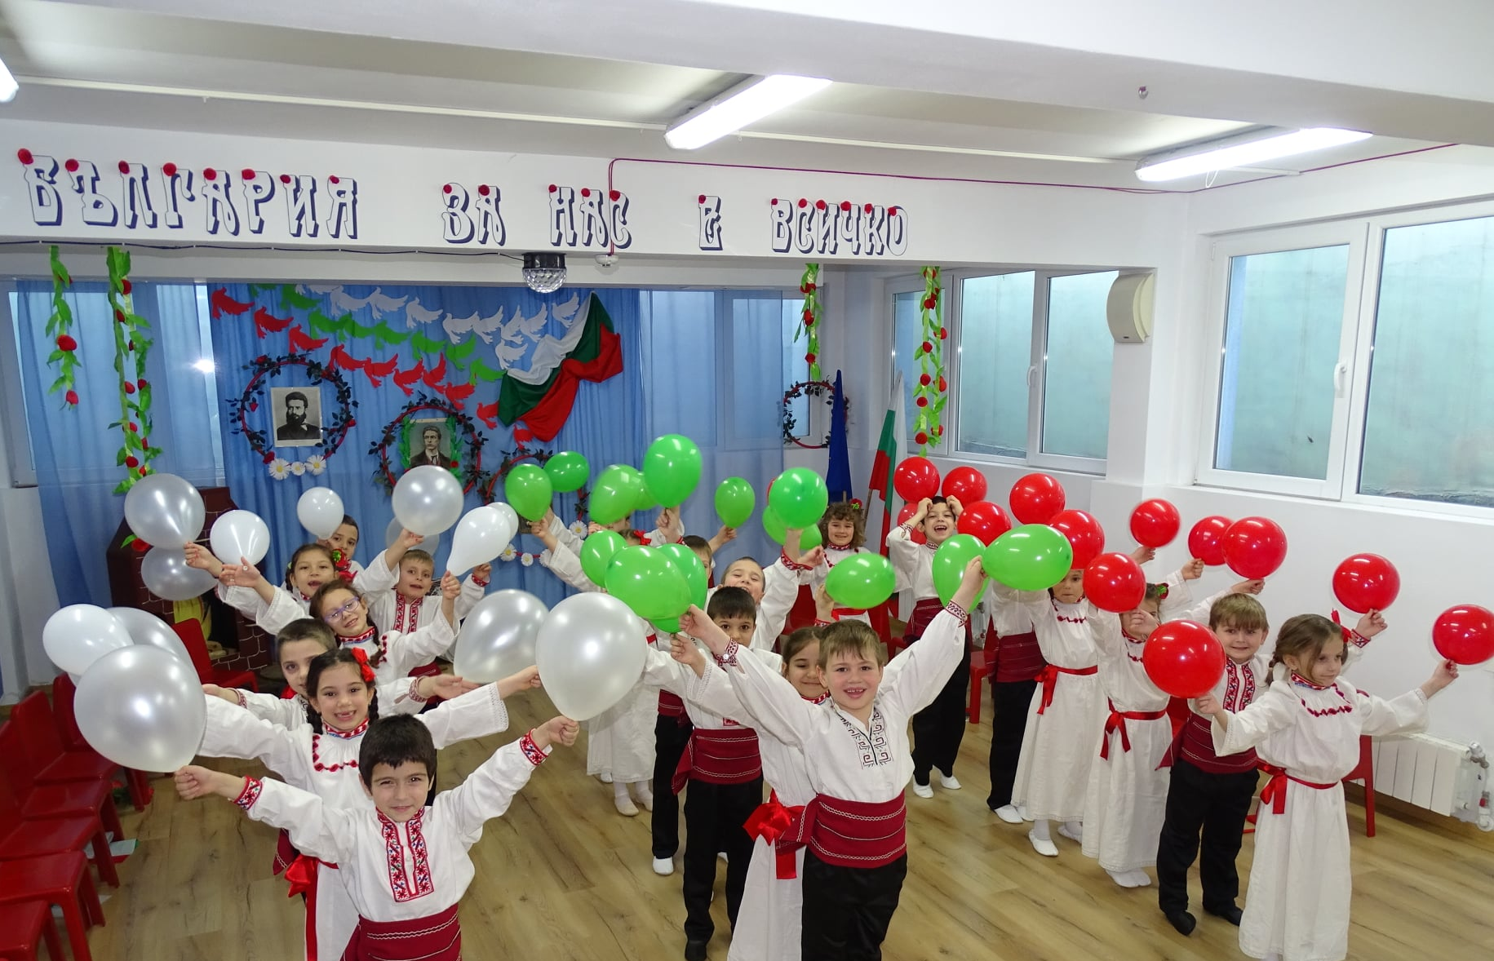
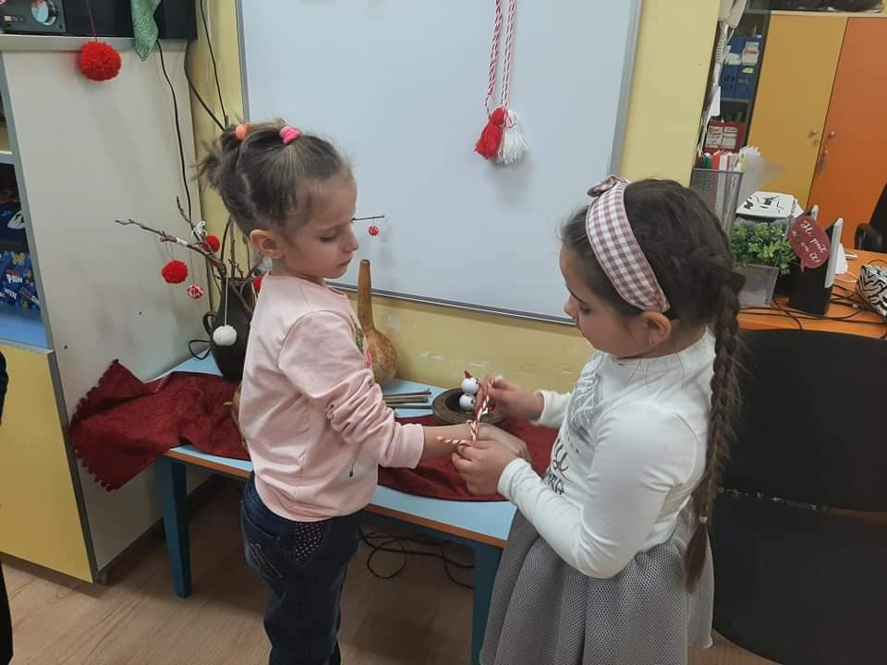
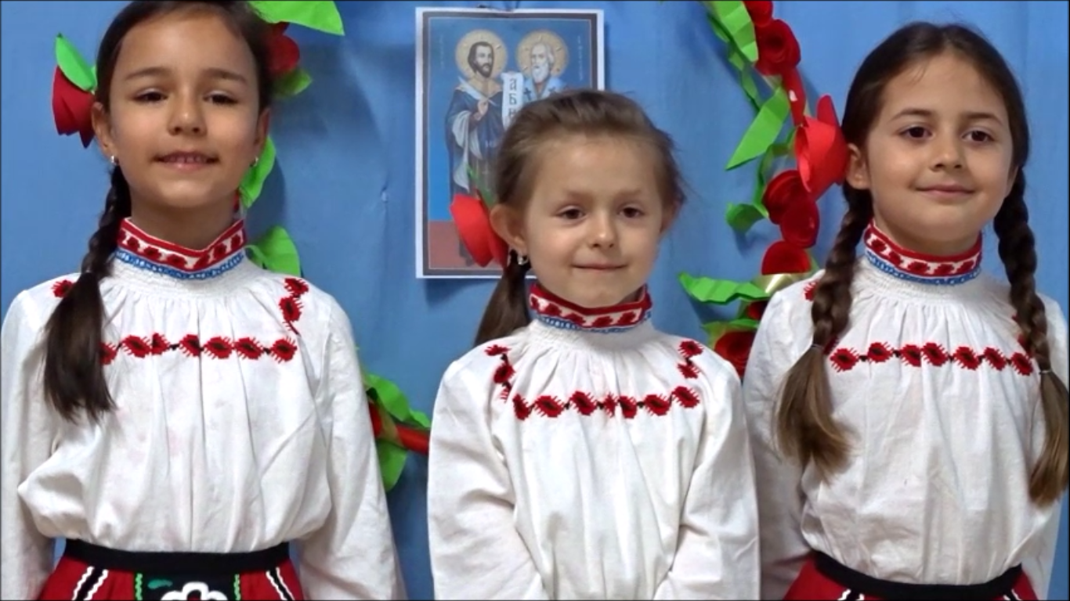
We have been applying extensively modern digital technologies to the distance learning education of children during COVID-19 state of emergency. We have established contact with parents and the community through various platforms.
3 mart
1 mart
Grand mother Marta
24 mai

Slide 12
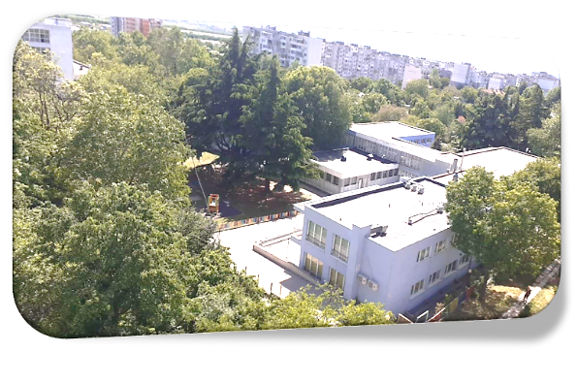
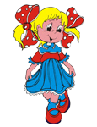
The biggest advantage of new technologies is that they enable children to learn through play. The digital world is a perfectly suitable to provide favorable conditions for new technologies to be implemented as a reliable tool in learning. Our role is to develop a digital culture in children, to get pupils into the habit of handling interactive toys and computers, as well as to encourage young learners to use them not only for entertainment but also for educational purposes.
Ghildren
world

