Slide 1



DIGITALIZATION AND INNOVATION IN EDUCATION AND SCIENCE
Organizer Varna municipality
08 - 10 june 2021
From older to younger...
VESELINA VELIKOVA TISHEVA
SASHKO ILIEV STOYANOV
VII SS „NAYDEN GEROV“
VARNA , BULGARIA

Slide 2


„ School in the cloud“ - not an utopia, but a working model in VII SS „Nayden Gerov“
Begining 2017
  Innovative school
  Digitalization of the learning process
  Created accounts:
      Teachers
      Students
      Administrative staff
  Virtual classrooms in Google
  Team drives in „cloud“
2020-2021
  Interdisciplinary lessons „From big to small“
  Model introduction 1:1

Slide 3


Interdisciplinary and project-based education. The student becomes THE TEACHER!
A method with good traditions, but with modern style
The creativity of two teachers grows into a creative process of the students
Provocation of creative search and cognitive activity
Ingenuity, sociability /strategies, experience/
Strategic thinking
Leadership
Continuity

Slide 4
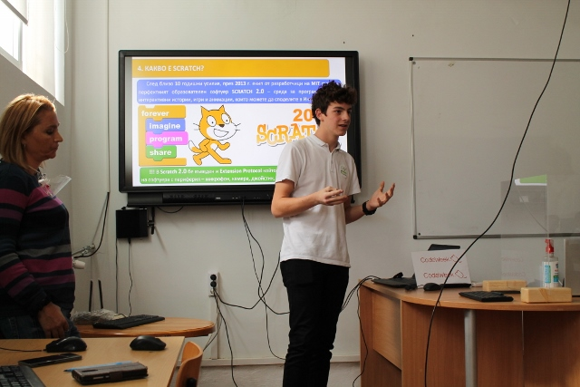
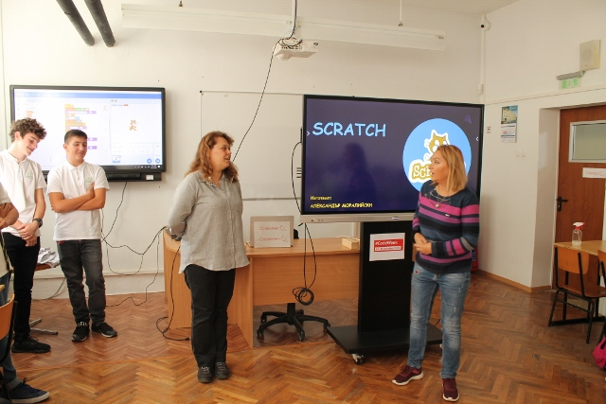
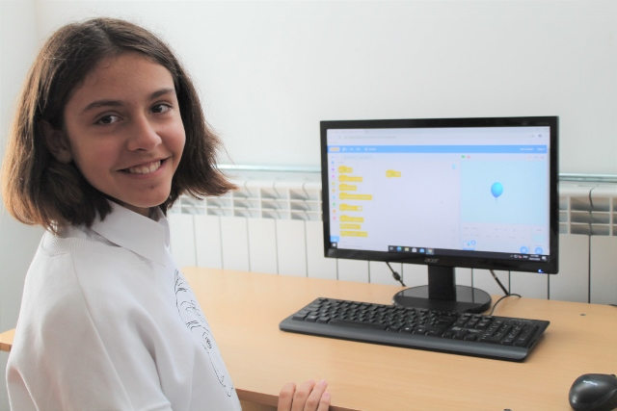
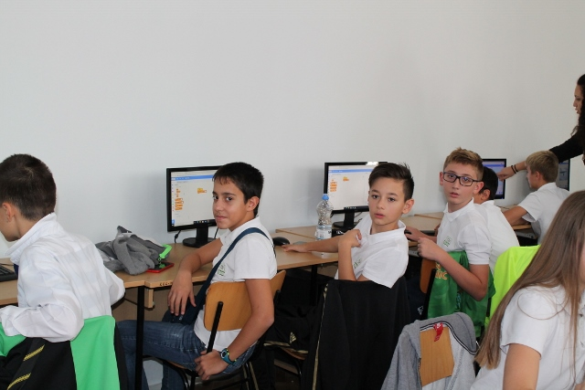
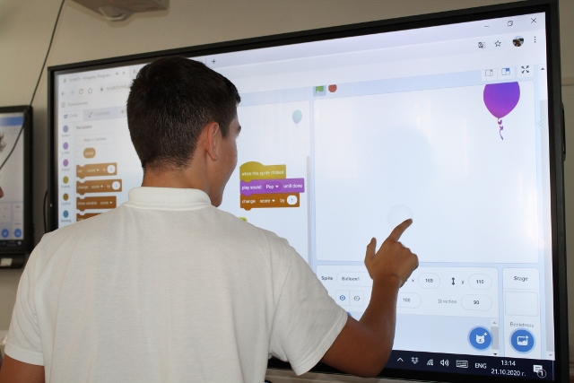
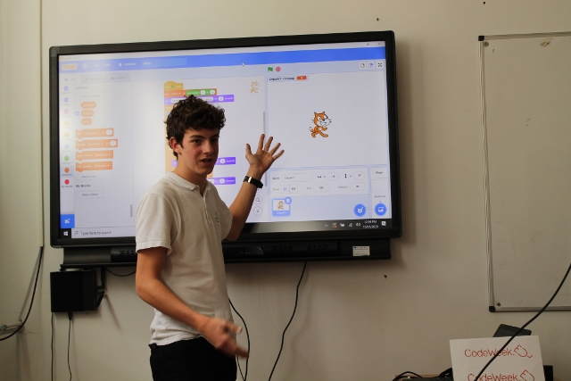
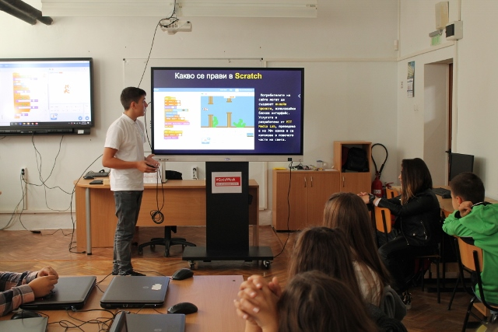
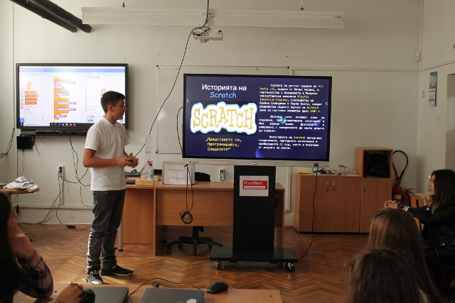
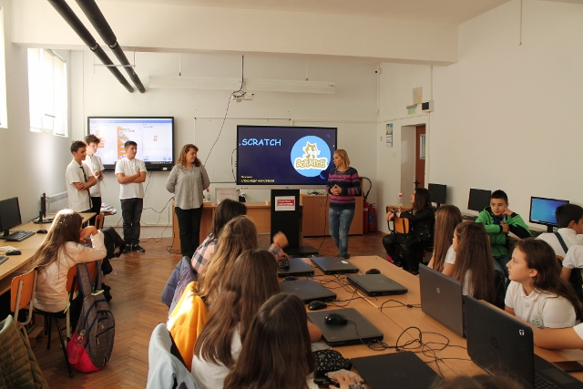

Eighth graders, sixth graders and...
Eight graders showed an easy and fun way for sixth graders to progress, to develop their creative skills by creating their own games and interactive stories. Programming skills and the development of logical thinking are among the main competencies that can ensure the professional realization of adolescents.

Slide 5
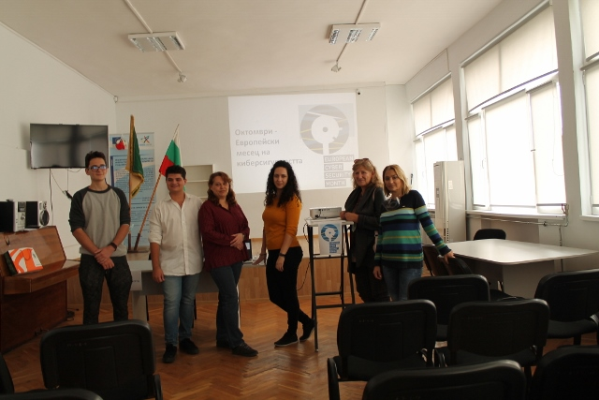
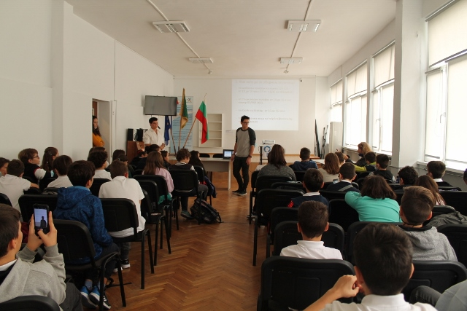
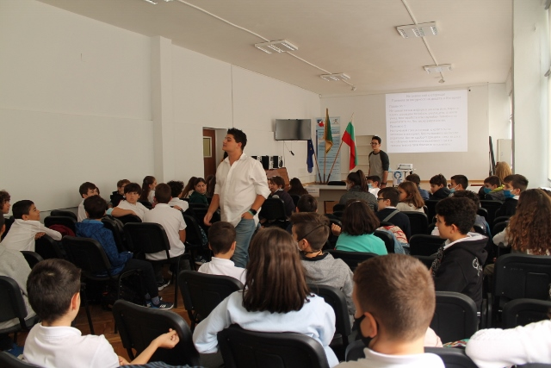
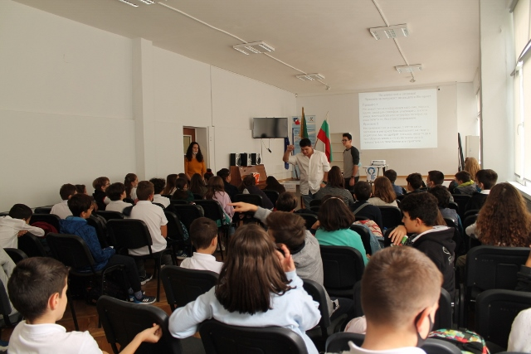
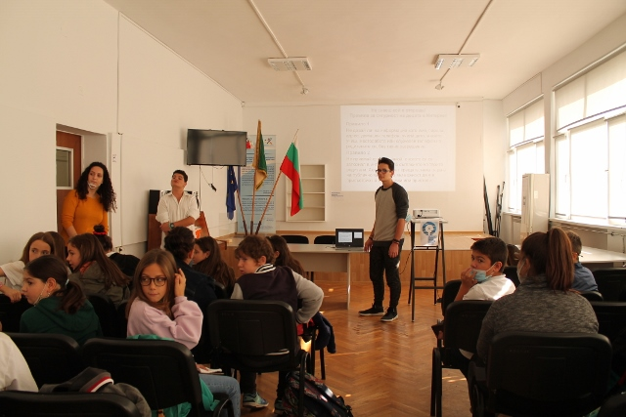
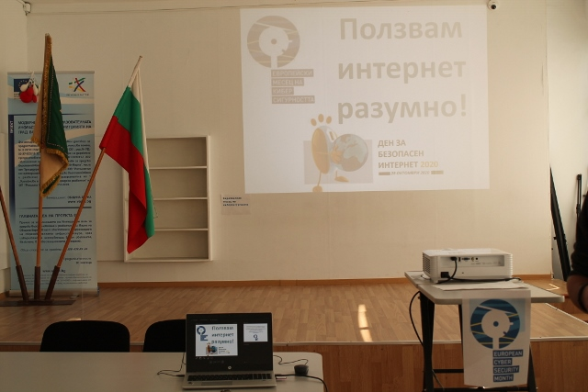
10th grade students introduce „SAFE INTERNET“ to 5th grade students.

Slide 6

Computer games in education game-based (learning) methods, realized in an interactive educational environment
Children-teachers
  Fulfillment of the role
  Challenge
  Teamwork
  Activity modeling
  Provocation
Students of the Children-teachers
  Motivation
  Competition
  Independence
  Activity
  Competitiveness
  Continuity

Slide 7
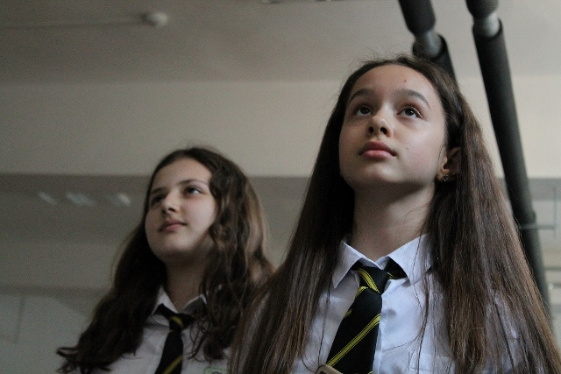
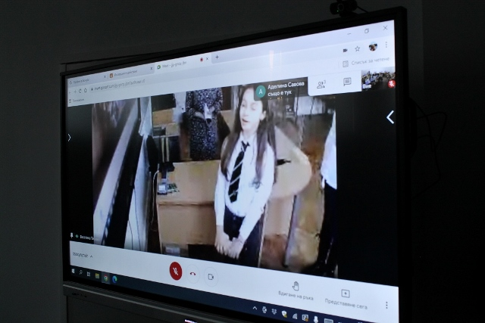
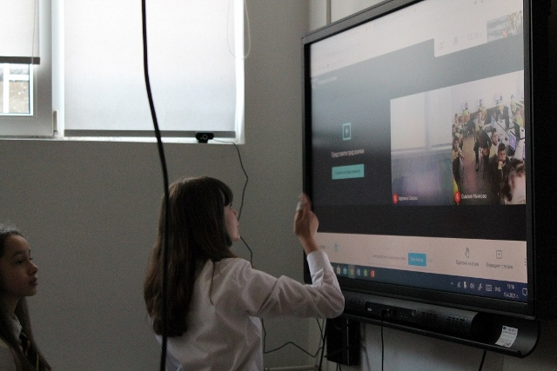
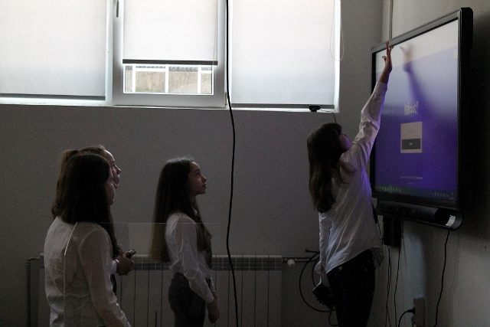
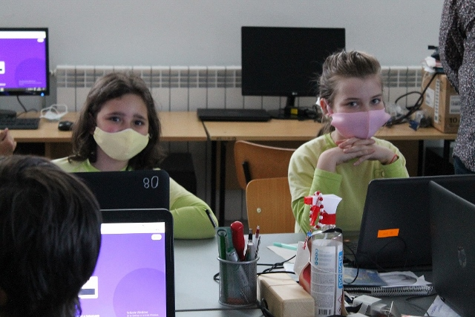
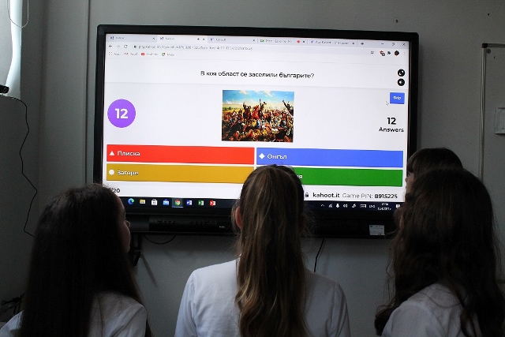
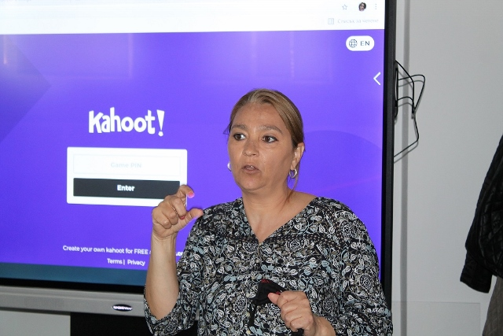
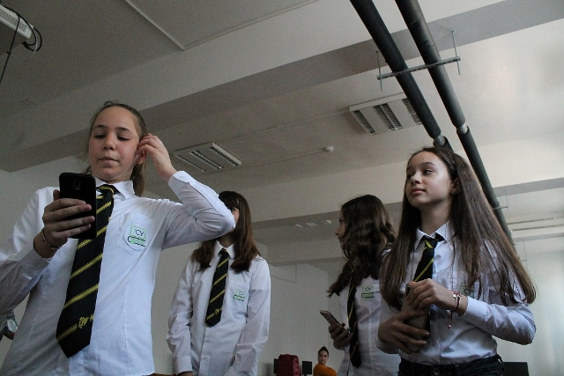
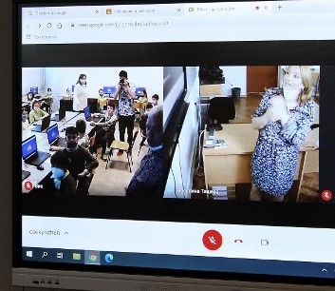

Sixth graders, third graders and...

Slide 8
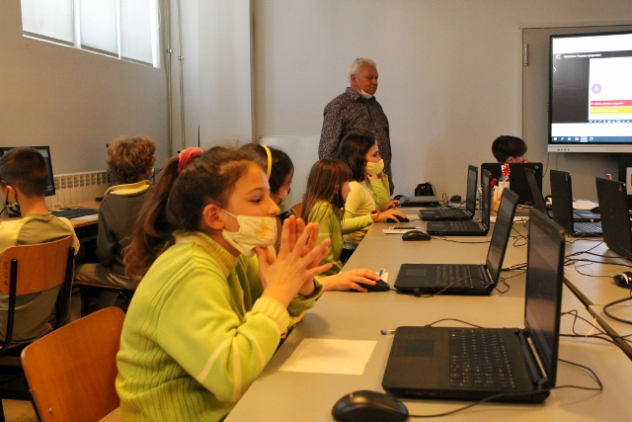
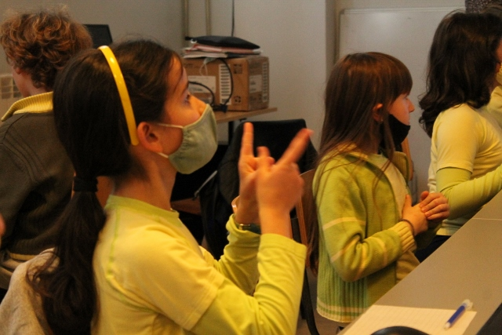
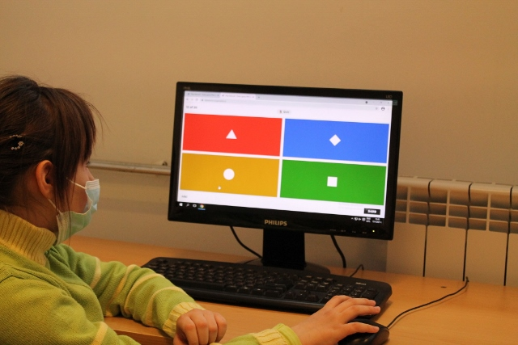
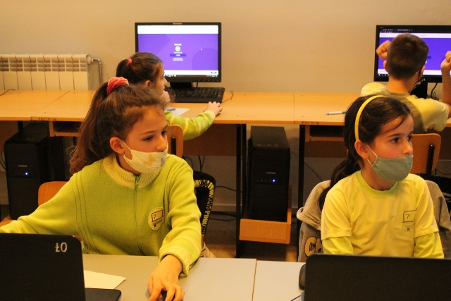
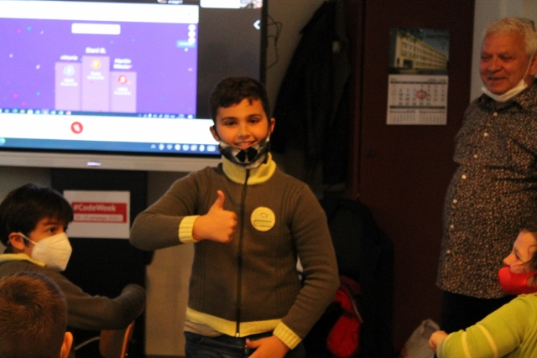
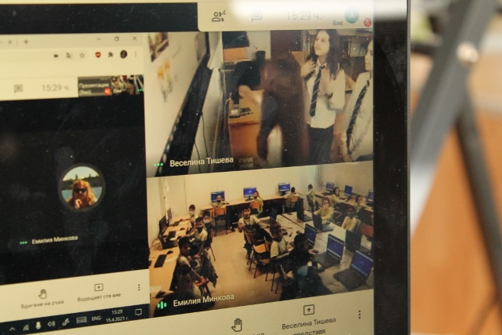
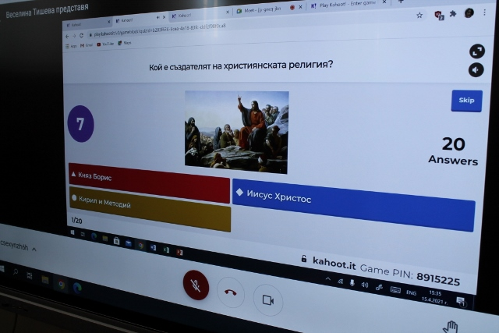
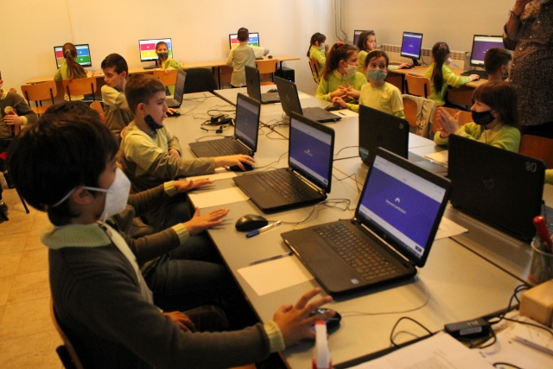
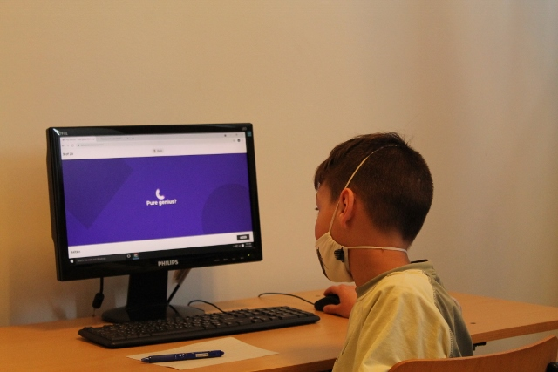
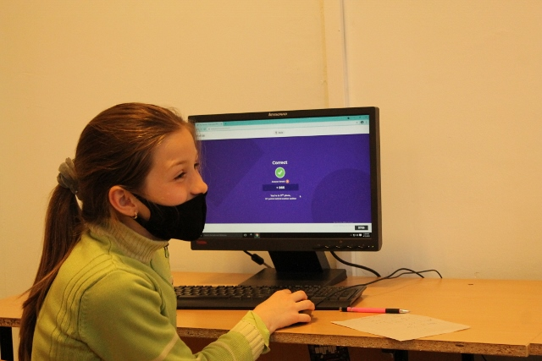
Sixth graders, third graders and...

Slide 9
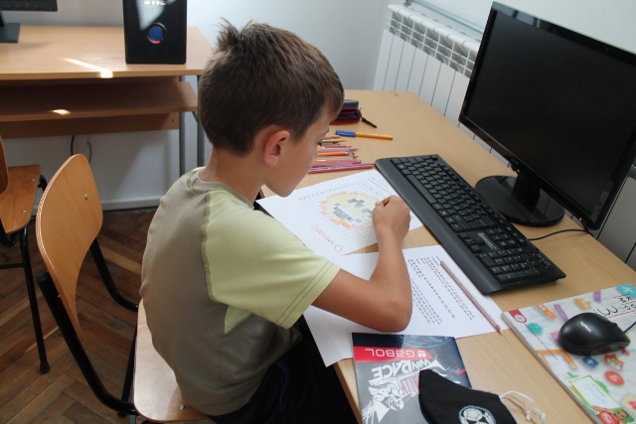
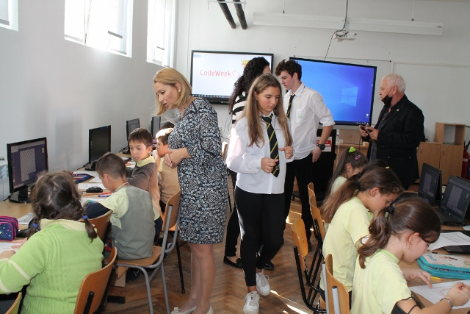
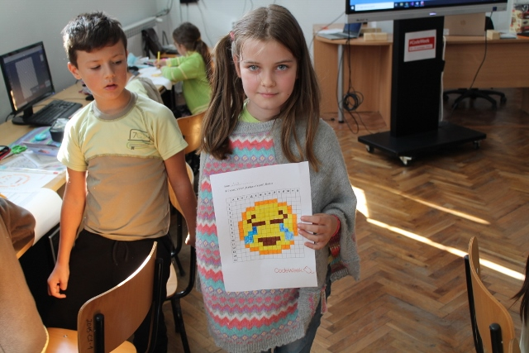
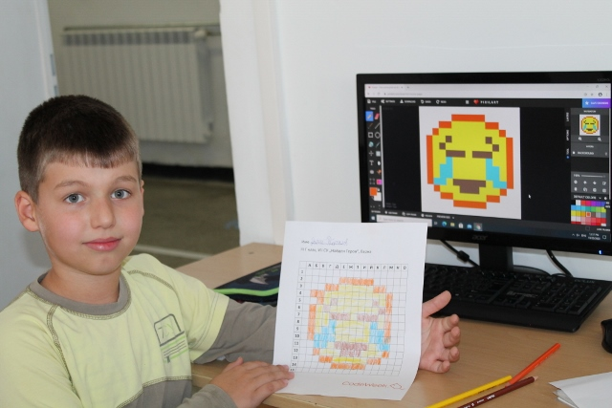
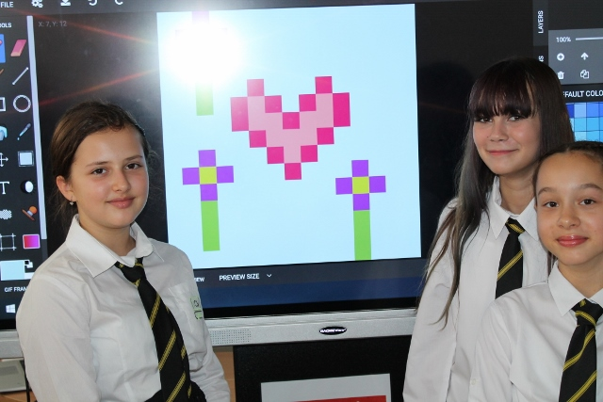
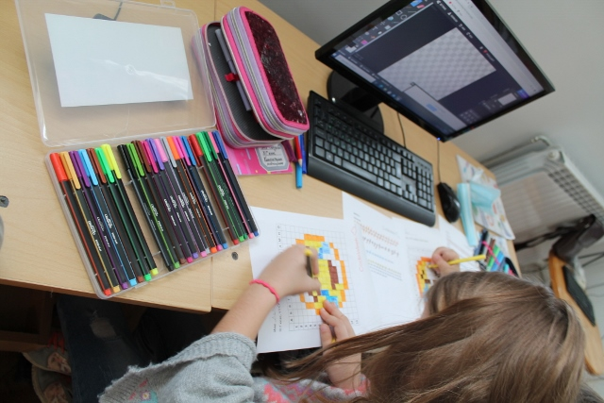
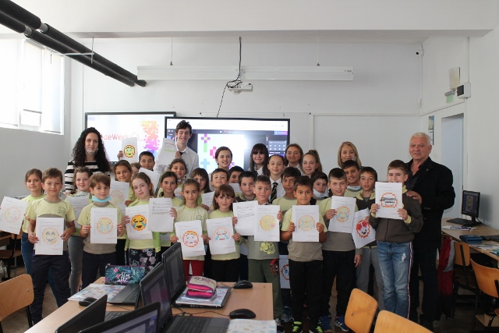
6th grade students introduce CODING WITH COLOURS to 3rd grade students.

Slide 10
We continue... ☺
“If your actions inspire others to dream more, learn more, do more and become more, you are a leader“
Quincy Adams

